Slide 1
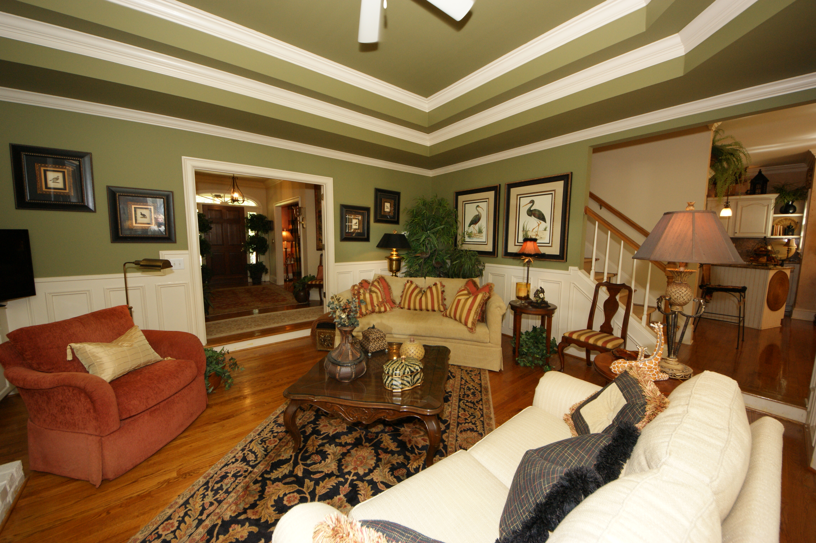
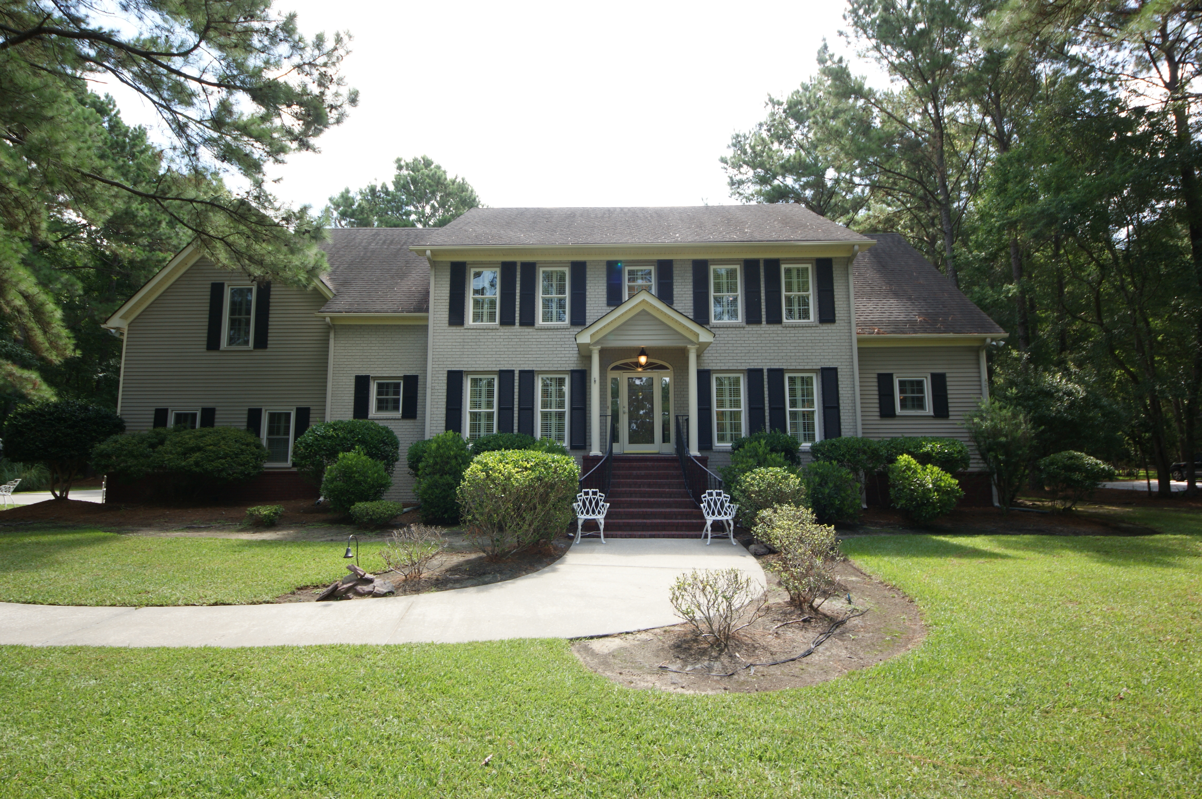
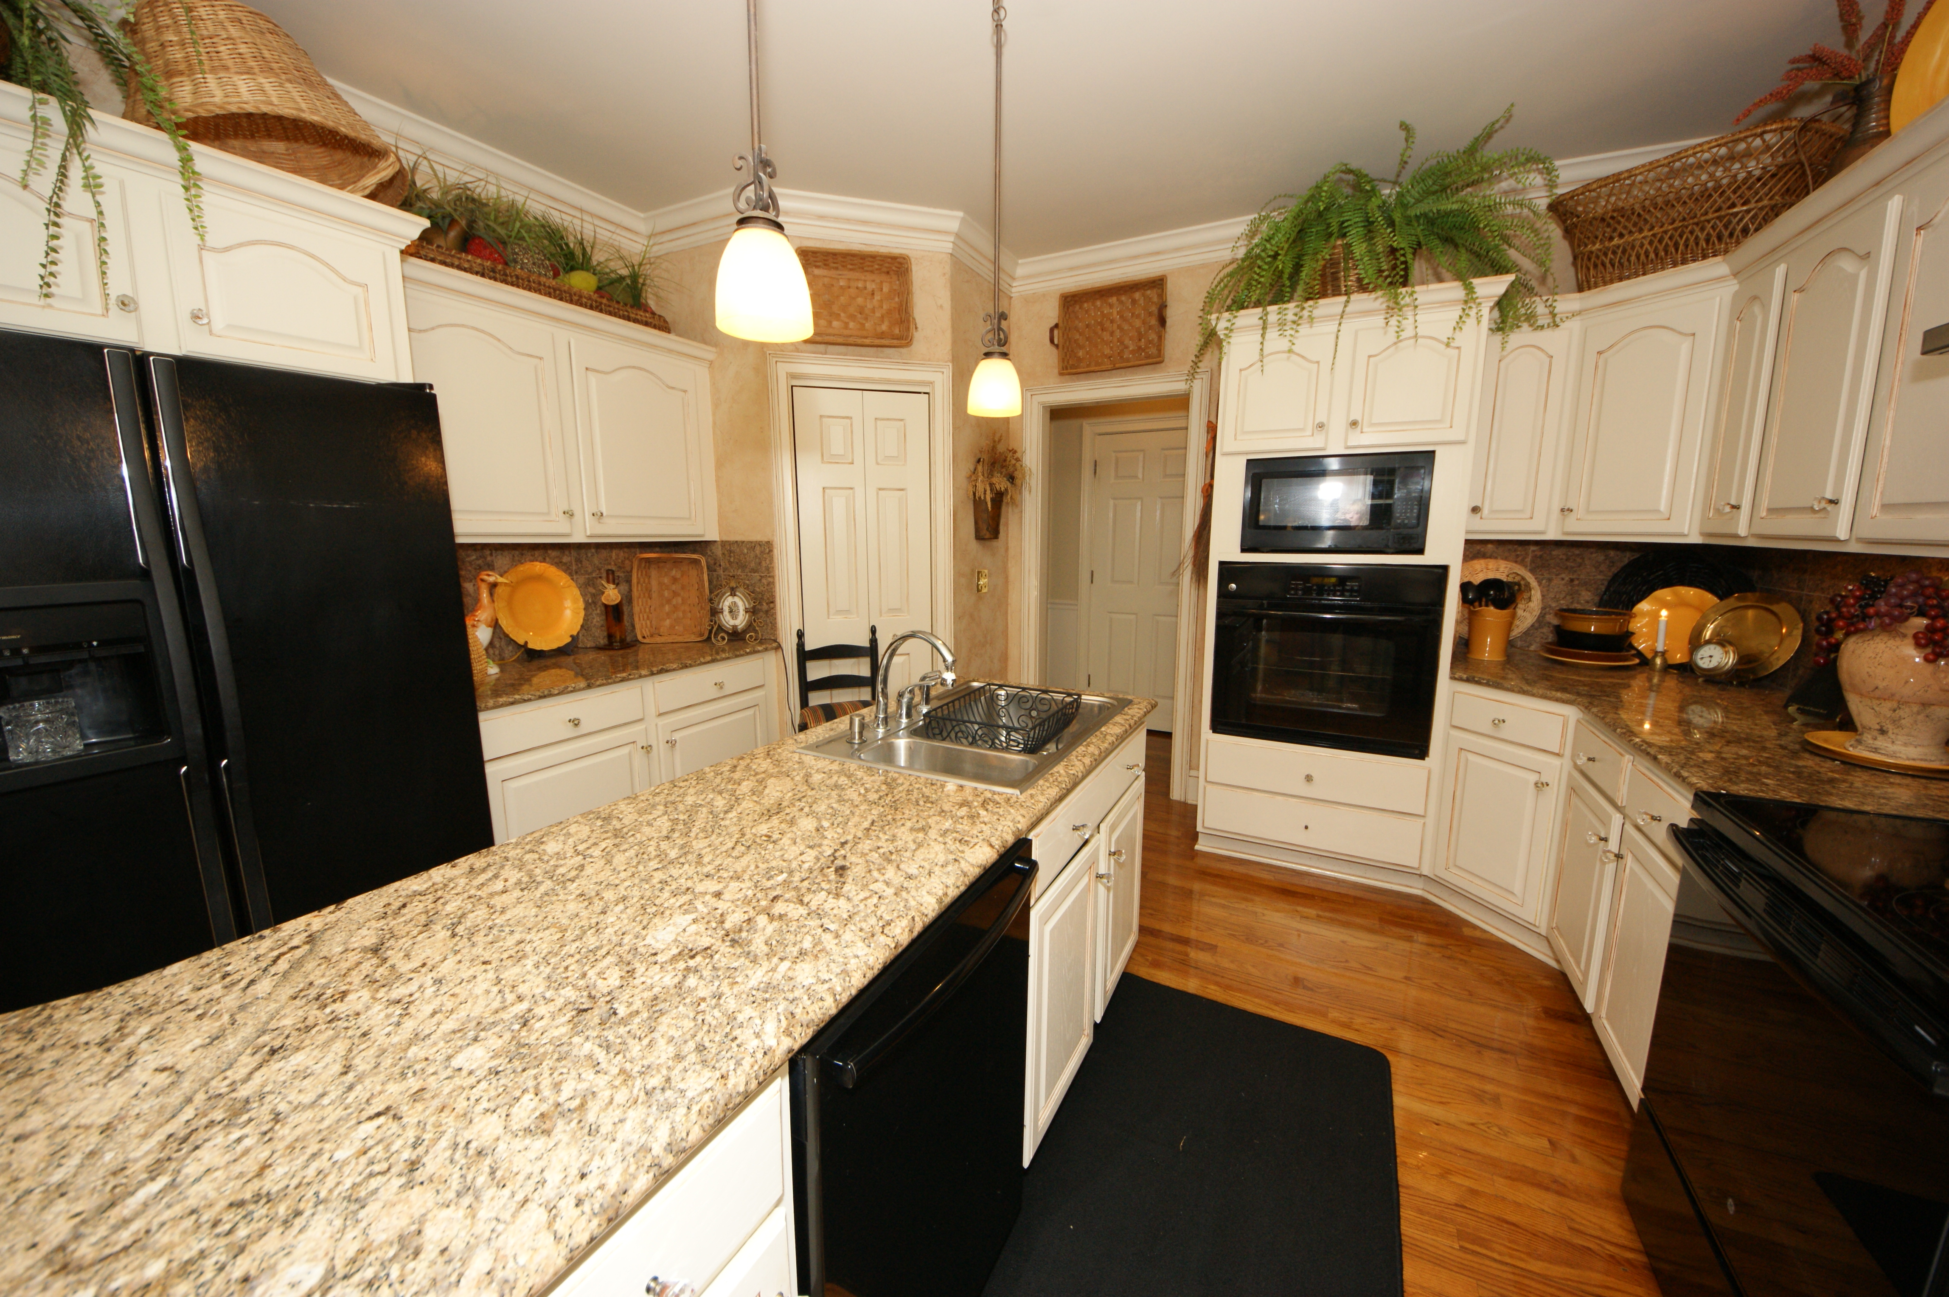
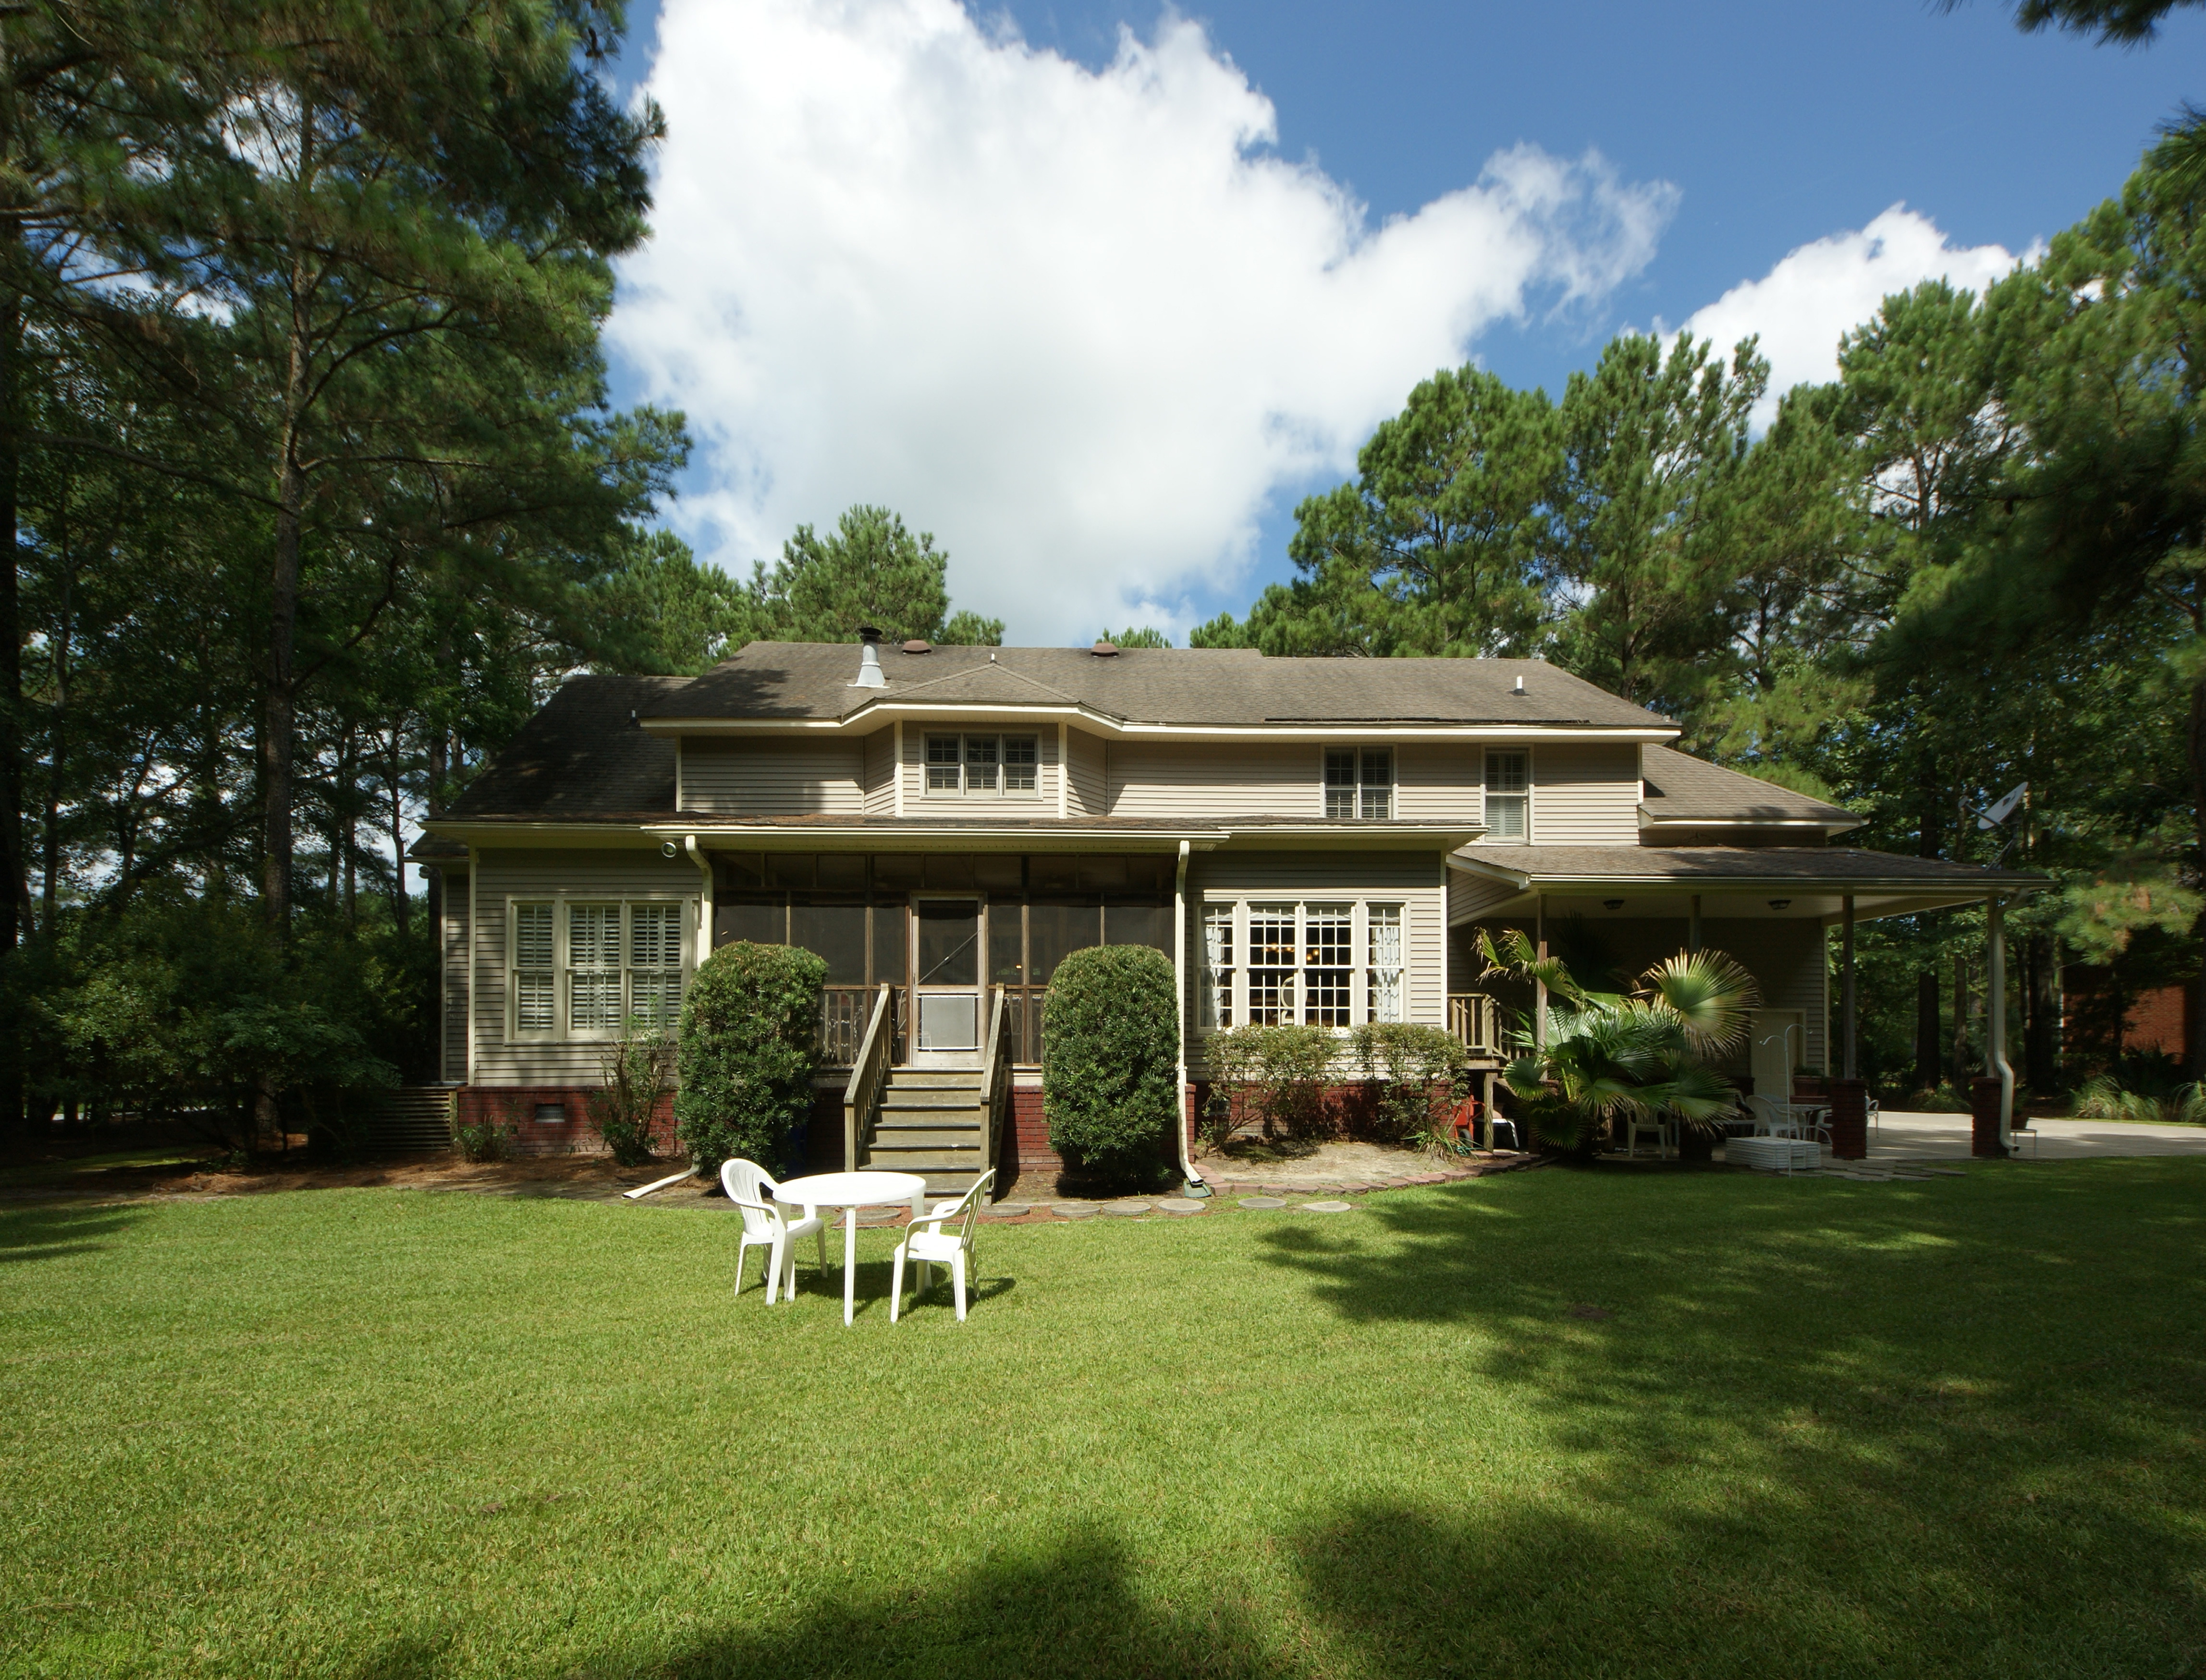

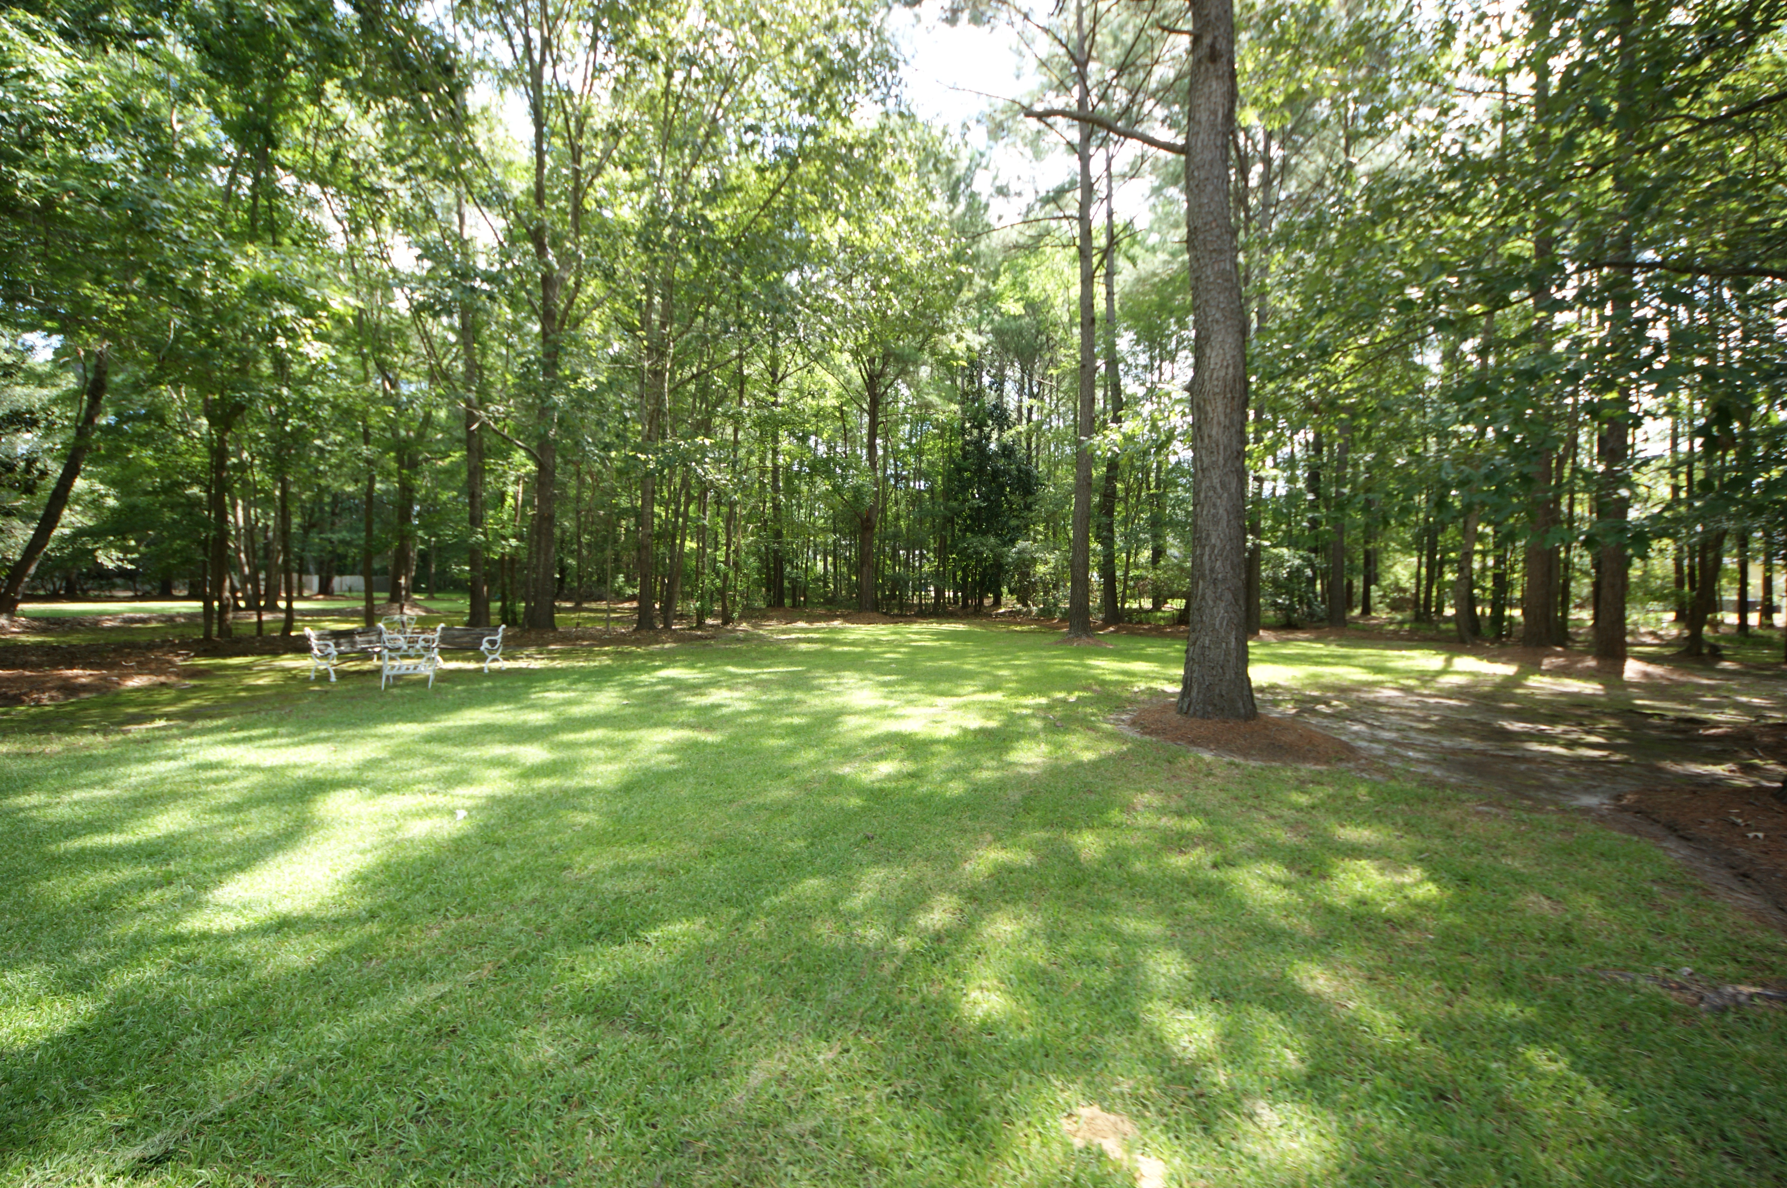

Beautiful custom home on over an acre of land
3477 Colonel Vanderhorst Circle
Dunes West ~ Mount Pleasant ~ MLS# 15020425 ~ $680,000
The backyard is wooded and very private. This executive home has it all. Formal living and separate dining room. Elegant foyer with 9' ceilings throughout. Hardwood floors and an large master bedroom on the first floor. Large walk in closet. The master suite has a large bathroom with separate vanities, Jacuzzi tub and shower. The master suite opens to a screened back porch which is the perfect place for the morning coffee. The eat-in kitchen is a chef's dream with a large island, granite counters, backslash overlooks the back porch and yard. Upstairs 4 bedrooms and a frog all with large walk-in closets and 3 baths. Plenty of room for a man cave/playroom, office, and guest bedrooms. The elegant home is a must see. This is a gated community with golf course, tennis courts, swimming pools, walking trails. The community is close to schools, shopping, and has a beautiful clubhouse with lots of activities for the entire family. Please call for a gate pass and see all that Dunes West has to offer. Chandelier in dining room does not convey.
Peggy Reese
E-PRO, GRI
phreese@bellsouth.net
Mobile (843) 693-2050
Real Estate ● Mortgage ● Insurance ● Business Brokerage

