Slide 1
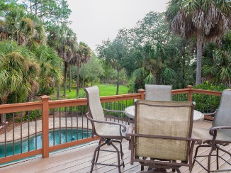
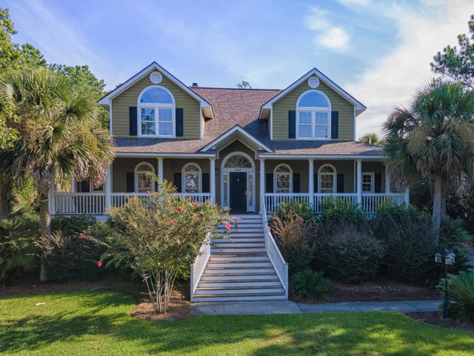
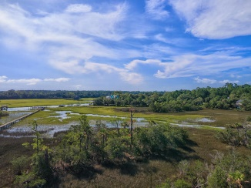
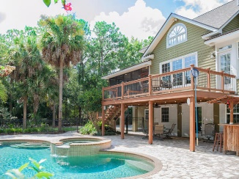
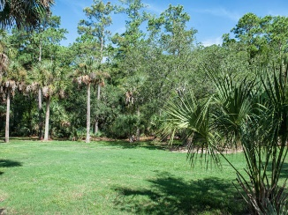
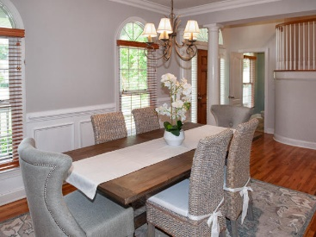
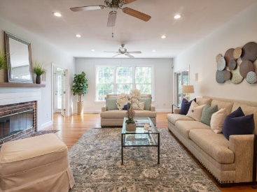
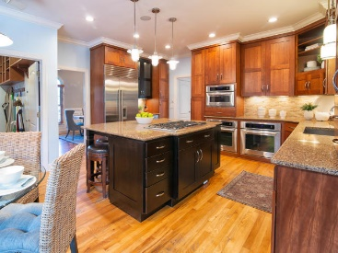
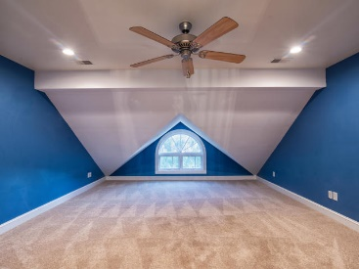
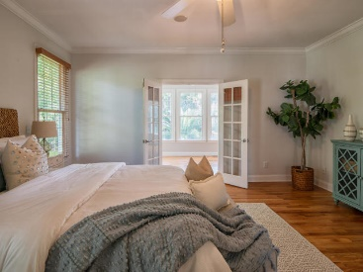
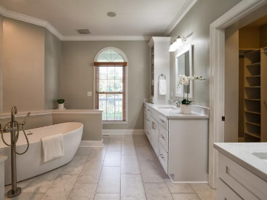
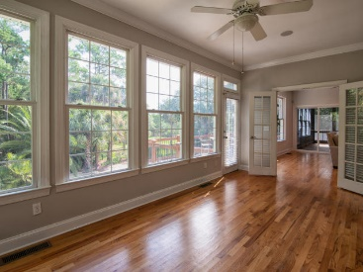
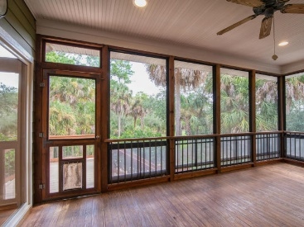



Why wait for new construction?
This Park Circle area home is LESS THAN 2 YEARS!
Open House Sat & Sun 12pm-3pm
347 Plantation View Lane
Longpoint ~ Mount Pleasant, SC 29464 ~ MLS# 20023076 ~ $890,000
Coastal charm meets casual elegance in this stunning custom, elevated home. Nestled into a private, lush cul-de-sac shaded with six Live Oaks, more than 26 Palmetto trees, and mature tropical foliage, this home welcomes you onto its Plantation style front porch and begs you to "set a spell" on your choice of inviting porch swings. Entering the home, you'll appreciate the two-story foyer, 9' ceilings and oak hardwood floors throughout the main level, and other features that hint at the custom details found throughout the home.
Caitlin Waddington
843-789-9820
caitlin.waddington@carolinaone.com
2713 Highway 17 North, Mt. Pleasant, SC 29466

