Slide 1
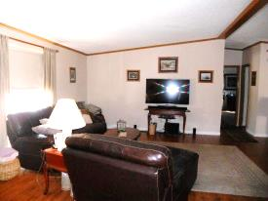
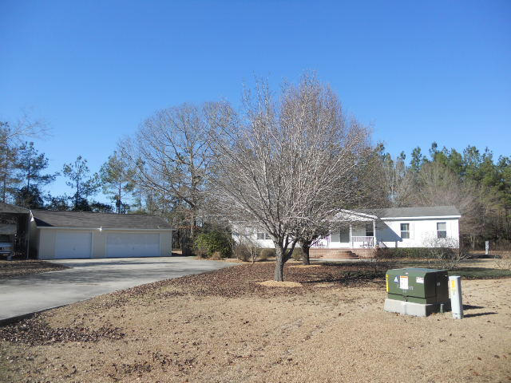
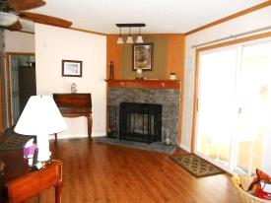
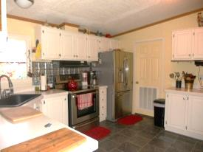
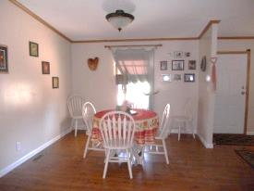
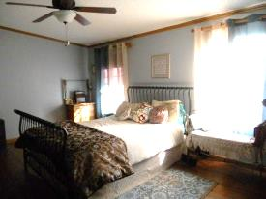
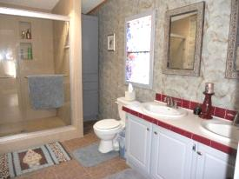

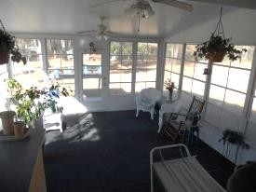


Near the Lake…Just a short drive to Town
2+ Acres!
347 Red Briar Lane
Loyal Acres
Cross, SC 29436
MLS# 15000828 | $169,000
3 Bed | 2 Bath
Country Living and 3 Car Detached Garage! Gorgeous doublewide nestled at the end of the cul-de-sac on 2.11 acres. The exterior presence and curb appeal is amazing when you approach the home. Brick foundation, circular brick stairs, porch, extended driveway, 3 car detached garage, car port and shed! This home has been upgraded with laminate wood floors, ceramic tile, stainless appliances, fire place and sun room. Home owners installed a Culligan water softening and filtration system that is only two years old. The homeowners have made their home and land a picture perfect paradise in the country. A must see for country living at its finest! Call listing agent if you need assistance with financing.
Connie White, Broker
C: 843-532-3356
conniesyouragent@gmail.com
Charleston Homes
111 Spring Hall Dr
Goose Creek, SC 29445

