Slide 1
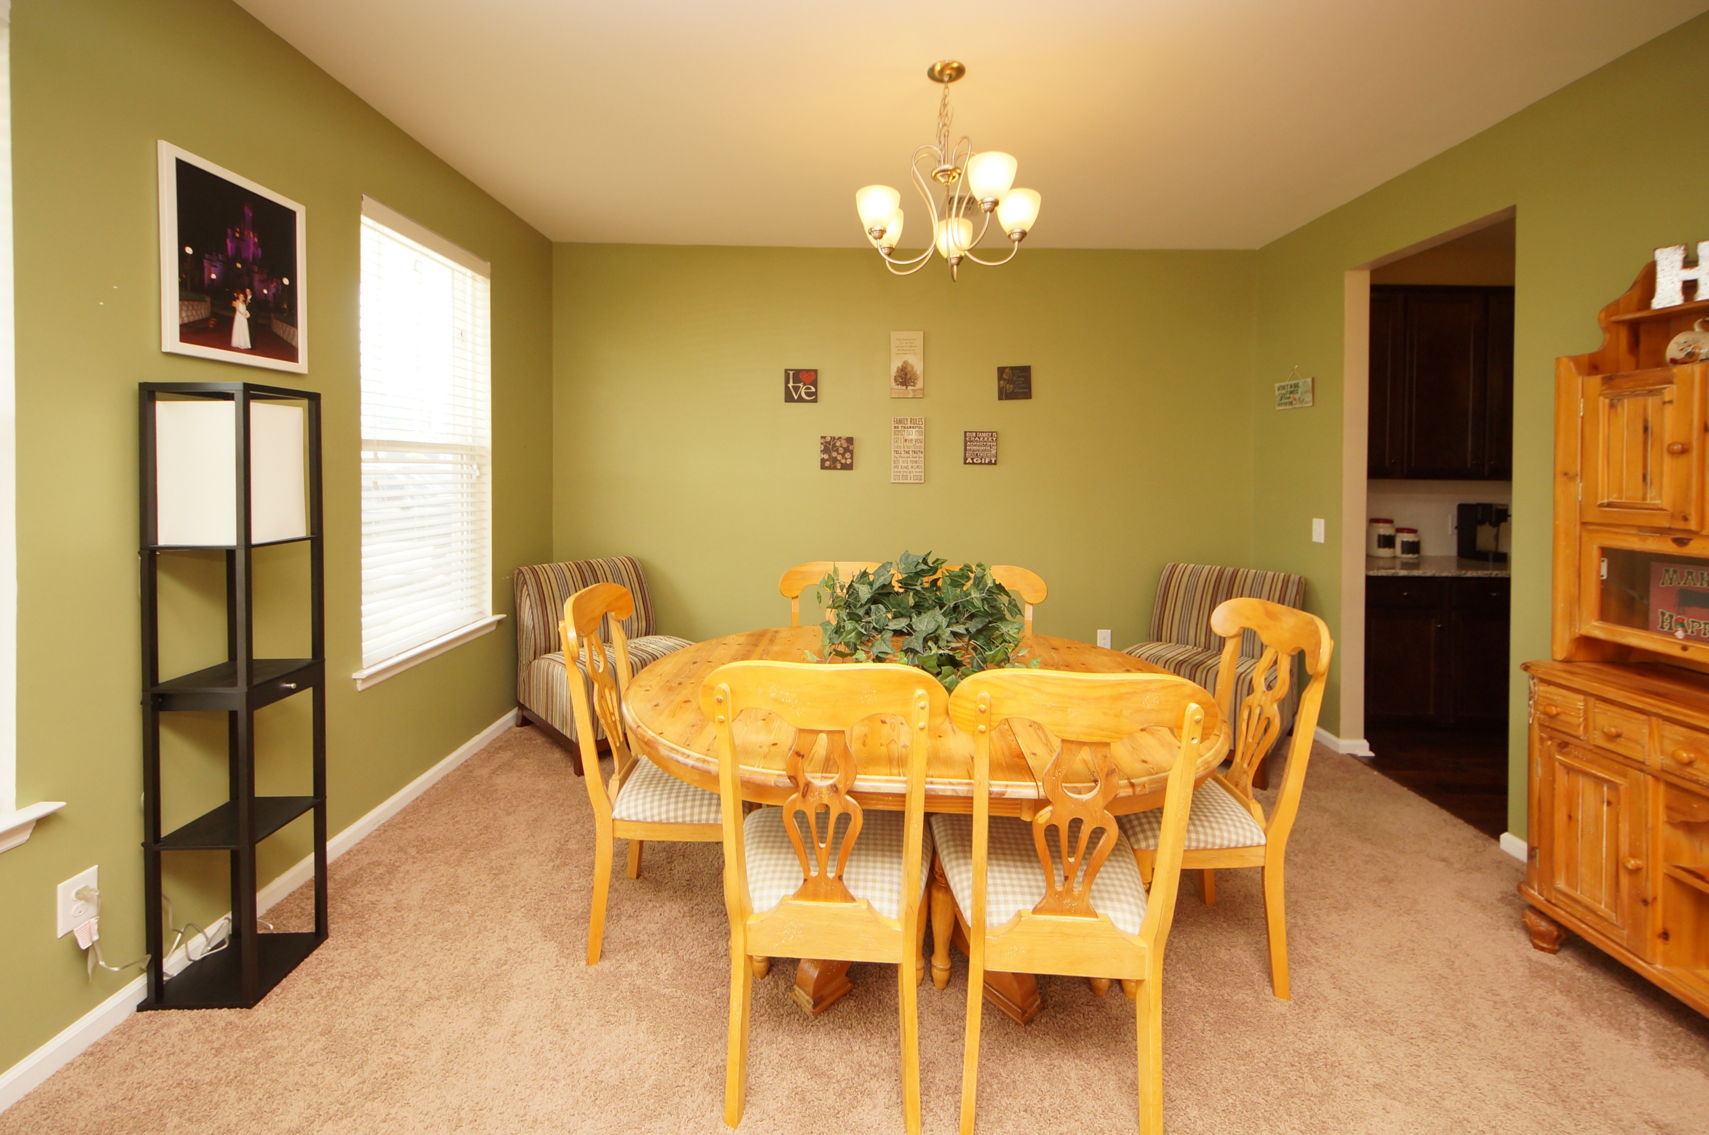
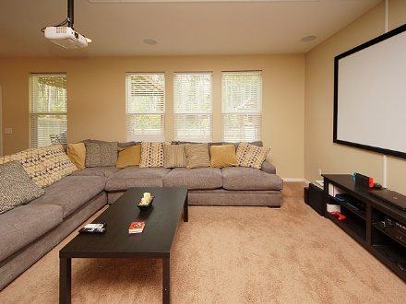
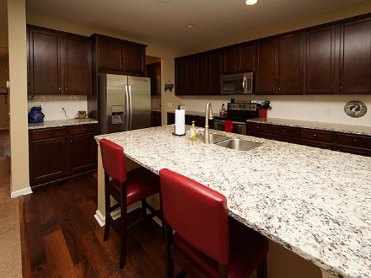
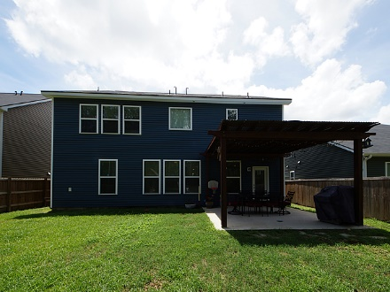


348 Beachgrass Lane
Cane Bay Plantation :: Summerville, SC 29486
MLS# 18013335 :: $319,000
5 Bed / 3 Bath
Just Reduced
$785,000!
Open House Saturday from 11a-3p
Why wait on new construction when you can own this 5 bedroom home with upgrades by the Builder and Seller!
Spacious kitchen with over sized granite island and open living room perfect for family evenings and entertaining. There is a guest suite on the first floor with a full bathroom. Spacious loft and 4 bedrooms upstairs with 2 full baths. Seller installed builder upgrades and Seller upgrades to include *Privacy fence,*Play/Swingset,*Front door Ring Alarm system,*Integrated home security with motion camera and live streaming, *1080p projector with 100 inch screen for movie night or football games! Enjoy all of the amenities of Cane Bay to include a neighborhood pool.
This home can be your new home in 30 days!!!
Connie White, Broker
843-532-3356
conniesyouragent@gmail.com
Charleston Homes · 597 Old Mt. Holly Road · Suite 301 · Goose Creek, SC 29445

