Slide 1
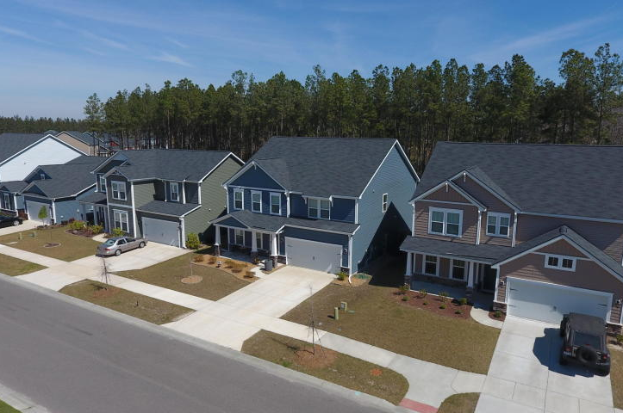
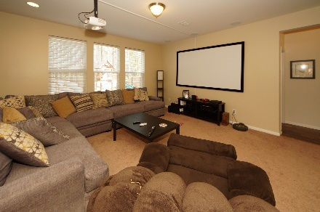
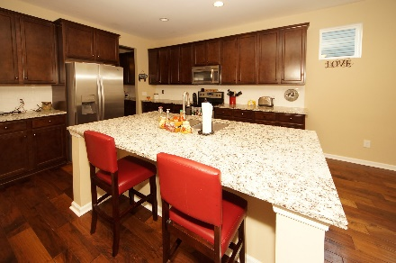
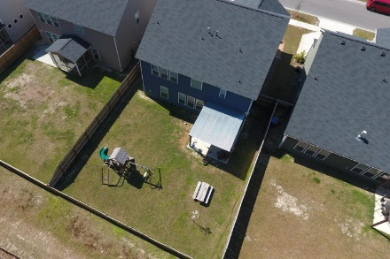


348 Beachgrass Lane Cane Bay Plantation :: Summerville, SC 29486 MLS# 17031895 :: $326,500 5 Bed / 3 Bath
Just Reduced $785,000!
Why Wait For New Construction?
Built in 2015 this spectacular 5 bedroom home is move in ready. Guest suite on the first floor and 3 full bathrooms.
Kitchen has an expansive granite island overlooking the great room and the first floor features a mud room from the garage entry.
This home is open, spacious and the owners have installed surround sound, a gorgeous privacy fence and pergola on the patio for relaxing evenings and entertaining.
Connie White, Broker
843-532-3356
conniesyouragent@gmail.com
Charleston Homes · 597 Old Mt. Holly Road · Suite 301 · Goose Creek, SC 29445

