Slide 1
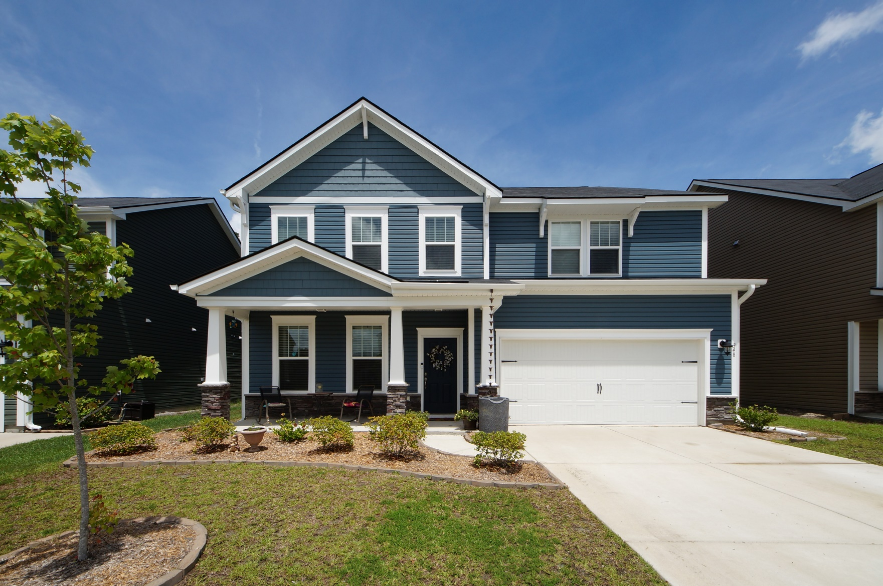
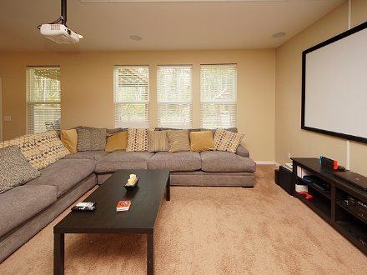
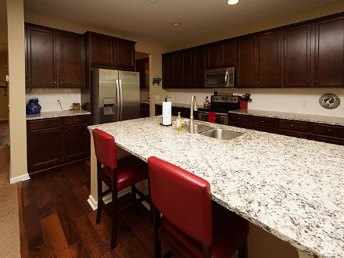
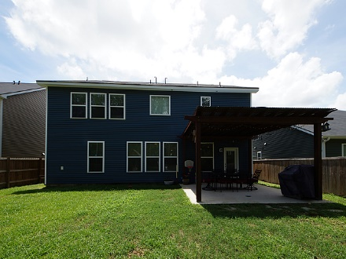


348 Beachgrass Lane Cane Bay Plantation :: Summerville, SC 29486 MLS# 18013335 :: $312,000 5 Bed / 3 Bath
Just Reduced $785,000!
Price Reduced!
$312,000
Why wait on new construction when you can own this 5 bedroom home with upgrades by the Builder and Seller! Spacious kitchen with over sized granite island and open living room perfect for family evenings and entertaining. There is a guest suite on the first floor with a full bathroom. Spacious loft and 4 bedrooms upstairs with 2 full baths. Seller installed builder upgrades and Seller upgrades to include *Privacy fence,*Play/Swingset,*Front door Ring Alarm system,*Integrated home security with motion camera and live streaming, *1080p projector with 100 inch screen for movie night or football games! Enjoy all of the amenities of Cane Bay to include a neighborhood pool. This home can be your new home in 30 days!!!
Connie White, Broker
843-532-3356
conniesyouragent@gmail.com
Charleston Homes · 597 Old Mt. Holly Road · Suite 301 · Goose Creek, SC 29445

