Slide 1
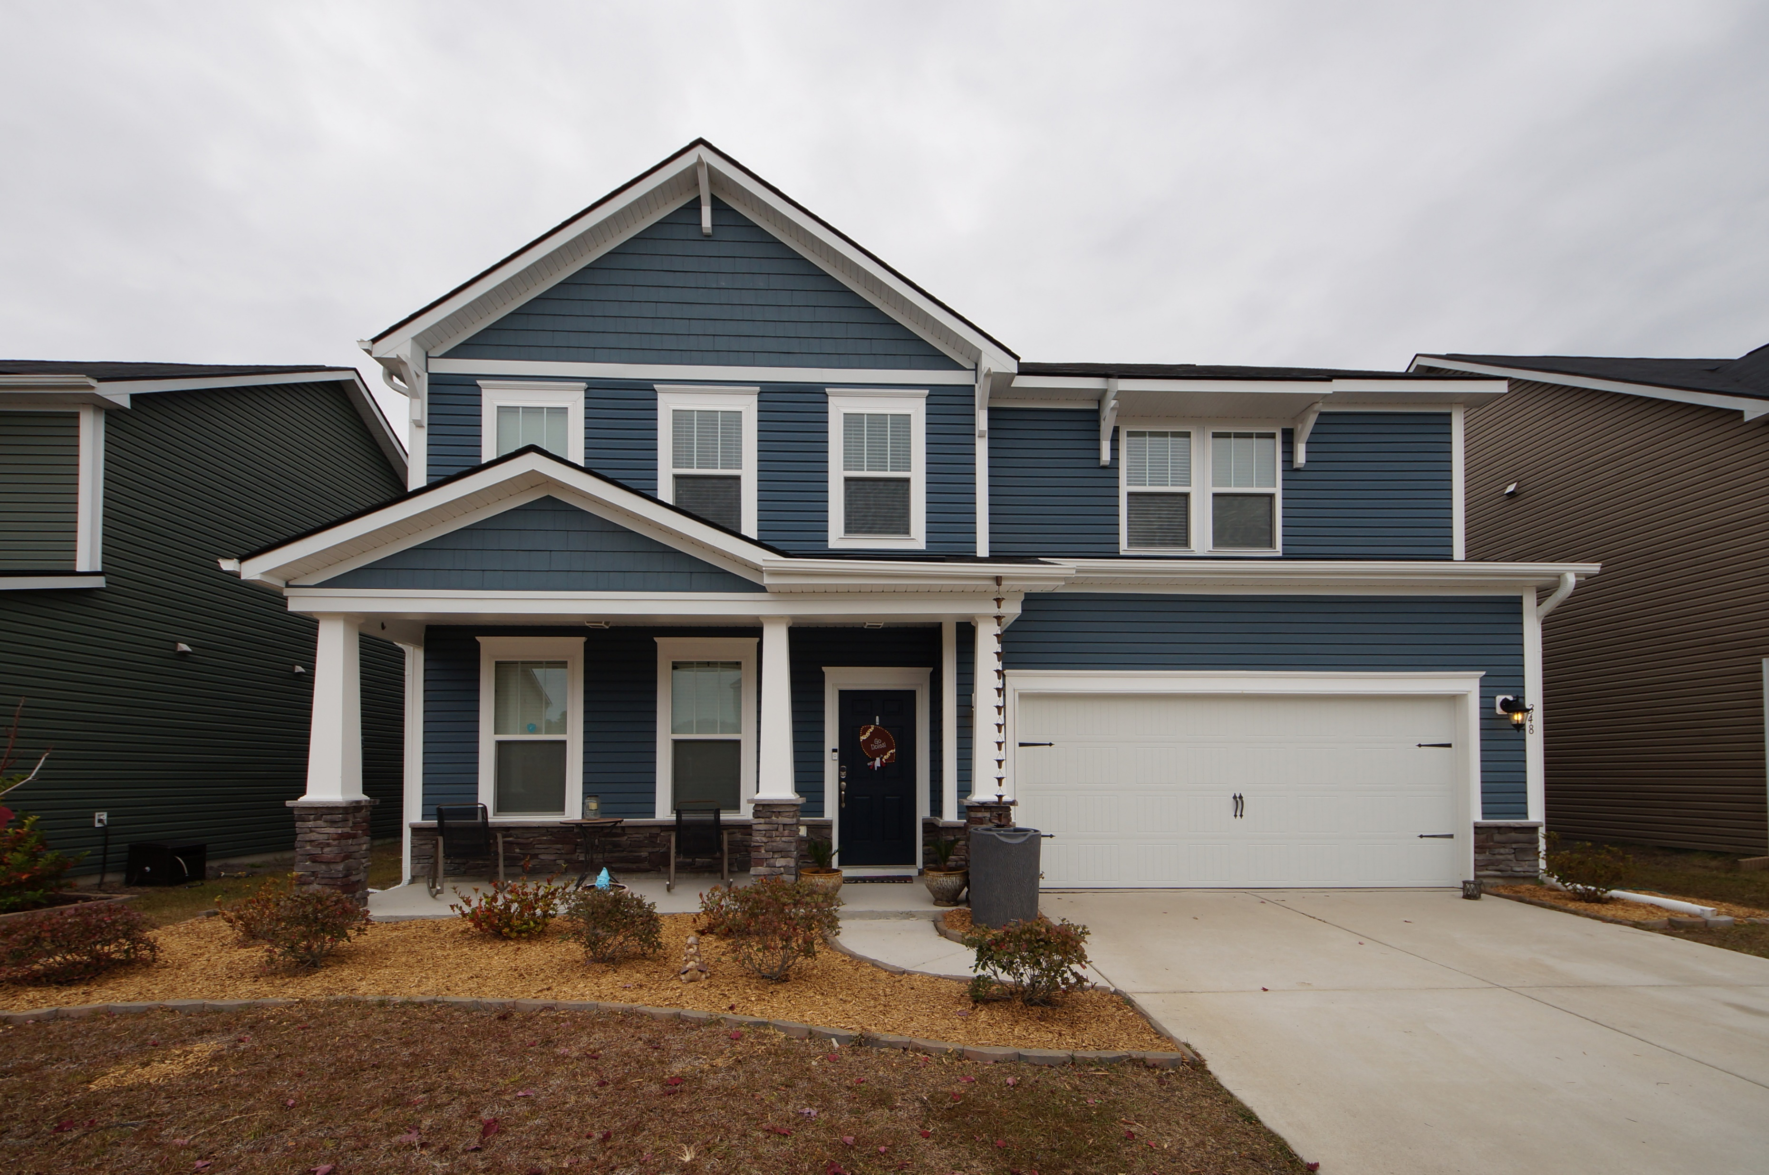
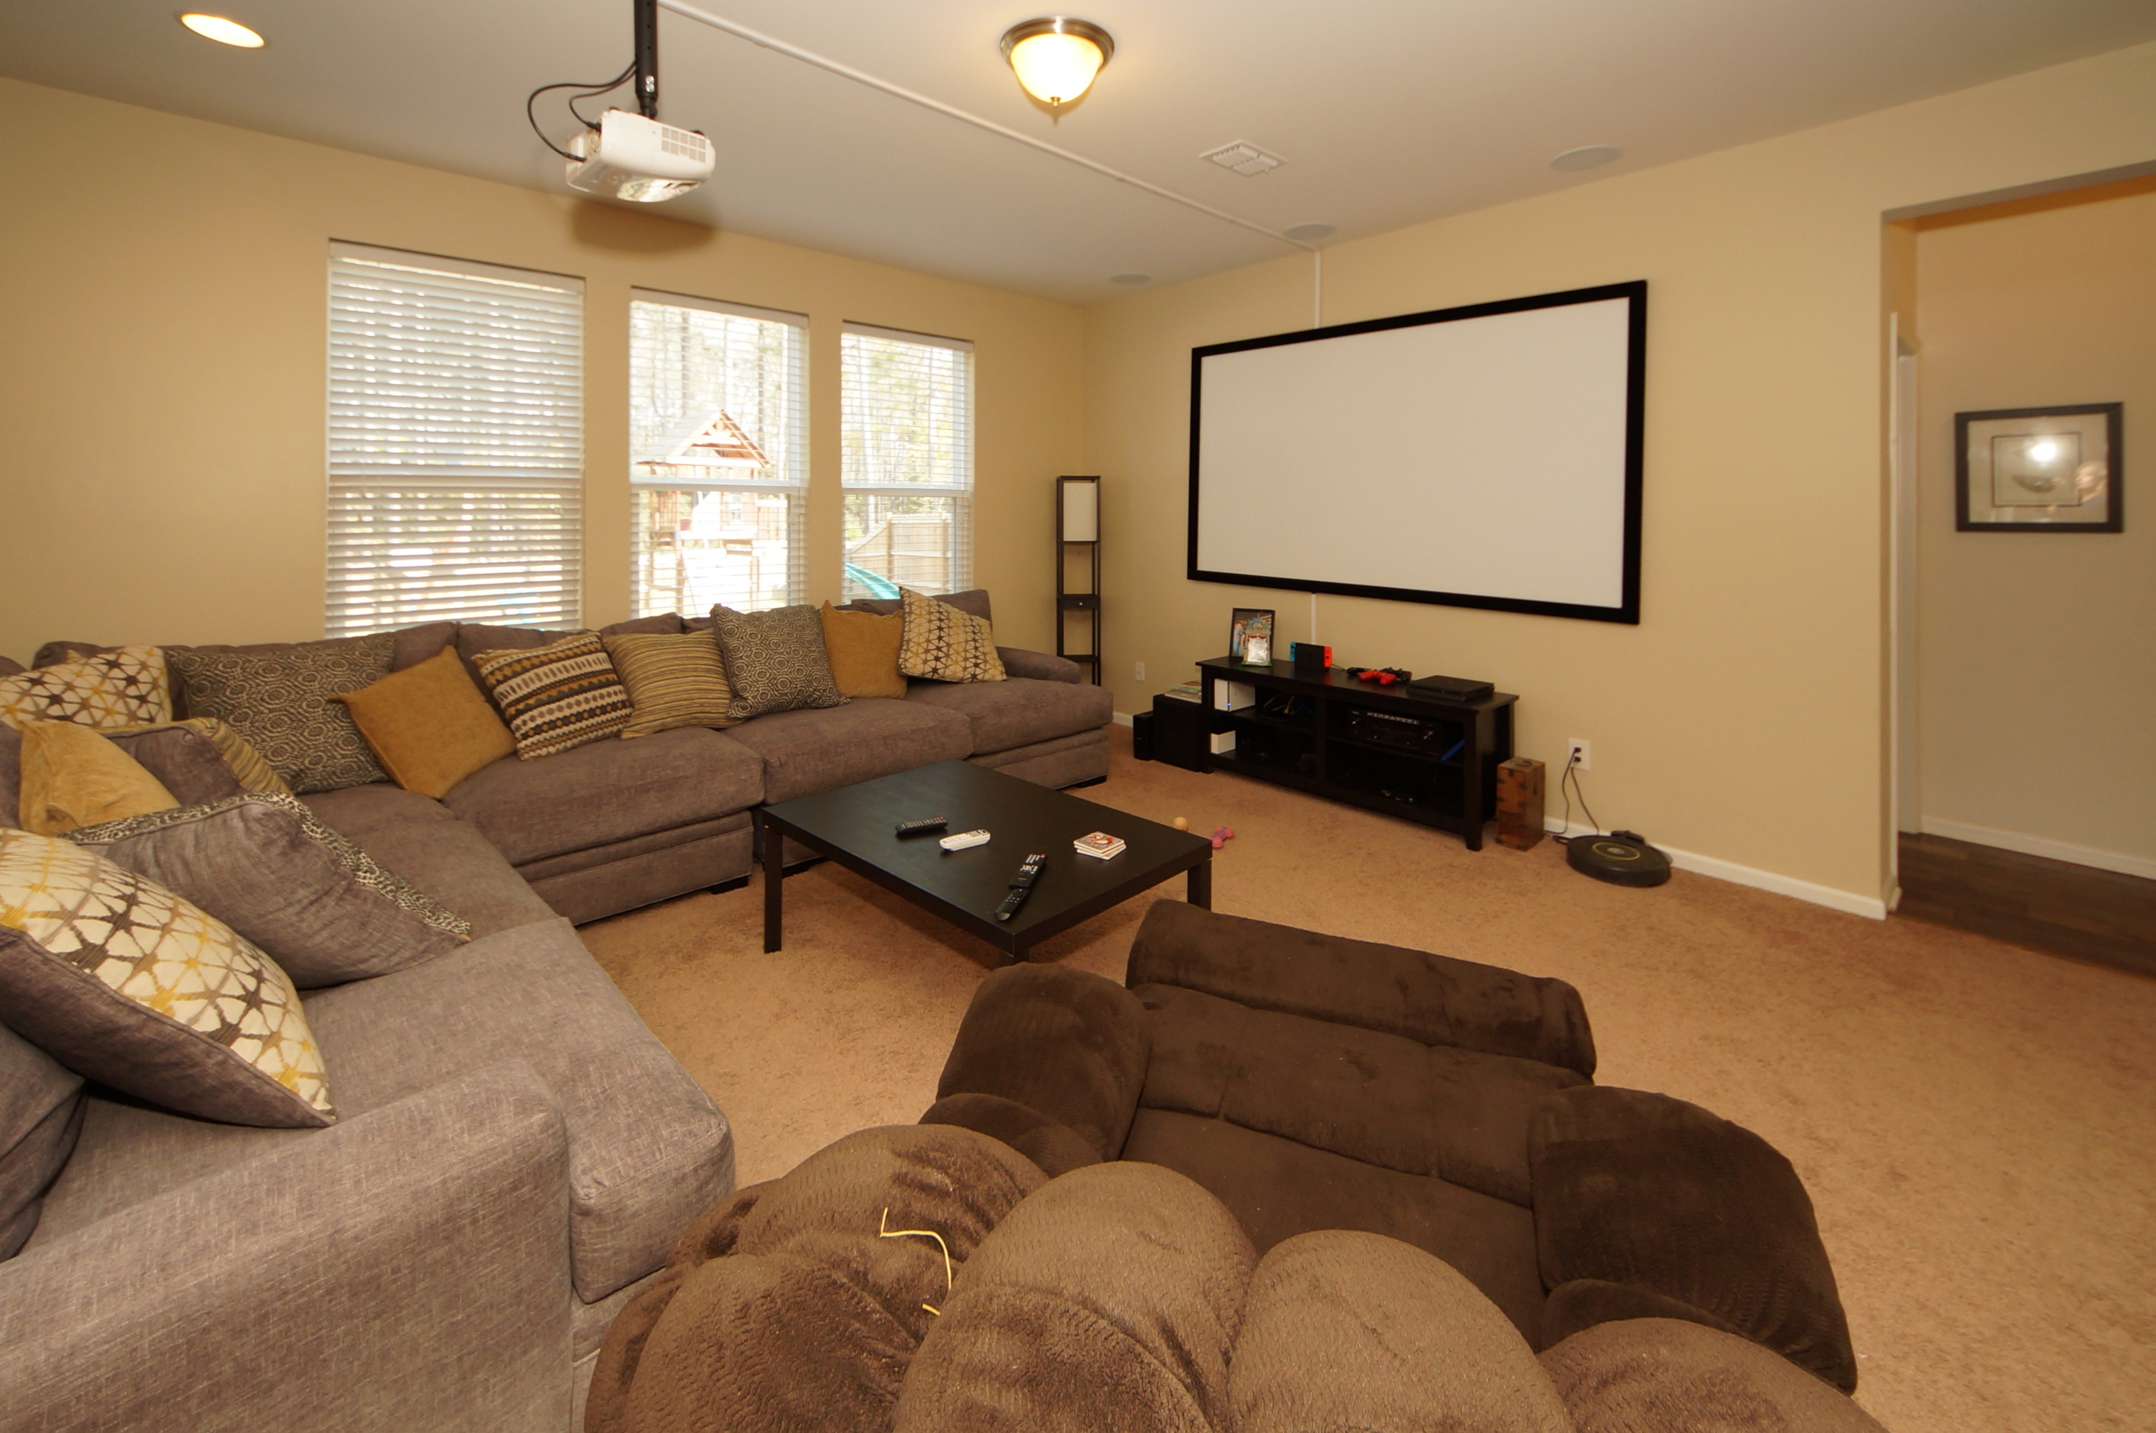
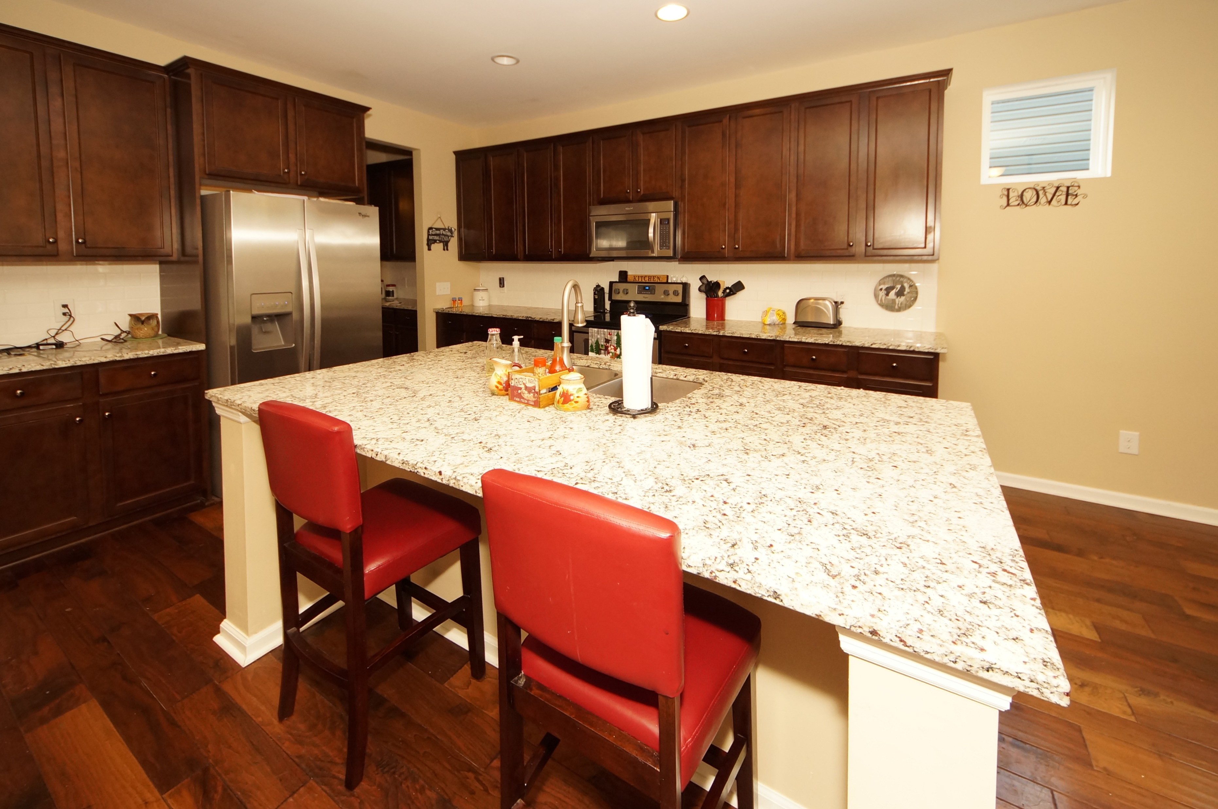
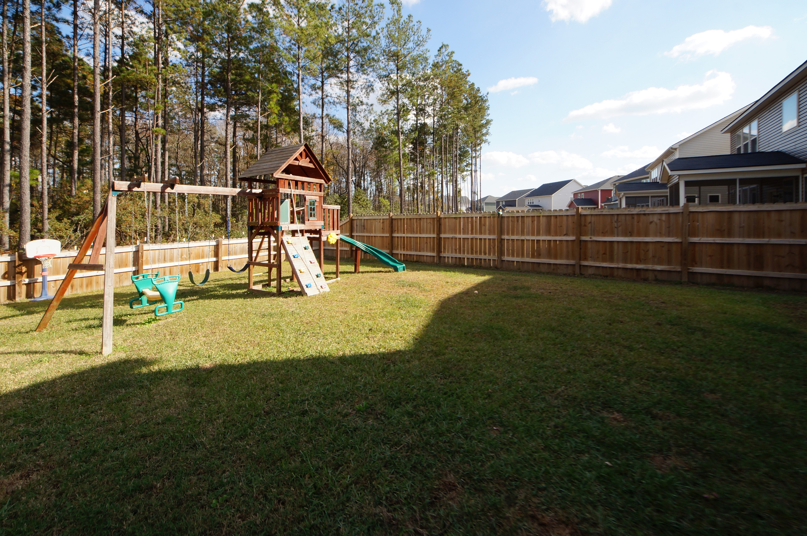


348 Beachgrass Lane
Cane Bay Plantation :: Summerville, SC 29486
MLS# 17031895 :: $350,000
5 Bed / 3 Bath
Just Reduced
$785,000!
Loaded with Upgrades…
Ideal for Entertaining!
Built in 2015 The Harding Plan features 5 bedrooms, of which one is a guest suite on the first floor and 3 full bathrooms. Kitchen has an expansive granite island overlooking the great room and the first floor features a mud room from the garage entry.
This home is open, spacious and the owners have installed surround sound, a gorgeous privacy fence and pergola on the patio for relaxing evenings and entertaining. Sellers have installed $32,000 worth of upgrades from the builder and the family room has an ''entertaining/cinema'' surprise when you view the gorgeous home!
Connie White, Broker
843-532-3356
conniesyouragent@gmail.com
Charleston Homes · 597 Old Mt. Holly Road · Suite 301 · Goose Creek, SC 29445

