Slide 1
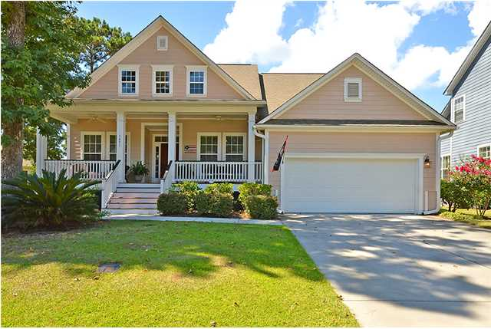
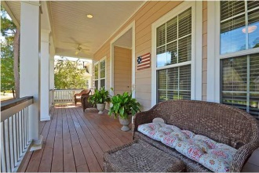
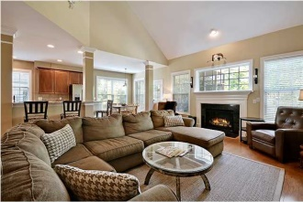
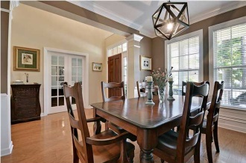
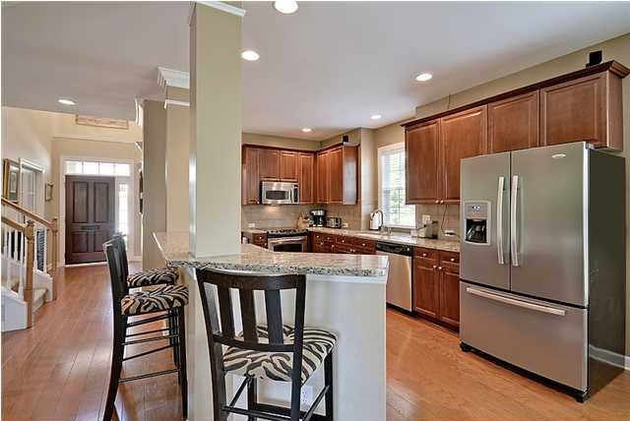
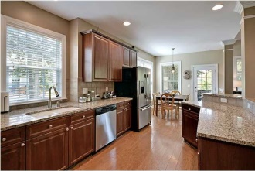
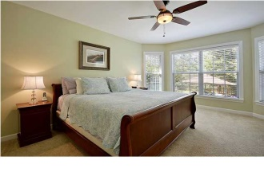
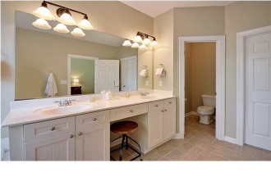
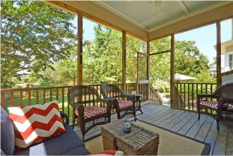
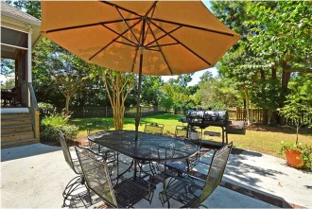
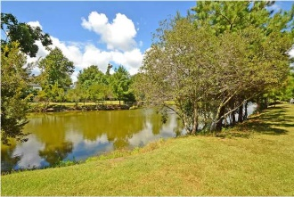

3491 Toomer Kiln Cir Park West Mount Pleasant, SC MLS# 1424054 Just Reduced to $459,999 5 Bedrooms | 3½ Baths | 2,747 sf
Open House Lunch ~ Friday, Oct 3 from 11 - 1
Handyman Special… Bring your hard hats!
Better Than New!
By “Better Than New”, we mean that, while the features of this home are like new, this beautiful home has none of the drawbacks of a new home such as noisy construction and immature landscaping. In contrast, this 2,700 square-foot, 5 bedroom, 3.5 bath home is cradled by a lushly landscaped lot. The home’s centerpiece is a virtual oasis in the back yard with a screened-in porch that overlooks a mesmerizing pond whose shimmering view, gentle breezes, graceful wildlife and glorious sunsets transport you on a Magical Mystery Tour in your mind to a place filled with peace and tranquility. . While residing in the midst of this “other worldly” existence, you are still in close proximity to award-winning schools, world-class, sun-kissed beaches, five-star dining/shopping, historic downtown Charleston, Boeing and the airport to enable you to experience luxury and serenity at home but ultra-convenience to all that greater Charleston has to offer. Whoever said "you can't have it all" obviously never visited this amazing home. As you enter the home, you are greeted by a chinaberry, solid mahogany front door that welcomes you to the gleaming hardwood floors. Inside, the super-open floor plan is "magnificence personified" with sumptuous features that include finely-detailed custom finishes on light fixtures, ceiling fans, moldings, fireplace, mantel, and airy tall ceilings whisk you from the great room effortlessly to the formal dining room and then over to the chef's eat-in kitchen with its sparking Stainless-Steel appliances complemented by glistening granite countertops and over-sized, 42-inch cherry cabinets. The luxurious master bedroom has a large window for natural light, and a spa-like bath with double vanities, a garden tub and separate shower. There are four additional bedrooms on the second floor that share 2 lovely baths. The spacious garage offers an abundance of storage and easy access to the laundry room. This home is located in what you might call "a city within a city" in that the Park West Subdivision in which your new home is situated is a beautifully landscaped community that includes playgrounds, running/biking paths, neighborhood pool, community sports park, schools, grocery stores, banks, specialty shops and restaurants â€“ all within the Park West confines. Live a life that epitomizes the "BEST OF THE BEST" by seizing this opportunity to own the #1 BEST VALUE in Mount Pleasant before it slips away! Lender paid closings costs of 0.50% of the loan amount, redeemable only at the time of closing when financing is completed by the seller's preferred lender. Closing costs credit must be mentioned at application and may only be applied to offset actual costs. *for a Jumbo loan amount (over $417,000) the credit is 0.375%
Jill Marcacci
843-297-5590 jill@agentowned.com
www.agentownedrealty.com
AgentOwned Realty Co. Preferred Group, Inc. | 824 Johnnie Dodds Blvd | Mt Pleasant, SC 29464

