Slide 1
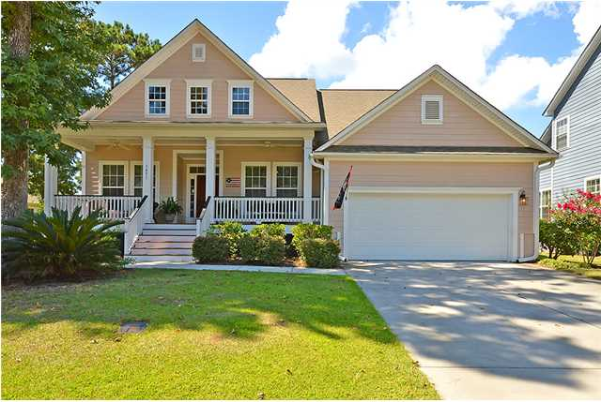
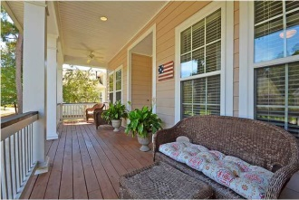
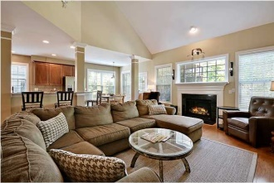
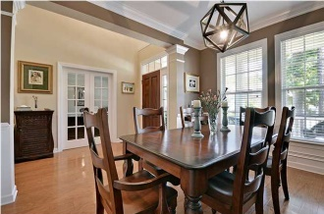
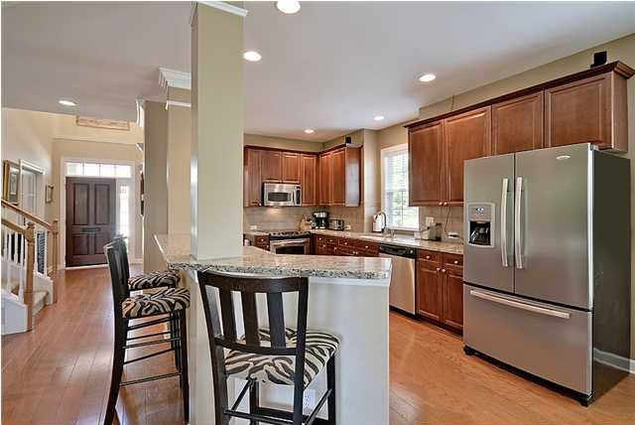
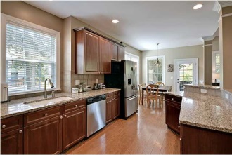
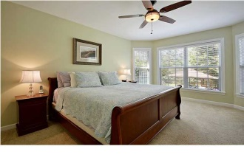
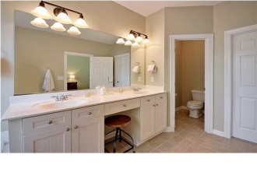
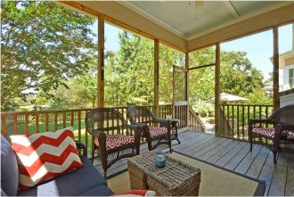
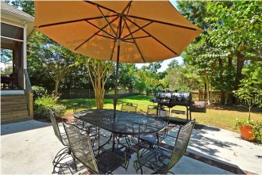
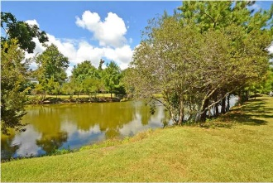

3491 Toomer Kiln Cir
Park West
Mount Pleasant, SC
MLS# 1424054
$469,000
5 Bedrooms | 3½ Baths | 2,747 sf
Open House Lunch ~ Friday, Oct 3 from 11 - 1
Handyman Special… Bring your hard hats!
Best Home in Coatbridge ~ Just Reduced
This beautiful home supersedes all expectations! Walking up to the over-sized front porch you are welcomed with a stunning solid mahogany front door and from there are greeted with numerous high-end, detail oriented, custom finishes of light fixtures, ceiling fans, moldings and airy tall ceilings that spread from the open formal dining room to the great room with a cozy inviting fireplace. The hardwood floors are rich and elegant and accentuate the overall appeal of the home. The open floor plan boasts of spaciousness; including over 2700 sqft., 5 bedrooms, 3.5 gorgeous baths, a great room, gourmet kitchen, office, open dining room and screened–in porch overlooking a serene pond. The gourmet eat-in kitchen has everything for family dining to informal and formal get-togethers! Stainless steel appliances, granite counter tops, and stunning 42” custom cabinets. The breakfast bar easily seats three for doing homework or grabbing a quick meal. The great room overlooks the welcoming screened-in porch, which is perfect for relaxing and enjoying a cup of coffee or a good book. The home has a master bedroom on the main floor, and an attached bath with huge walk-in closet. The luxurious master bedroom has a large window for natural light, and a spa-like bath with double vanities, a garden tub and separate shower. There are four additional bedrooms on the second floor that share 2 lovely baths. The spacious garage offers an abundance of storage and easy access to the laundry room. The home sits on a lovely pond lot and has a wonderful fenced in back yard with a charming patio. Park West is a beautifully landscaped community that includes playgrounds, running/biking path, neighborhood pool, community sports park, schools, grocery stores, banks, specialty shops and restaurants….its own community inside of Mount Pleasant. The home is only a short drive to downtown Charleston with 5-star restaurants, world class shopping and iconic history as well as a short drive to the beaches. This property also has easy access to Hwy 526 so you can easily get to work, the airport, military bases, or Daniel Island. This Mount Pleasant home is a must see for a growing family or ones with live-in relatives or guests! Lender paid closings costs of 0.50% of the loan amount, redeemable only at the time of closing when financing is completed by the seller’s preferred lender. Closing costs credit must be mentioned at application and may only be applied to offset actual costs. *for a Jumbo loan amount (over $417,000) the credit is 0.375%
Jill Marcacci
843-297-5590
jill@agentowned.com
www.agentownedrealty.com
AgentOwned Realty Co. Preferred Group, Inc. | 824 Johnnie Dodds Blvd | Mt Pleasant, SC 29464

