Slide 1

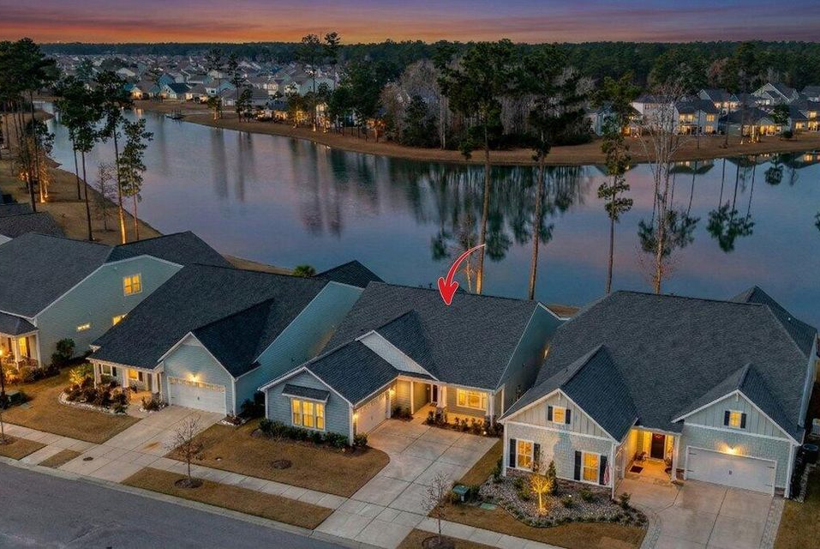

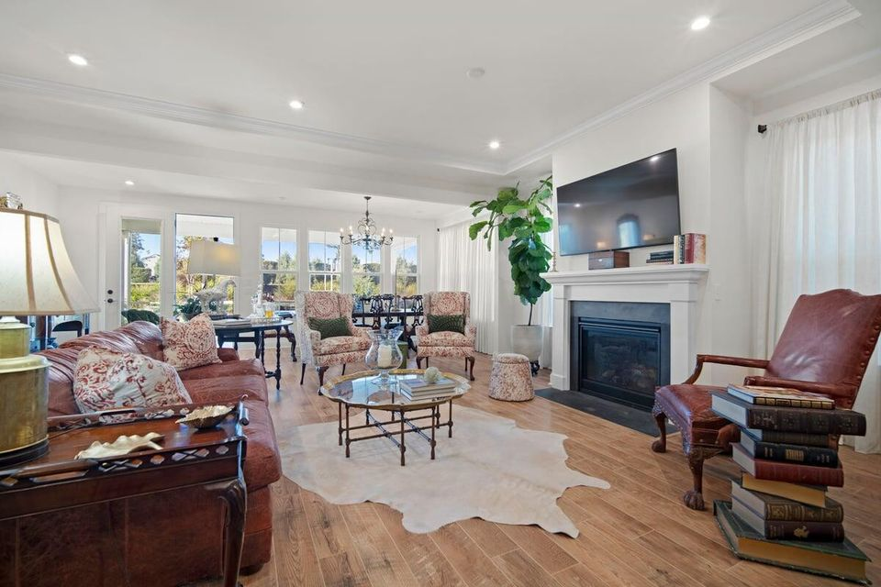





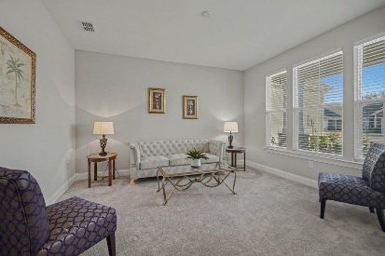
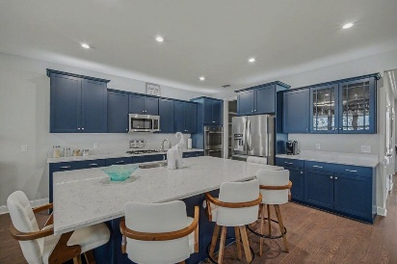
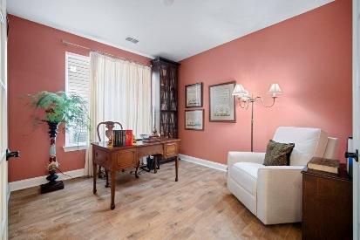
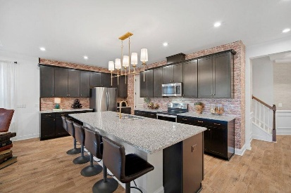

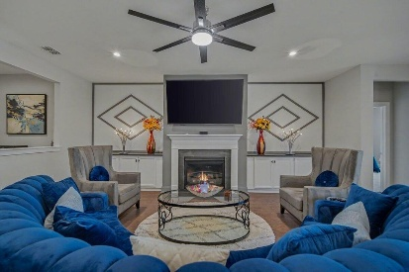
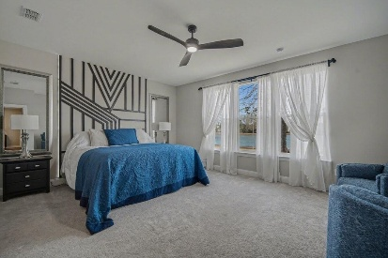
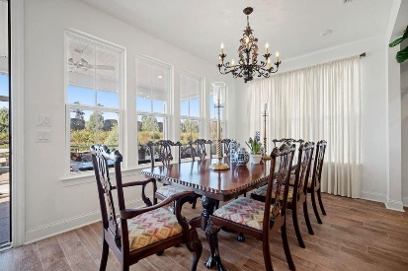
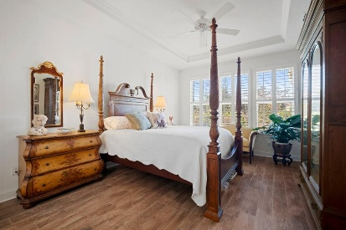
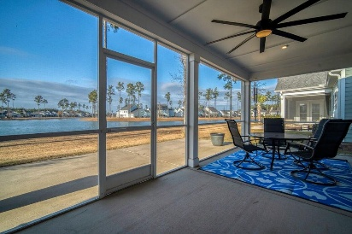

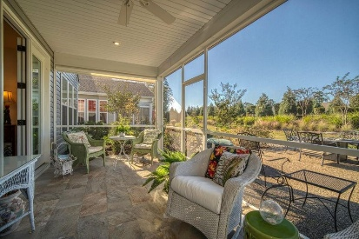
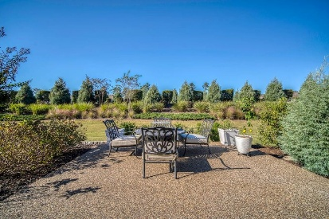
349 Tupelo Lake Drive
MLS# 25033186 | $689,900
Lakefront Lot | 3 Bed | 2½ Bath | 2475 SF
Video Walkthrough
New Years Double Open House in Four Seasons
Sunday January 4th from 2-4PM
JUST LISTED!
376 Seaside Trail
MLS# 25028727 | $559,900
Loft Home | 3 Bed | 3 Bath | 2668 SF
Video Walkthrough
Elissa Campbell
843-853-1433 | elissa.campbell@agentownedrealty.com
AgentOwned Realty Preferred Group | 824 Johnnie Dodds Blvd | Mt Pleasant, SC 29464

