Slide 1
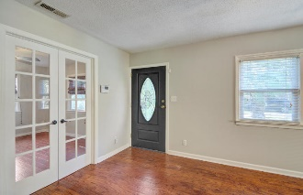
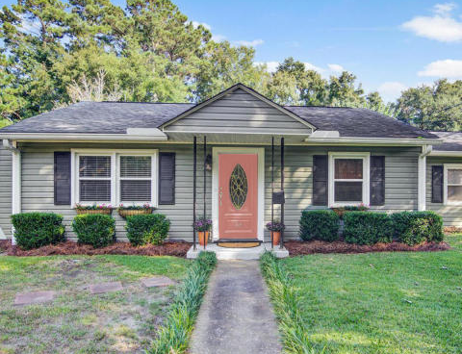
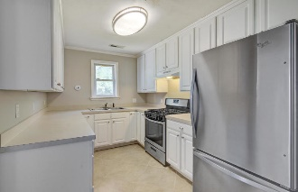
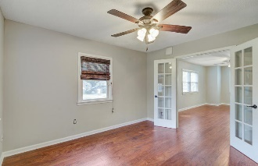
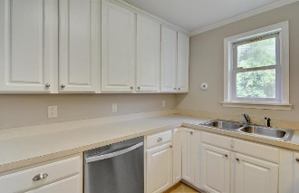
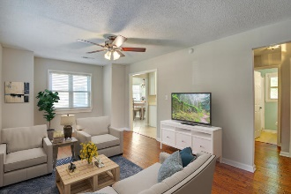
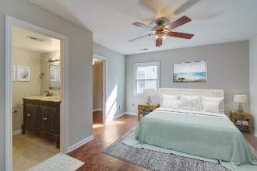
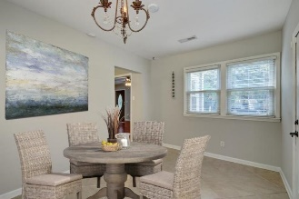
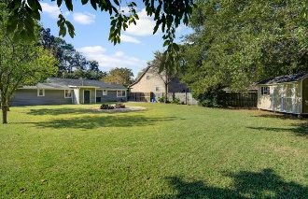


Open House ~ Saturday, February 16th ~ 11-1
34 Anita Drive
Magnolia · Charleston, SC 29407 · MLS# 18026527 · $335,000
Charming West Ashley bungalow just steps from Avondale! Hardwood floors extend through the living area and all bedrooms with ceramic tile in the kitchen, flex room and both bathrooms. The large master suite has dual closets and master bath with custom vanity, dual sinks and a large tiled walk in shower. The kitchen is just off the family room and features a stainless steel gas range, refrigerator and dishwasher! Off of the kitchen is a flex space that could be a dining room, mud room, play room or second living space. The fully fenced backyard features a patio, fire pit and large storage shed, perfect for your lawnmower, tools, bikes, kayaks, paddleboards etc. With easy access to downtown, I-26 and I-526, this location is perfect for wherever you work or play! X FLOOD ZONE!!!
Josie Gould
(843) 324-4545
josieg843@gmail.com
josie.thesandlappergroup.com
AgentOwned Charleston Group
902 Savannah Hwy
Charleston, SC 29407
Real Estate ● Mortgage
Insurance ● Business Brokerage

