Slide 1

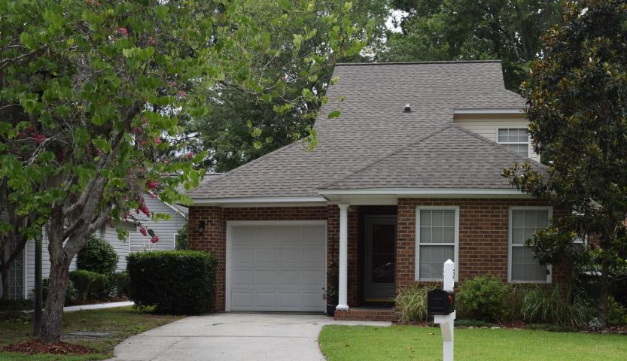
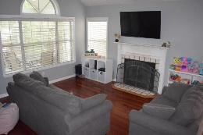
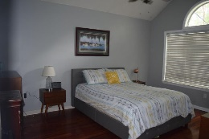
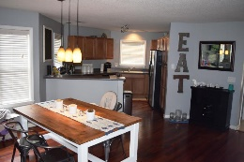
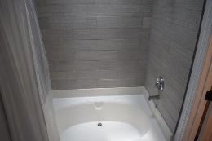
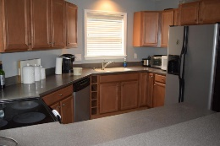
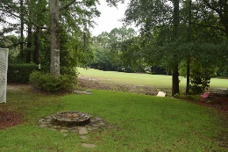
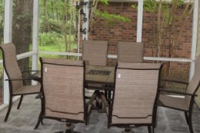
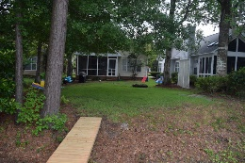


Agent Luncheon And Open House Friday, Sept 16th, 11:30a-1p $50 Gift card drawings
34 Arbor Trace
Arbor Trace • Charleston, SC 29414 • MLS# 16017421 • Reduced to $249,900
Well maintained and updated 3 bedroom home on the golf course in Shadowmoss. Home has 2 Master bedroom suites, 1 master downstairs and one up. Convenient location! Close to I526, shopping, hospital and downtown.
Open floor plan with modern touches. Living area has vaulted ceiling and wood burning fireplace. Stainless steel appliances, Brazilian Tigerwood flooring and recently painted. Large screen porch and backyard overlooking 11th hole on golf course. Perfect for entertaining!
Christina Garvin
(843) 270-7667 | cgarvin63@gmail.com
Elaine Brabham and Associates, LLC • 1890 Sam Rittenberg Boulevard, Suite 217 • Charleston, SC 29407

