Slide 1
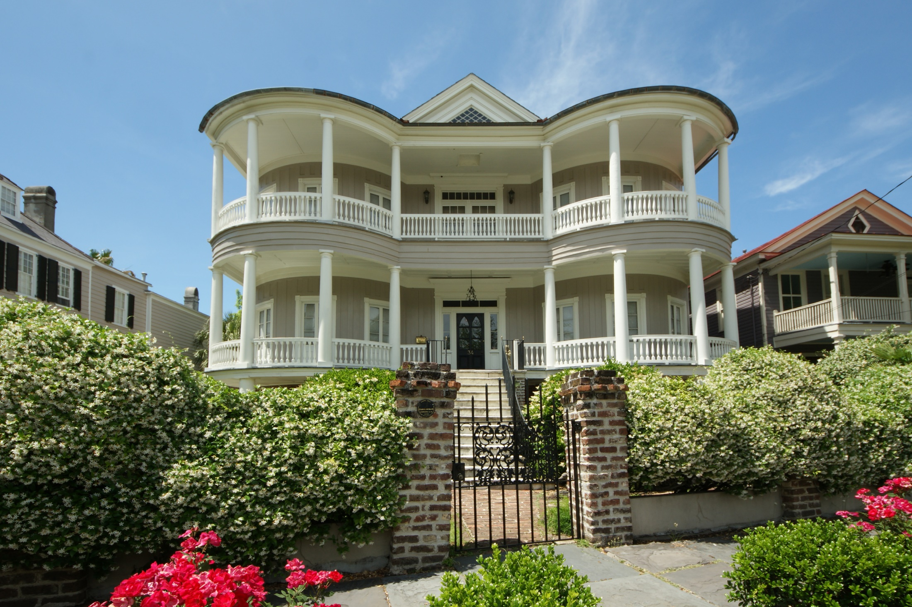


Just Listed
34 Chapel St
Charleston, SC 29401
MLS# 15013249
Come experience the best of the best. Fall in love with the most elegant entrance hall and sinuous double staircase in Charleston. You will get a sense of its incredible beauty, architectural detail and grace. A showpiece that celebrates Robert Mill's genius as an architect. Featured in American Home Magazine.
Over 1900 square feet of exterior porches, 6,500 square feet in the main house with fireplaces in all 6 bedrooms , two drawing rooms, elegant dining room, and a private study. Two separate garden apartments with separate entrances. Featuring a private walled gated garden and fountain designed by Sheila Wertimer.
Offered at $3,800,000
Angela Black Drake
C: (843) 991-0337
Limehouse Properties • 8 Cumberland Street • Charleston, SC 29401

