Slide 1
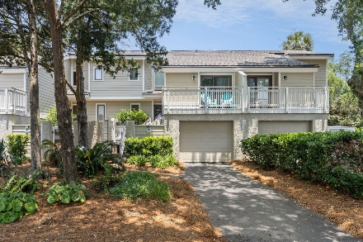
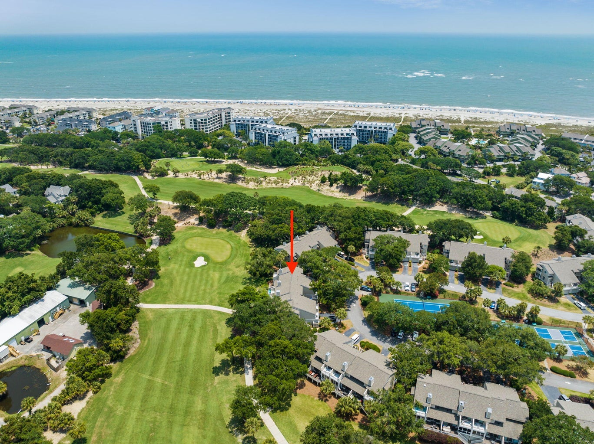
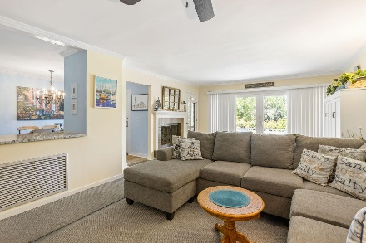
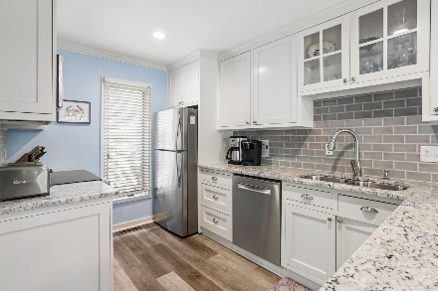
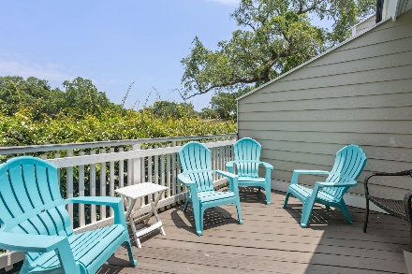
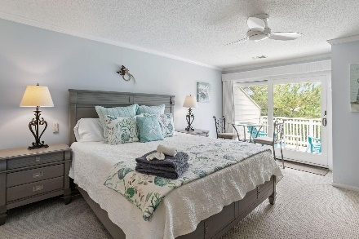
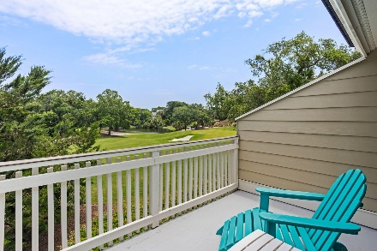
34 Fairway Dunes Lane
Wild Dunes | Isle of Palms, SC 29451
MLS# 23016540 | $1,140,000
Fairway Dunes ~ Furnished 3 Bed/2 Bath ~ Great Price!
Beautiful, fully furnished, 3 bedroom, 3 bath townhome on the golf course in Wild Dunes. This unit has been regularly updated and meticulously maintained by its owners. This section of Wild Dunes has it own amenities including a pool, tennis, and pickle ball courts. The location is perfect for owners to enjoy the Owner's Beach House'' with an open pavilion, full kitchen, open outdoor seating, a covered picnic area, restrooms, outdoor shower and easy beach access. Owners have the ability to join the Wild Dunes Club for golf, tennis, additional pools, social and more. Approach the townhome through its private courtyard and enter through the front door into the foyer. Straight ahead is the large family room with crown molding, fireplace and a hidden Murphy bed. Sliding glass doors access the back deck and a full-light door accesses the screened porch, both overlooking the 7th fairway of beautiful Links Golf Course. Adjacent to the family room is the beautifully updated kitchen with custom Shaker-style white cabinetry, granite countertop glass tile backsplash, stainless steel appliances, breakfast bar, which flows into a large dining area with sliding glass doors leading to the screened porch. The main level also included the laundry room. Take a few steps up to a full bath and the lower level bedroom. Upstairs there are 2 bedrooms with en suite baths and the primary suite with sliding glass doors that lead to a private deck with golf course views. The primary bathroom features raised vanities, granite countertops, and a spacious shower with tile floor and surround. Don't miss this opportunity to experience resort living at its finest! Fairway Dunes has it own pool, tennis and new pickleball courts and is a short walk to the pristine IOP beach and the Owners Beach Club.
Andrea Rogers
(843) 532-3010 | andrearogers1@gmail.com | www.andrearogersrealtor.com
AgentOwned Preferred Group | 1400-G Palm Blvd | Isle Of Palms, SC 29451

