Slide 1
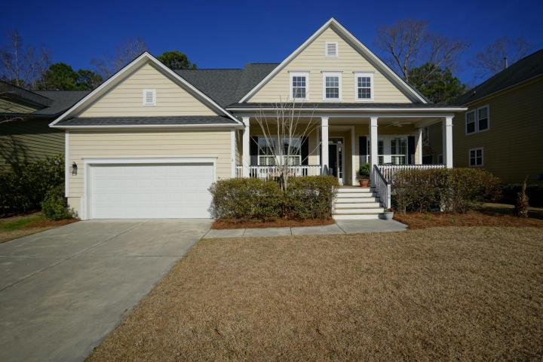
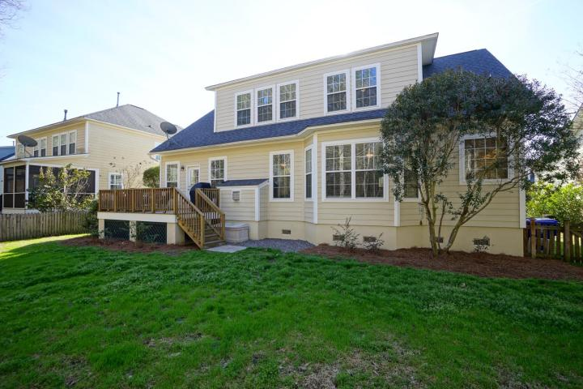
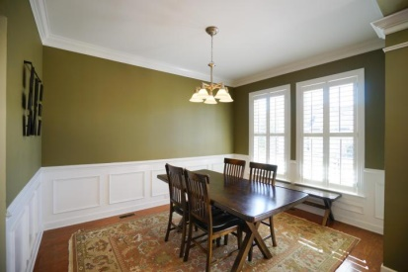
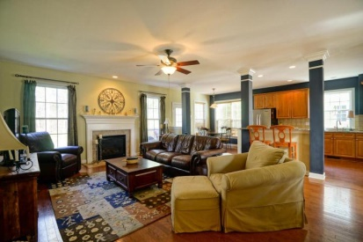
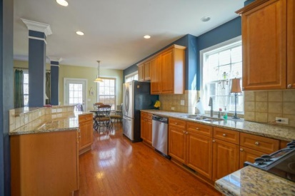
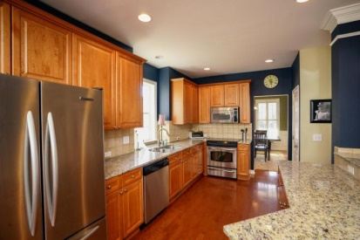
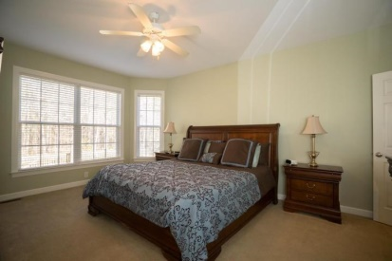
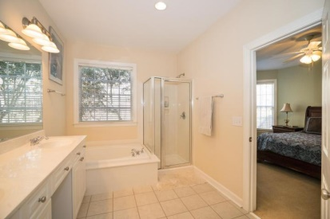
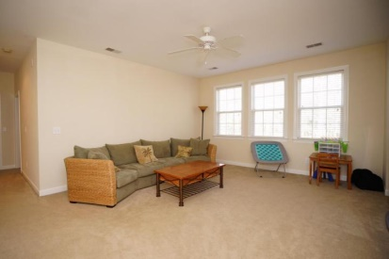
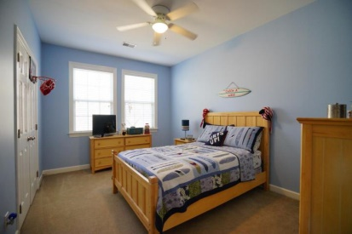


Coatbridge at Park West :: Motivated Sellers
3506 Toomer Kiln Circle
Park West | Mount Pleasant | MLS# 15006003 | $465,000
Great price and motivated sellers!!! Very spacious and well maintained home with lots of privacy backing up to wooded wetlands. This home has it all with 4 bedrooms 3.5 baths, bonus/play room, and office. The eat-in kitchen is completely updated with granite countertops and stainless steel appliances and it opens to the large great room/living room. Hardwood floors throughout the main living area and crown molding in the foyer, dining room, and office. The master is located downstairs with a spacious bathroom and walk in closet. There are 3 bedrooms, 2 full baths and a bonus room on the 2nd floor. Great opportunity to live in Park West with a large fenced in lot and lots of privacy! Enjoy all that Park West has to offer with tennis, swiming pools, parks, schools, and much more!
Kristen Kern-Whitehead
Mobile - 843-670-1671
kwhitehead@kwchs.com
www.charlestonislandagents.com
Keller Williams Realty
Charleston Islands
1304 Palm Blvd
Isle Of Palms, SC 29451

