Slide 1
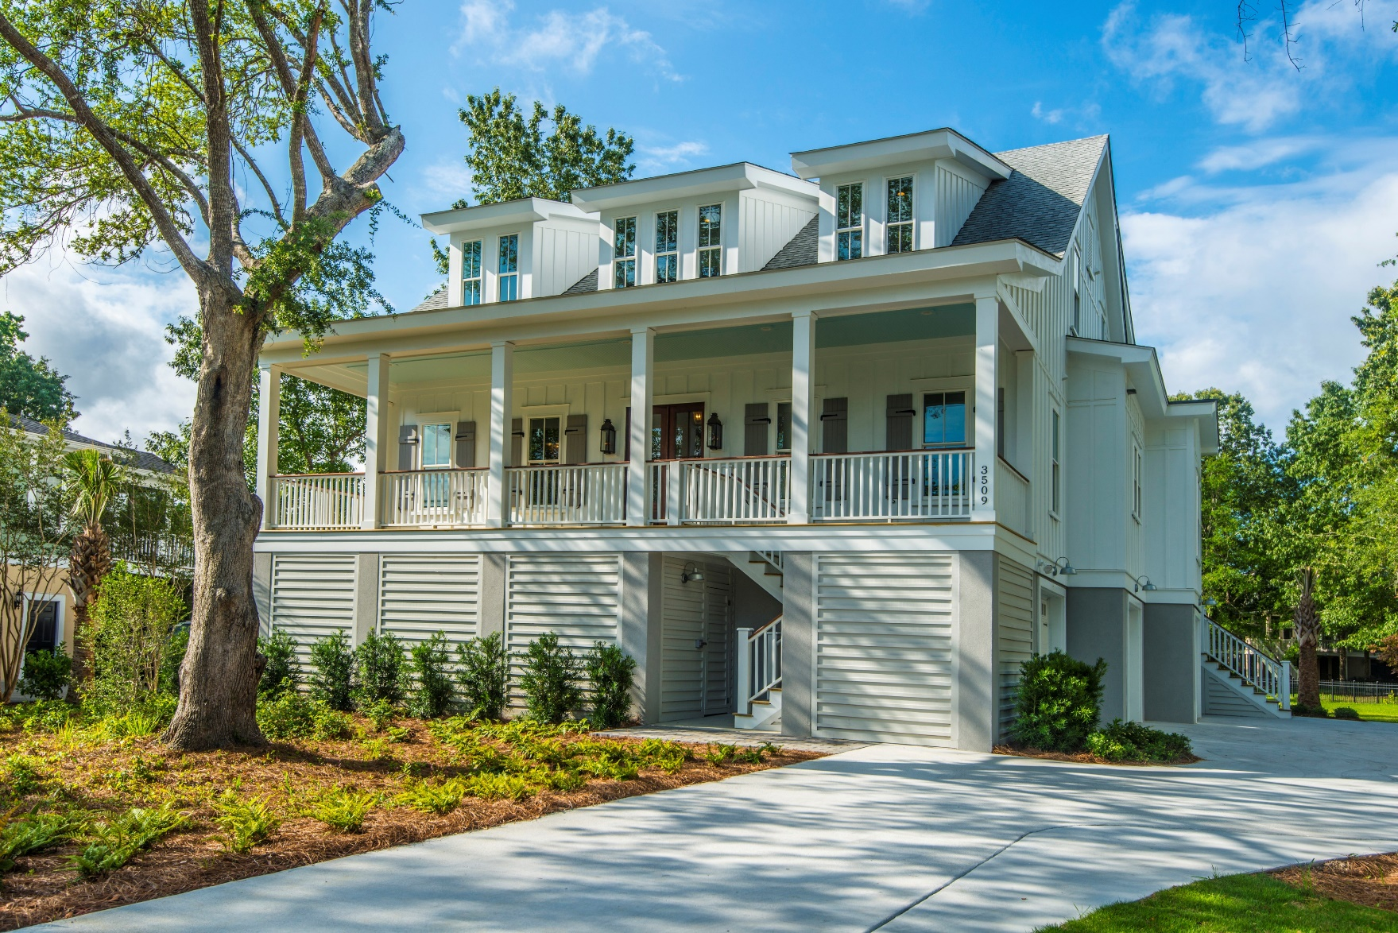
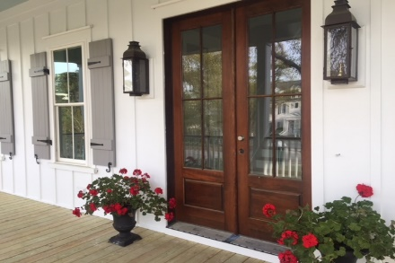
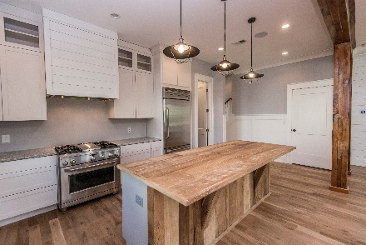
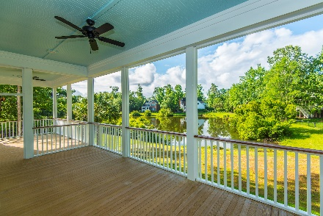


3509 Henrietta Hartford Road
Tennyson At Park West :: MLS# 18014854 :: $950,000
New
Construction
New Construction in Prestigious Mt. Pleasant Neighborhood
Located on one of Mt. Pleasant's most coveted streets, this Lowcountry charmer has been built with meticulous attention to detail from top to bottom. The Builder takes great pride in his craftsmanship and absolutely loves mixing new trends with unique antique or reclaimed pieces, as well as the latest technology.
The Board and Batten exterior frames a full Lowcountry Front Porch with lovely gas lanterns. The Open Floor Plan is filled with an abundance of natural sunlight and features reclaimed wood accents and antique white oak flooring throughout.
The Master Suite, on the main level, features antique white oak wood floors, gorgeous window views, a sleek soaking tub, separate shower, Double Vanity, Quartz Countertop, is adorned with shiplap, and has "His" and a "Hers" Walk-in Closets that would make anyone jealous!
Whether you have a larger family, work from home, have parents or older children at home, desire a separate guest suite, or just want a separate game or workout space, the ground level Suite makes this the perfect home for you! Entering from the 3 Car Garage there is a drop zone, a private Living Room, Full Bath, and a Bedroom that opens to the outdoor covered patio at your disposal! Wood floors, ceiling fans and a closet complete this insurable space.
Top it all with being located in Tennyson, with it's own private creekside park, and Park West Amenities (2 pools, tennis courts, play grounds, clubhouse, miles of walking and biking trails), what are you waiting for??
Completion expected in June 2018.
Wendy Arnsdorff
843-364-8619 – M :: 843-284-1800 – O
wendy.arnsdorff@carolinaone.com
www.wendyarnsdorff.com
Carolina One Real Estate :: Mt. Pleasant North Office :: 2713 N Highway 17 :: Mt. Pleasant, SC 29466

