Slide 1
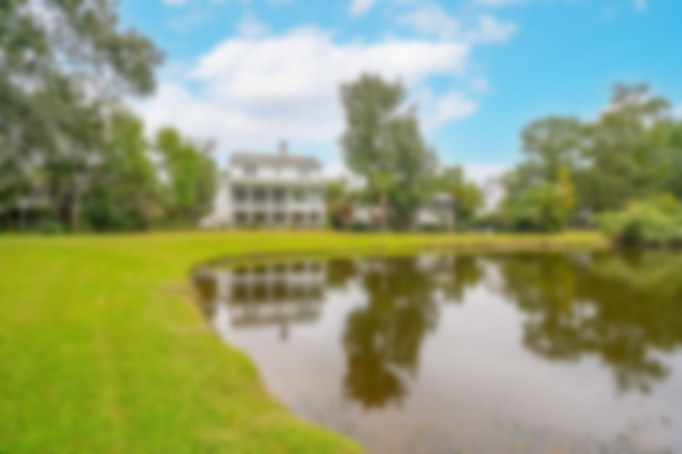
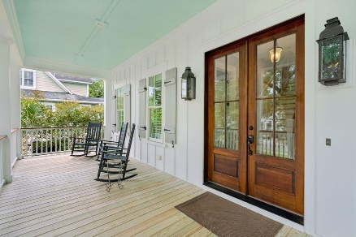
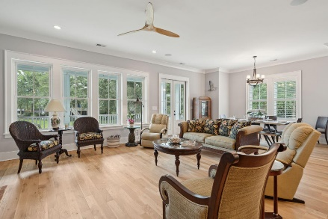
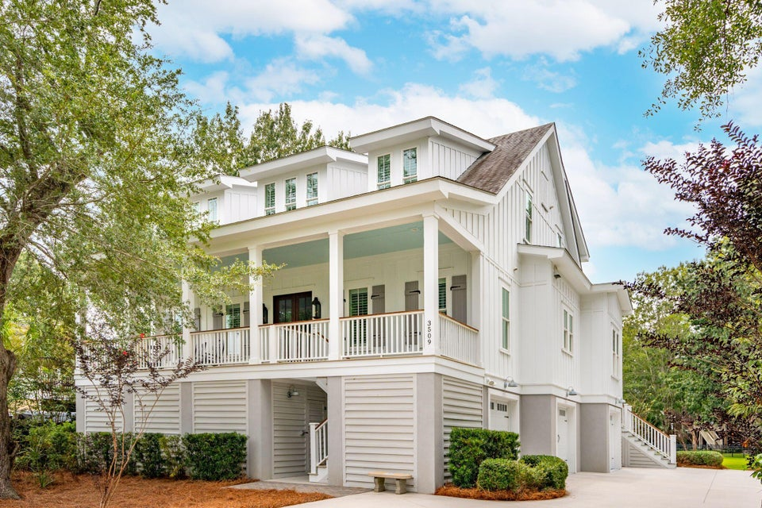
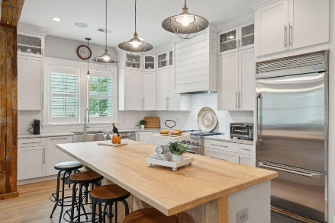
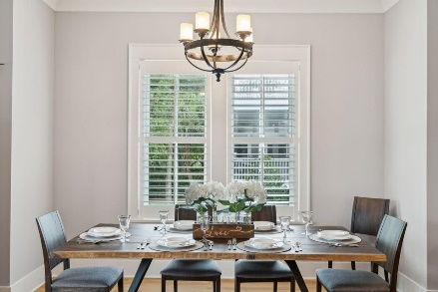
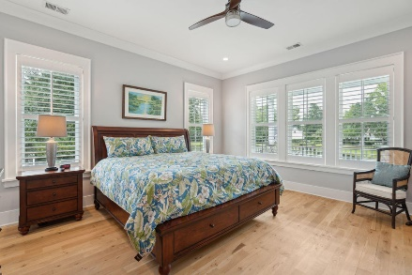
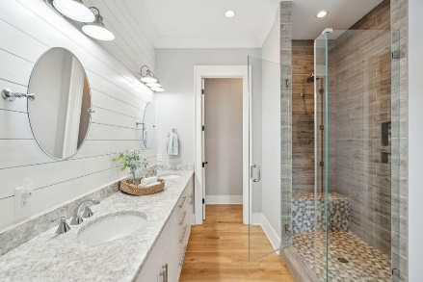
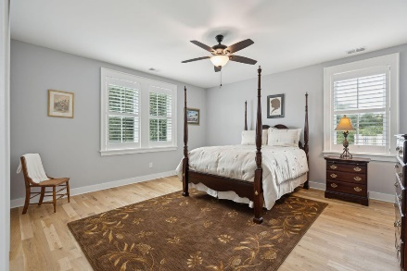
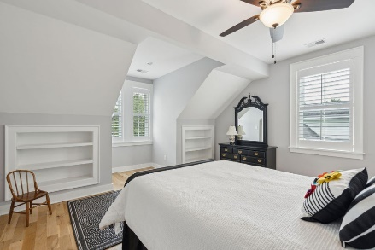
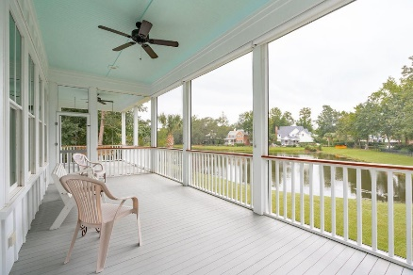

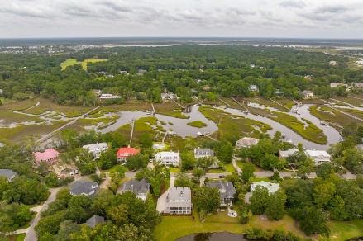
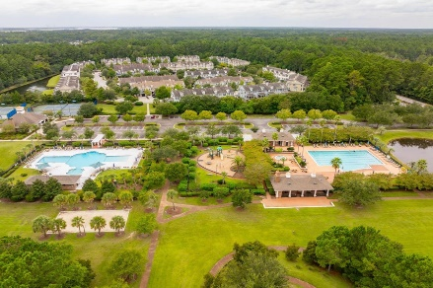


3509 Henrietta Hartford Road
Park West
Mount Pleasant, SC 29466
MLS# 24023955
NEW PRICE $1,525,000
Open House Sunday 1 to 3
Nestled into an idyllic Lowcountry setting of Live Oaks, tranquil pond waters and native flora, this gorgeous home is located in Tennyson, one of the most highly sought after neighborhoods in Mount Pleasant. Custom built by local homebuilder Coe Brier Construction, every inch of this property is designed to combine form and function. From the deep southern sitting porch enter a true foyer where you'll immediately note the custom touches found throughout. The millwork is outstanding and includes not only details such as crown moulding and tall baseboards but wall treatments of board and batten and antique white oak flooring throughout the home.
Open to the living and dining areas, the kitchen is delineated with a stunningly beautiful reclaimed wood beam and posts. A dining area offers plenty of room for hosting holiday and family celebrations while the spacious living area offers plenty of options for furniture arrangement. With a wall of windows to the rear and french doors to the porch, this living area is flooded with natural light. A gorgeous fireplace features reclaimed brick surround, an antique wood mantle and shiplap. This beautiful focal point is adjoined with a custom built-in cabinet for extra storage or for use as a dry bar.
Much of life in the Lowcountry is spent outdoors and this home provides many opportunities to take advantage of the beautiful weather and surroundings. In addition to the full front porch, the rear of the home offers a large screened in porch with adjacent open air deck. Sip your morning coffee, grill dinner or toast the sunset with these abundant outdoor living areas. This custom home offers additional benefits and features such as hurricane resistant windows, spray foam insulation along the roofline, 2 Tankless water heaters. Located in Tennyson at Park West, one of Mount Pleasant's most sought-after master planned communities with amenities including a private Tennyson Park just a stroll down the street and located on Toomer Creek with a dock for crabbing & fishing or just enjoying the view. Park West offers two neighborhood pools, a play park, tennis and pickle ball courts, and walking trails. A Mount Pleasant Recreation facility and primary, elementary and middle school campus are all located within the neighborhood. Bike or golf cart to local neighborhood eateries, the gym, or Publix grocery store. All of this and just minutes to the area beaches and the world-class shopping and dining of historic downtown Charleston.
VIDEO TOUR | MATTERPORT 3D TOUR
Don Dawson
843-514-0452
ddawson@carolinaone.com
Carolina One Real Estate • 2713 Highway 17 North • Mount Pleasant, SC 29466
www.TeamDawsonSC.com

