Slide 1
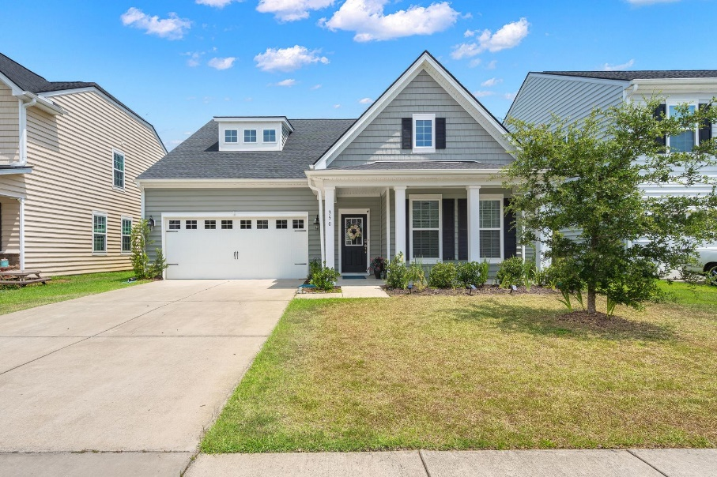
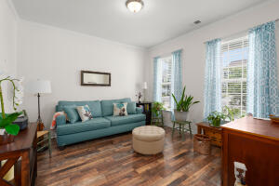
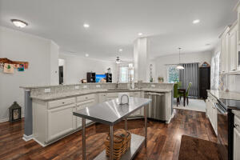
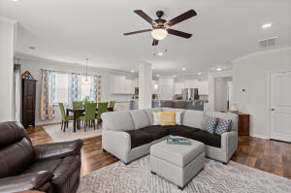
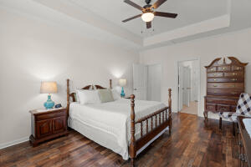
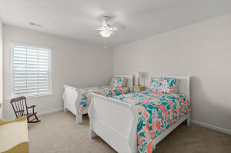
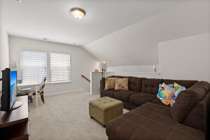
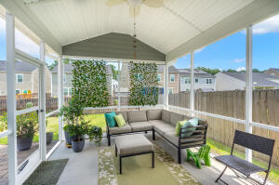
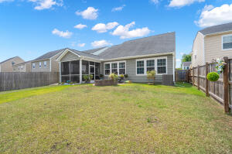



Shows Like A Model Home!
350 Bradley Bend Drive
Moss Grove Plantation
Moncks Corner, SC 29461
MLS# 22017073
$385,000
4 Bed | 2½ Bath | 2,643 sf
Highly desirable floor plan in an highly desirable neighborhood? Welcome to 350 Bradley Bend, a 4 bedroom and 2 and a half (2.5) bathrooms - with primary bedroom downstairs, located in the popular Moss Grove Plantation neighborhood! This wonderful home was built in 2017 and is ready for it's SECOND owner! That's right - only a single owner. This home was meticulously cared for and cleaned, bringing you a basically NEW home. Upon walking this gorgeous home, you first notice the hardwood floors in the foyer which leads into the open great room and kitchen area. The enormous great room, kitchen and breakfast area boast high ceilings, hardwood flooring and tons of space perfect for every day living. The kitchen boasts tons of cabinets and countertop space - making cooking at home, hosting events, holidays, parties, etc SO easy. The owner has added several upgrades to this original floor plan, one of which is an upgraded kitchen. You have PLENTY of room for your fine china and everyday cookware. The pantry is also located within the kitchen as well, making it easily accessible for your dry or canned goods or any other storage. This floorpan has one of the ONLY kitchen set ups like this in the neighborhood, making it very unique. And speaking of storage, there's PLENTY of it throughout the entire house. The new buyers will be delighted with more than enough room to store decorations or whatever it is you please to store, just know - you have TONS of room to do so. While in the great room area, you notice the wonderful screened in porch area - perfect for spending your time outdoors, regardless of the weather! Downstairs you also have the PRIMARY bedroom. Yes, the main bedrooms is downstairs! This bedroom boasts tray ceilings along with the owner's en-suite with enormous walk-in closet and DUAL vanities. Before heading upstairs, you'll find the laundry room and half bathroom prior to entering the 2 car garage. Upstairs you enter into a loft area leading into the 3 additional huge guest/secondary bedrooms with walk-in closets. Off the loft, you'll also find a full guest bathroom and linen closet with plenty storage. There's also additional storage off a couple of the bedrooms as well, for even more storage. I'm telling you, you cannot miss taking a look at this wonderful house! It really has it all including a large fenced-in backyard, gutters with LeafFilter leaf guards, all appliances CONVEY, HVAC serviced YEARLY, transferable Home Defense Team pest treatment with termites bi-annually, AND a transferrable HomeChoice Warranty until 2026.
Nick Mazzilli
(843) 640-5575
nick@nickmcharleston.com
www.mavenrealtysc.com
Maven Realty
2180 McMillan Ave
#71672
Charleston, SC 29405

