Slide 1
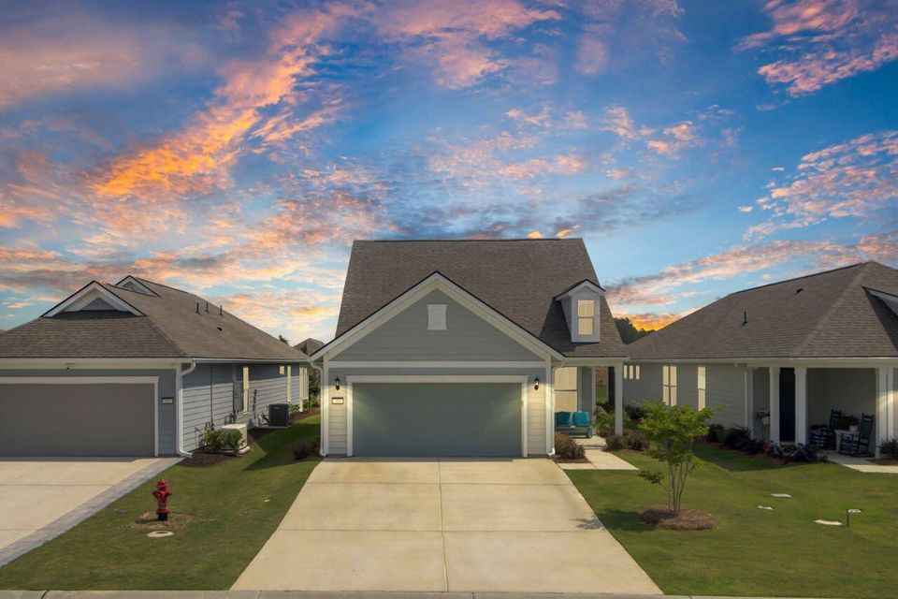
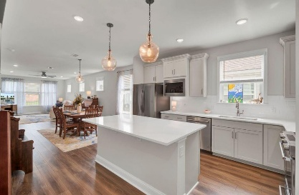
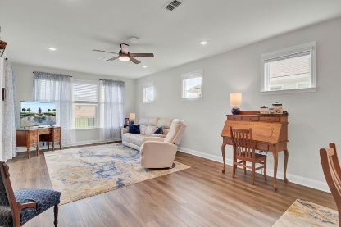
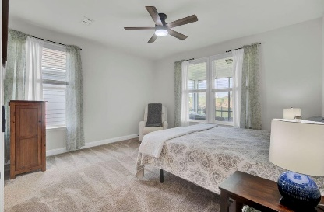
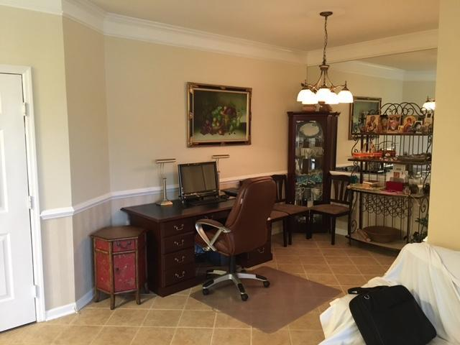
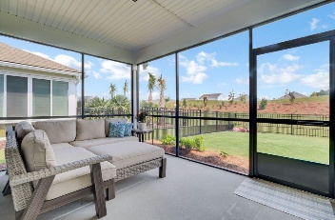
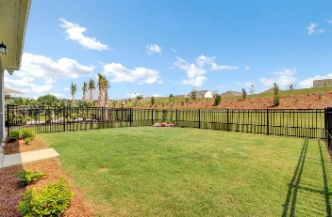
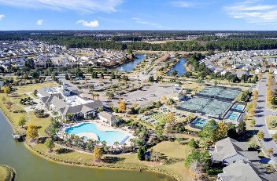
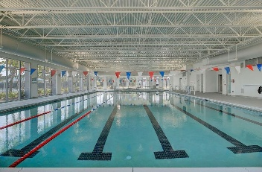
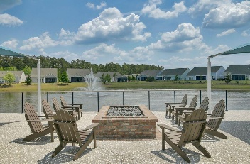



Right Size For The Downsize! 3 Bed | 3 Full Bath Including Full Guest Suite…A Rarity In Over 55 Communities. High Tech Upgrades Throughout. You Could Not Build New For This Price.
350 Dahlia Row Drive
Nexton | Summerville, SC 29486 | MLS# 25014123 | $650,000
This is it. The perfect home for those who want to downsize but not over downsize! Over 55 living just over 2000 square feet with 3 bedrooms, 3 full bathrooms and private office. Open concept kitchen with high-end Kitchen Aid stainless appliances, including gas range and quartz countertops, extended gathering room, screened porch, iron rod style fully fenced back yard, lovely landscaping that overlooks a freshly planted berm. This nearly new and hard to find, Contour floor plan, has been thoughtfully upgraded to be both comfortable and stylish for years to come. On main level, primary suite looks onto the backyard, as well as one guest room and office. Upstairs you will find a full second suite, bedroom, bath and generously sized sitting room and walk-in utility and storage area.
Cabinetry, trim and ceiling fans have been upgraded throughout, as well as tiled backsplash and primary shower. In addition to walk-in storage, there is a pull-down attic with insulation over garage and utility sink in the finished garage. You will be prepared for all your technology needs with 7 additional GIFI outlets, specialized outlet in garage to accommodate an electric vehicle or future pool equipment. Additionally, property is also pre-wired for a Generac generator. This Smart home also boasts a network wireless access point, Wi-Fi thermostat, Wi-Fi garage door opener, keyless door lock, CAT 6 ethernet cable throughout and data port package. Outside, you will find the driveway has been extended by 2 feet on either side for easy parking, irrigation for landscaping, full house gutters.
The gated community of Del Webb Nexton offers resort style amenities, ample sidewalks and walking paths, gathering areas, gorgeous landscaping, actively managed social and athletic programs and events. Residents may enjoy additional amenities provided by the overall award-winning Nexton community including pool with water slides (great for visiting youngsters). Several of Charleston's finest restaurants have Nexton locations and there are two grocery stores nearby as well as indoor Pickleball. Your lawn maintenance is provided by HOA so you are free to enjoy all that Summerville and greater Charleston has to offer. Welcome home!
ENJOY A VIDEO TOUR
Jenn Gallagher
843-327-2053
jenn.gallagher@cbrealty.com
Visit My Website
Coldwell Banker Realty
55 Broad St
Charleston, SC 29401

