Slide 1
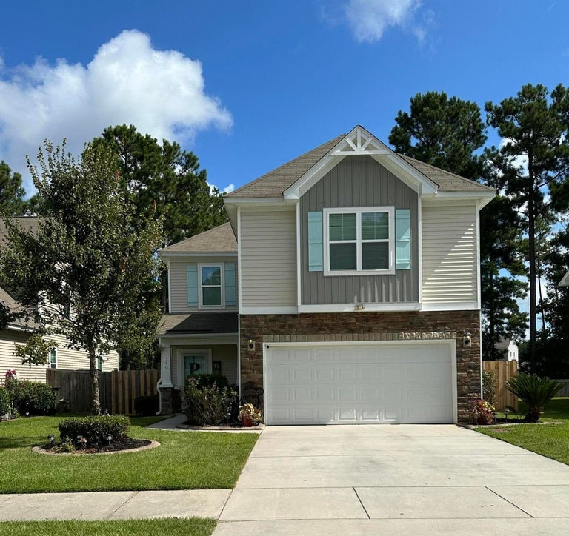

Beautiful Cul-De-Sac Home in USDA Direct Area
350 Drayton Place Drive Spring Grove · Moncks Corner, SC 29461
MLS# 23019716 · $420,000
3 Bedrooms/2.5 Baths
ELITE Spacious Master Bedroom
Master Bathroom with Separate Garden Tub/Shower
Fenced Backyard
Loft & More!!!
Mattie Nesmith, ABR
Broker-in-Charge
844.ELITE.48
mattie@ergroupofsc.com
The Elite Realty Group of SC, LLC
8310-A Rivers Ave
North Charleston, SC 29406

