Slide 1
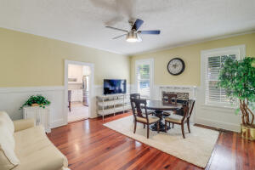
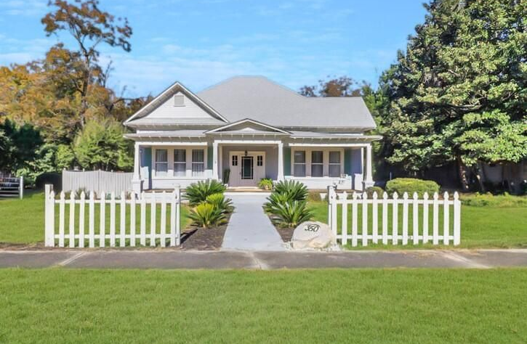
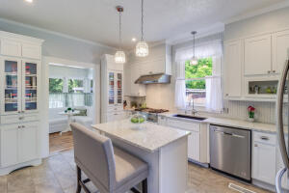
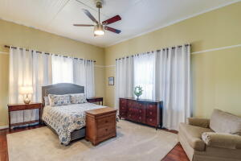
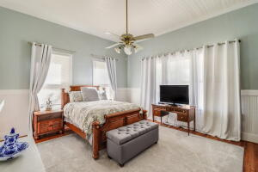
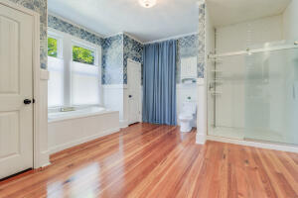
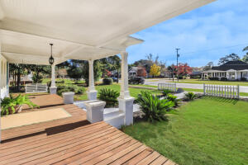
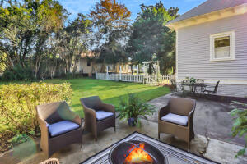
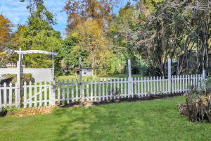


350 E Barkley Street
Elloree, SC 29047 | MLS# 21030585 | $325,000
Renovated 1920 Craftsman Cottage
Near Lake Marion!
SCHEDULE YOUR SHOWING TODAY!
Over $100K in upgrades and updates! You do not want to miss out on making this beautiful house your home! Welcome to this charming 1920's craftsman style home. The home has 3 bedrooms, 2 full bathrooms , 1 half bathroom, 4 fireplaces and 2,359 sq. ft. of living space on .74 of an acre. This home has recently had many upgrades and renovations. To name a few; new blown in insulation around the entire perimeter of the house, new roof with 30 year shingles and ice shield underlayment, interior and exterior home painted, electrical box and electrical have been updated and replaced throughout the home, plumbing has been replaced throughout the home, chef's kitchen remodel, master bathroom remodel, new hot water heater, one new HVAC, new windows, new garage door, and many more. Approaching the home you will notice the well maintained mature landscaping, the perfect white picket fence and the inviting full front patio. Sit out on your patio swing and enjoy the view and peacefulness within the quiet neighborhood. Enter the home into the spacious foyer with plenty of space to welcome guests and kick off your shoes and hang your coats. A large family room is the perfect place to converse or enjoy a family movie. Through the living area is a beautifully remodeled chef's kitchen, this kitchen is sure to spoil the chef in the family. Quartz countertops, marble backsplash, an array of kitchen accessory specific Kraftmaid custom cabinets, 36" stainless steel Jenn-Air Pro Style cooktop with gridle, Jenn-Air hood with heat lamp, Kitchenaid convection oven/microwave, Maytag dishwasher, Samsung french door refrigerator, recessed lighting, pendant lighting, and a new porcelain tile floor. Notice all the character including the trim work and ceilings through out the home especially in the relaxing sun room. The sun room is filled with natural sunlight from the wall of windows and would be a great place to have another seating area or a separate dining area. The master bedroom has plenty of room for furniture arrangement and its own private en-suite. Recently renovated master en-suite includes a fully tiled Kohler shower with glass doors, a separate garden tub, new vanity, new lighting, new toilet, and refinished hardwood floors. Two additional generously sized bedrooms and 1.5 bathrooms are included within the home. If you are wanting to take the entertaining outside, there is a wonderful back deck and large patio space. You will have to see for yourself what this incredible home has to offer, schedule your showing as soon as possible! Located in the quaint town of Elloree and located less than 10 minutes from Lake Marion, 1 hour from Charleston or Summerville, and just over an hours drive to Columbia!
Brandon Ray
(843) 499-1928
brandon.ray@carolinaone.com
www.therightrayhome.com
Carolina One Real Estate
900 N Main St
Summerville, SC 29483

