Slide 1
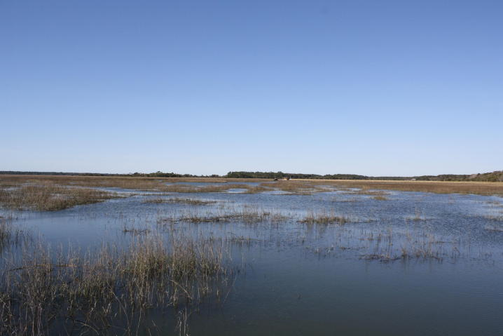
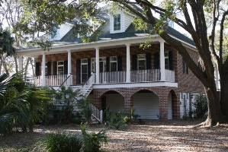
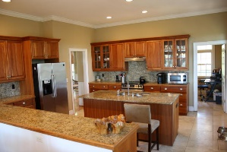
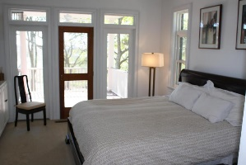
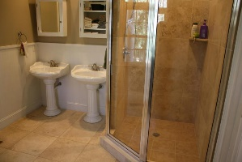
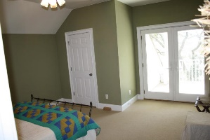
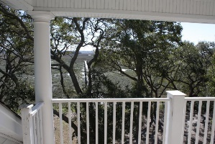
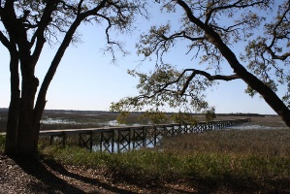
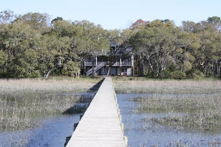
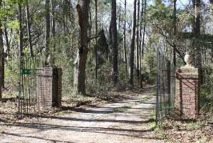

3511 Legareville Road Contentment Hall ~ Johns Island, SC 29455 MLS# 17007089 ~ $849,900
If waterfront solitude and breath-taking views are on your wish list, then look no further! You will feel the stress of the day begin to melt away as you drive through the canopy of oaks that line Legareville Road and make your way along the half mile entrance drive that meanders through grand oaks, palmettos, and a beautiful brick and wrought iron gate. Tranquility awaits as you arrive at this custom, low-country home with spectacular views of Chaplin's Creek, Kiawah River, and Terrapin Island. A semi-circular antique brick walkway leads up to a deep, full-length front porch, featuring tongue and groove antique pine decking. The charm of this home is accentuated by workable Charleston green hurricane shutters, complete with Old Charleston-style hardware, on the front and side windows. Entering the home, some of the custom design elements you will quickly notice are 10-foot ceilings downstairs and 9-foot upstairs, solid oak flooring, 18 inch Travertine tile, elevated wood-burning fireplace, Anderson French doors and full-length windows, chair railing and bead board trim, natural cherry kitchen cabinets, and a spiral staircase that leads from the deep, covered back porch to a private, covered upstairs balcony. This home was designed to take full advantage of the incredible views; sunrises can be captured through the kitchen/dining room area and beautiful sunsets from the rear porch, balcony, or dock. The seclusion of this property makes it difficult to believe that downtown Charleston and Kiawah and Seabrook beaches are only 20 minutes away. This property is a must see for anyone who wants privacy and awe-inspiring waterfront views.
Buyer is to verify information that is important to them such as square footage, schools, and acreage.
Lori Bates
(843) 224-4597
lori@beresfordrealty.com
http://beresfordrealty.com
Beresford Realty, LLC | 672 Marina Dr, S-206B | Charleston, SC 29492

