Slide 1
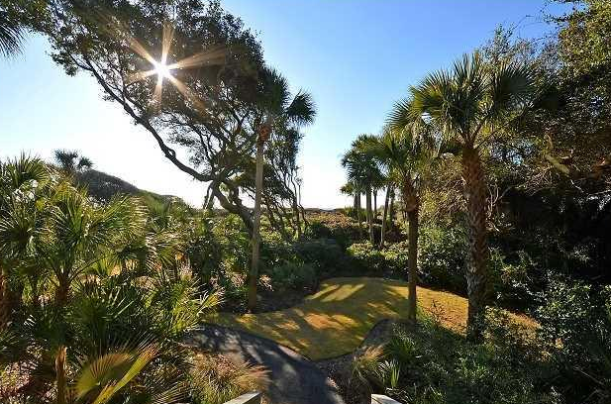
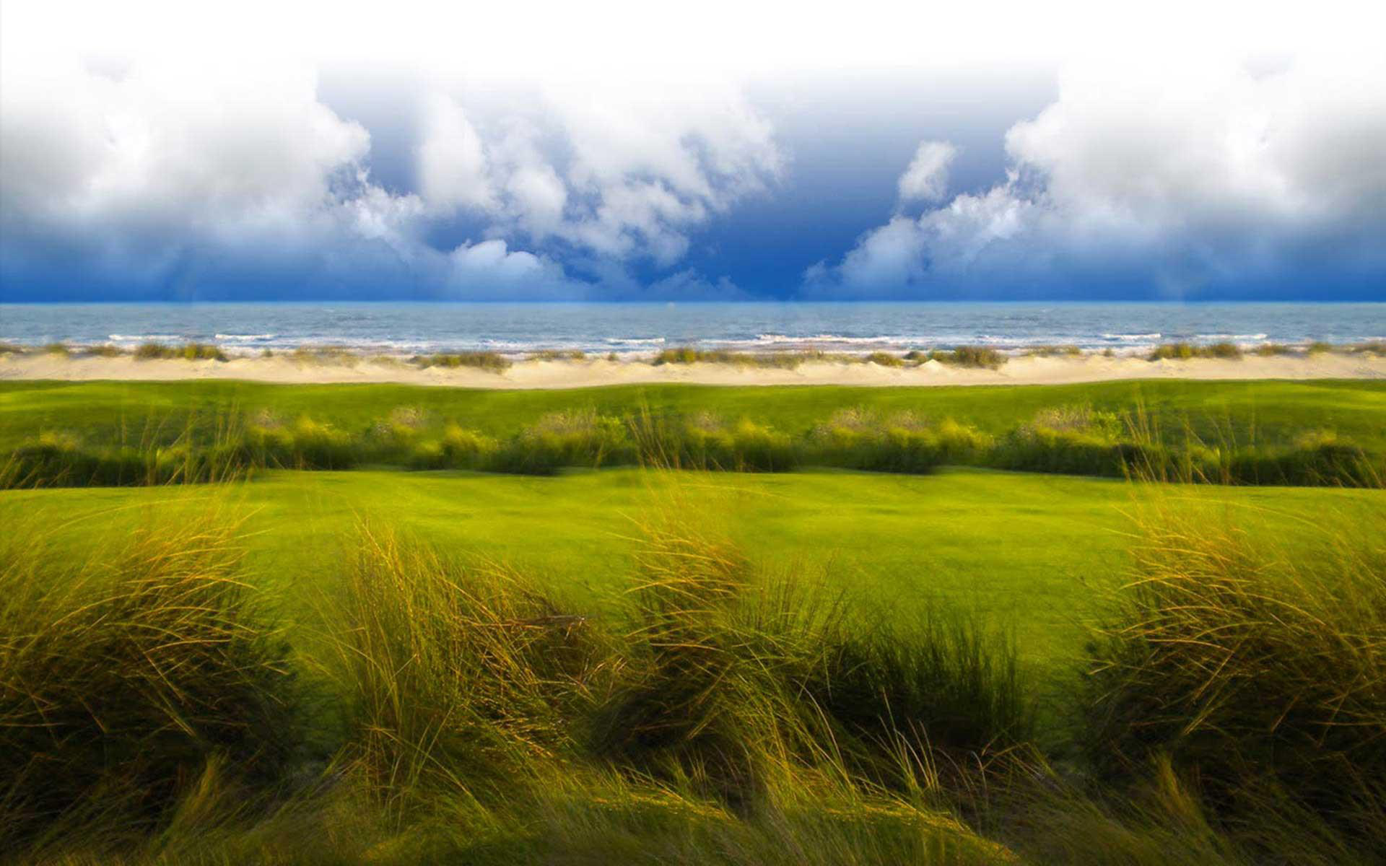
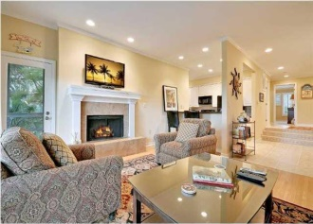
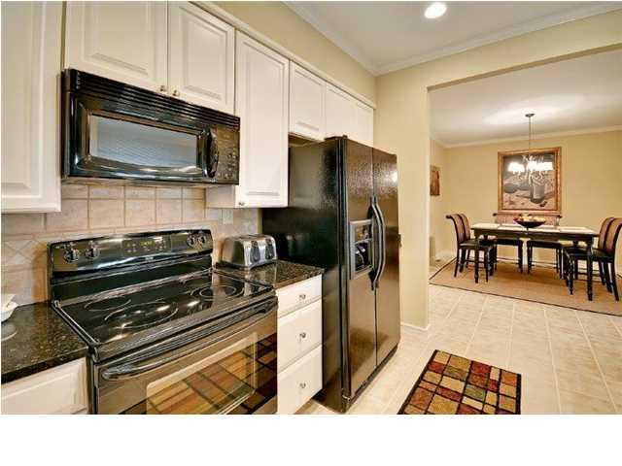
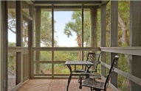
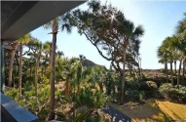
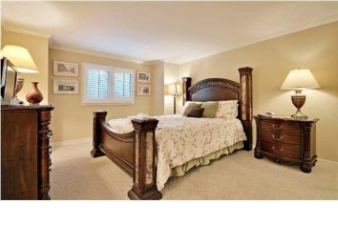
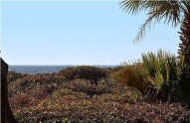


3512 Seascape Villa
Kiawah Island, SC
MLS# 1327971 ~ $1,399,000
Location, Location, Location
West Beach Village of Kiawah Island
Beautifully furnished 3 bedroom end unit villa
The open living area of this home offers expansive ocean views
Enjoy quiet evenings and outdoor dining on the spacious deck/screen porch
The open living area of this home offers ocean views and embraces island living
Well-equipped kitchen, complete with granite countertops and custom cabinets
Decorated with comfortable furnishings, creating a perfect atmosphere
The master bath and twin bath has been recently renovated in 2012
Freshly painted, new carpet, new HVAC
Currently on established rental program
Convenient to golf and tennis
Kiawah Island has 10 miles of pristine beach
Listed Exclusively by
Christina Bucci
843-830-0888 Cell
christina@sweetgrassps.com
RE/MAX Elite | Sweetgrass Properties, 91A Broad St, Charleston, SC 29401

