Slide 1
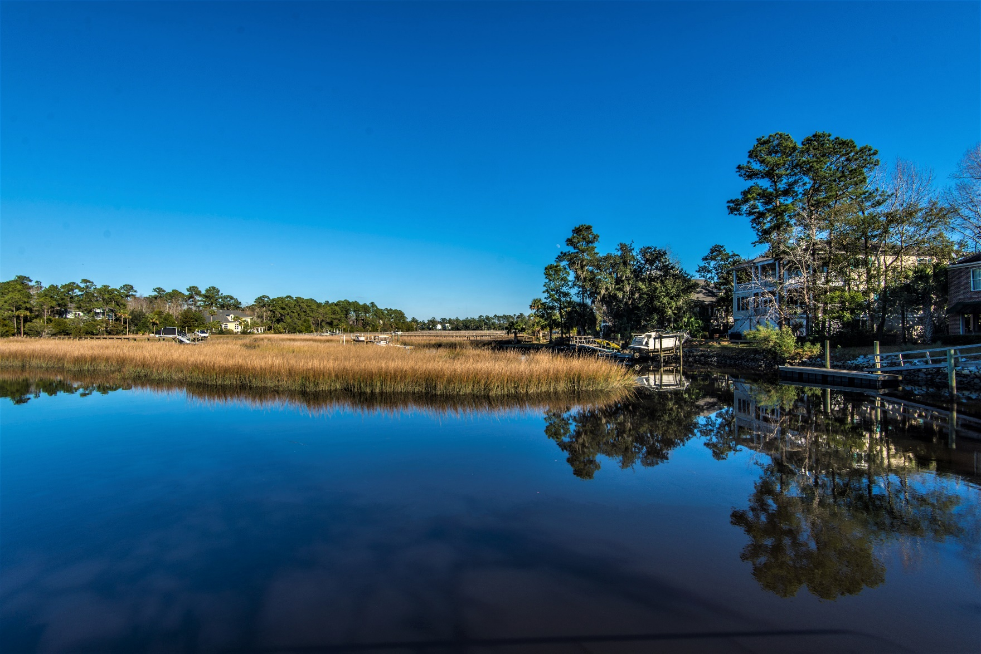
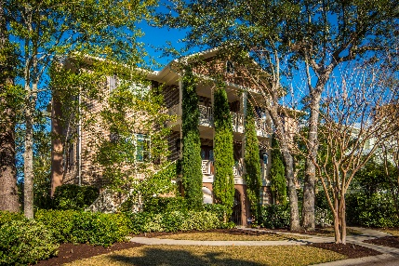
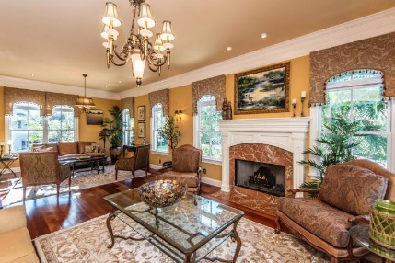
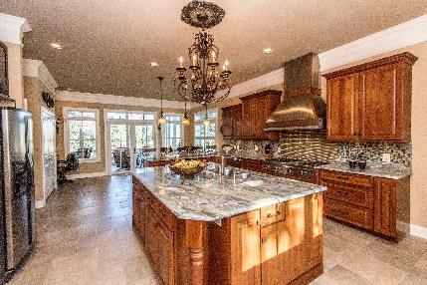
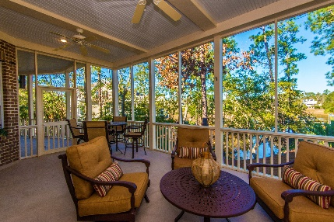


3516 Henrietta Hartford Road Park West ~ MLS# 19003332 ~ $1,189,000
New
Construction
Water Front, Full Mother-In-Law Suite, Mt. Pleasant!
Just in time for Summer!
Located on one of Mt. Pleasant’s most desirable streets, this stunning all brick home offers some of the most amazing views, exquisite trim and craftsmanship, versatile living spaces, and one of the best fishing spots on the creek! The Great Room is large enough to have dual Living Areas, fireplace, tons of windows with natural light, and access to an open back porch overlooking Toomer Creek. An elegant Dining Room connects the Great Rooms with a Gourmet Kitchen that was built for entertaining! Brazilian Cherry Hardwood flooring stretches throughout the Great Rooms, Foyer, and Dining Rooms. A generous screened porch offers the perfect location for your morning coffee or enjoy a picturesque sunset! The Master Suite awaits you at the top of the stairs. There is flexible use space perfect for a sitting area, office, workout station, or even a nursery. The Bedroom is enormous, has 3 walk-in closets, and opens to another screened-in porch. The view is spectacular! The ground level is one large Guest or Mother-in-Law Suite with open Living and Kitchen areas, a Bedroom that easily accommodates a king bed, and full bath featuring a walk-in Shower. Located on the banks of Toomer Creek, you are a 10 min cruise to the Wando River. The shared EPI dock has a private ramp, floating dock and boat lift. Fishing, crabbing, shrimping, kayaking, paddle boarding, motor boating, and sunbathing are just the beginning of all you can enjoy in this picturesque paradise. What are you waiting for? Welcome home!!
Wendy Arnsdorff
843-364-8619 – M :: 843-284-1800 – O
wendy.arnsdorff@carolinaone.com www.wendyarnsdorff.com
Carolina One Real Estate :: Mt. Pleasant North Office :: 2713 N Highway 17 :: Mt. Pleasant, SC 29466

