Slide 1
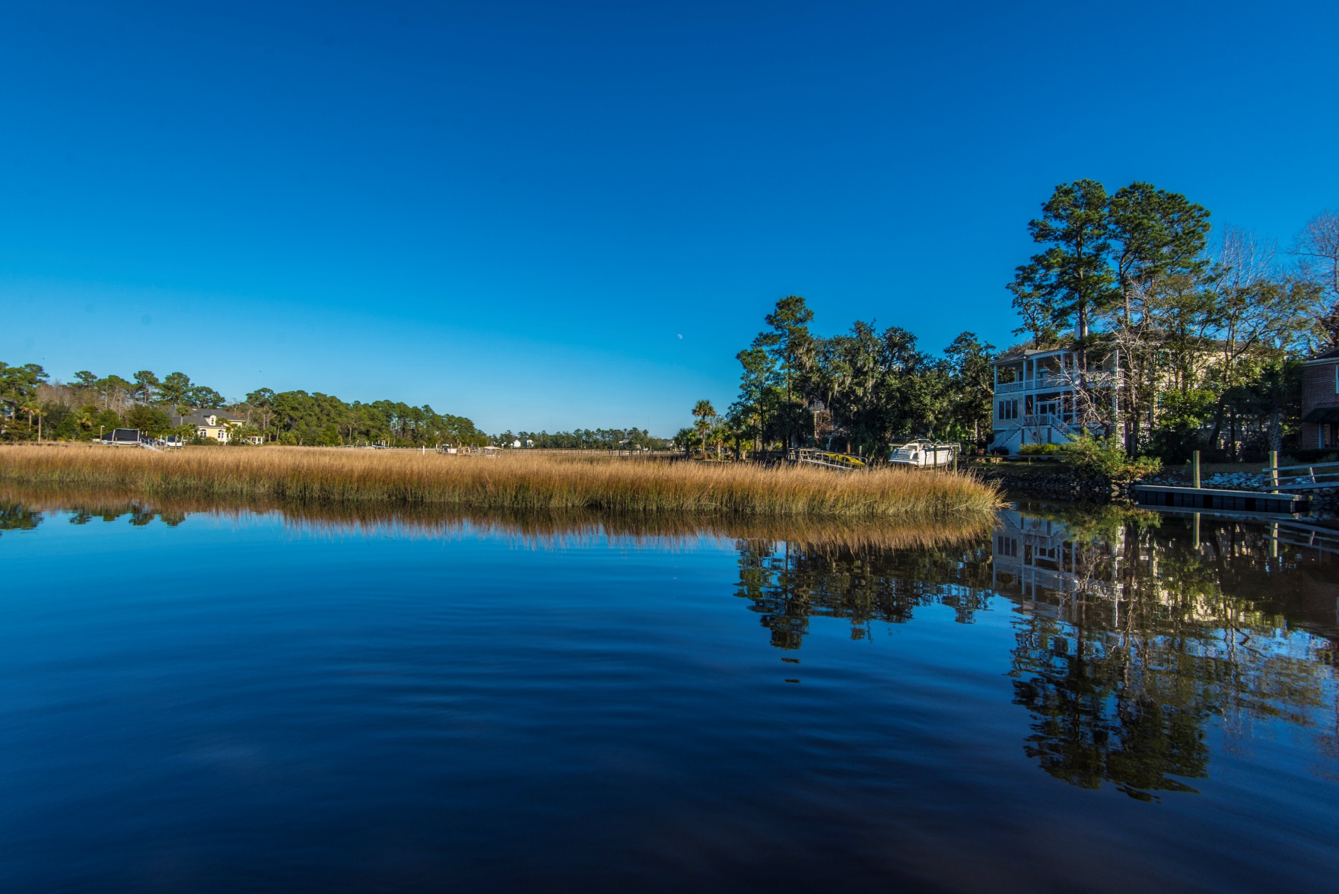
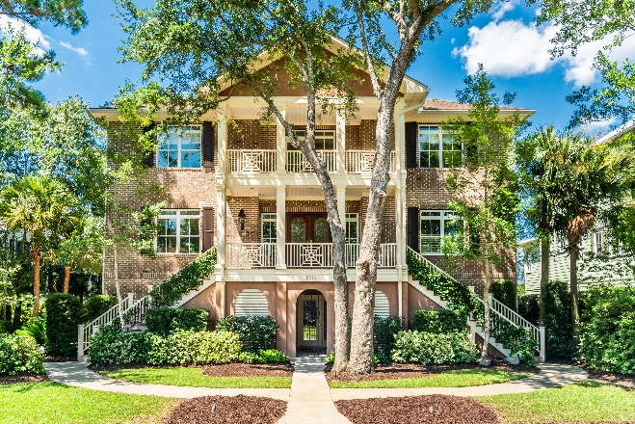
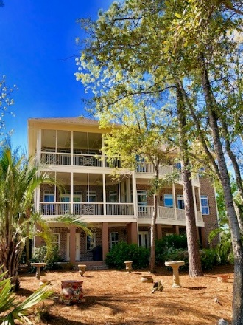
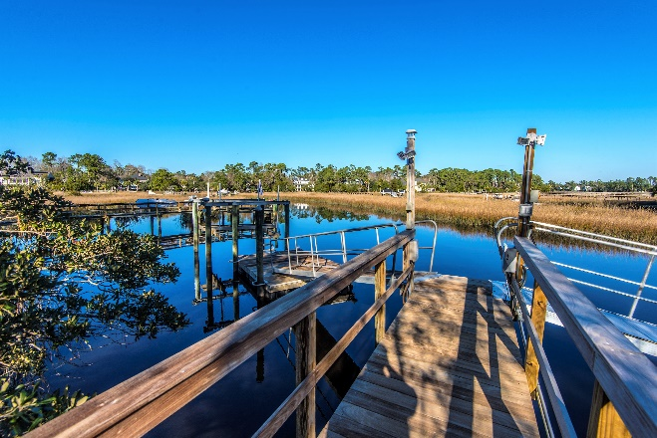


3516 Henrietta Hartford Road
Park West ~ MLS# 19021792 ~ $1,099,000
New
Construction
Shortest Dock in Mt. Pleasant!
Old Charleston charm AND your boat literally just steps from the backdoor!
This rare find offers some of the most amazing views, exquisite trim and craftsmanship, versatile living spaces and one of the best local fishing holes right in its backyard!
4 Bedroom
4.5 Baths
Mother-in-Law Suite
Deep Water
Dock and Lift in place!
Offered at $1,099,000
Wendy Arnsdorff
843-364-8619 – M :: 843-284-1800 – O
wendy.arnsdorff@carolinaone.com
www.wendyarnsdorff.com
Carolina One Real Estate :: Mt. Pleasant North Office :: 2713 N Highway 17 :: Mt. Pleasant, SC 29466

