Slide 1
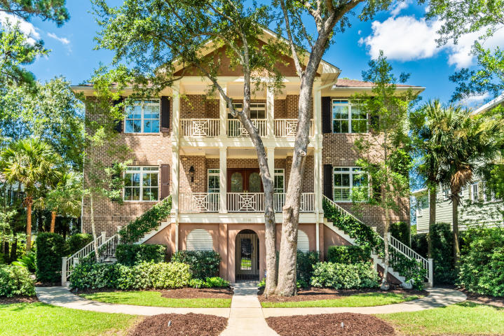
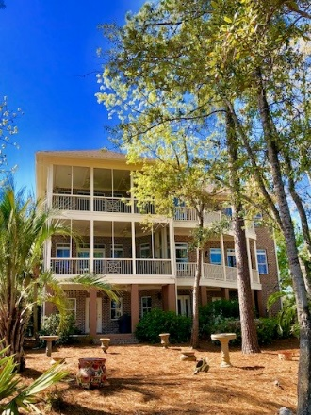
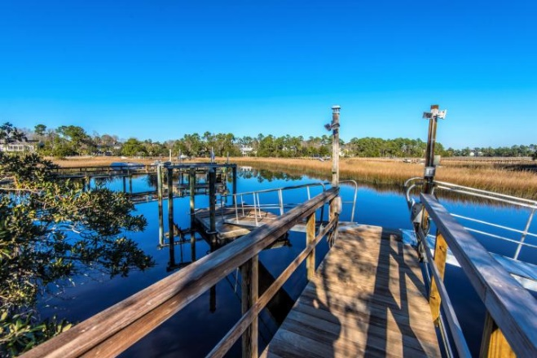
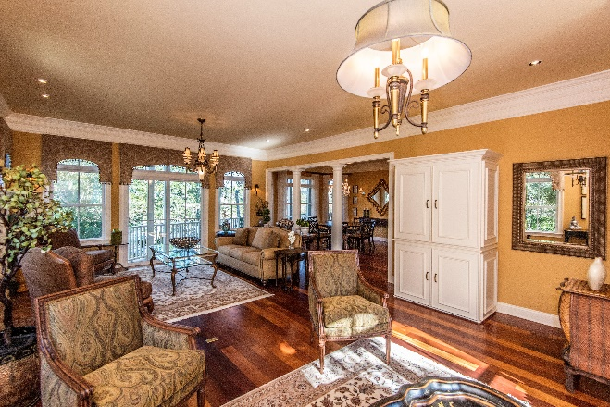


3516 Henrietta Hartford Road Park West ~ MLS# 19021792 ~ $1,094,000
Waterfront Home On Your
Client's Holiday Wishlist?
New
Construction
Old Charleston charm AND your boat literally just steps from the backdoor!
This rare find offers some of the most amazing views, exquisite trim and craftsmanship, versatile living spaces and one of the best local fishing holes right in its backyard!
4 Bedroom
4.5 Baths
Mother-in-Law Suite
Deep Water
Dock and Lift in place!
Offered at $1,094,000
Wendy Arnsdorff
843-364-8619 – M :: 843-284-1800 – O
wendy.arnsdorff@carolinaone.com www.wendyarnsdorff.com
Carolina One Real Estate :: Mt. Pleasant North Office :: 2713 N Highway 17 :: Mt. Pleasant, SC 29466

