Slide 1
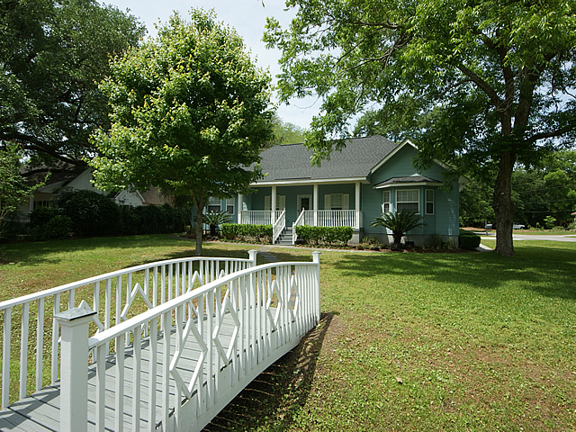
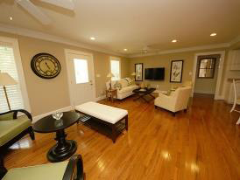
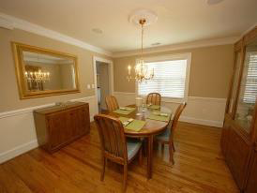
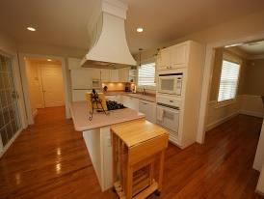
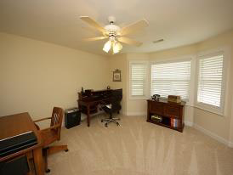




Agent Open House! Thursday, August 21 4-6 pm
3518 Old Ferry Rd
Shell Point
Johns Island, SC
MLS# 1402775
$329,000
3 Bedrooms | 2½ Baths | 2,552 Sq Ft
Exceptional custom home near the Intracoastal Waterway and Limehouse boat landing. 3 bdrm, 2.5 bath on corner lot. Mature landscaping. Spacious kitchen with solid surface counters and eat-in dining. Living room with gas fireplace opens into formal dining room. Gleaming hardwoods. Private master bedroom suite has his and hers custom closets and large remodeled master bath with granite and custom tile and cabinetry. Two car garage has extra bay for golf cart/boat. Staircase to newly renovated media room, which includes updated half bath along with wet bar with granite counter. Unfinished attic provides much room to expand living space. Outside landscaping includes custom walking bridge, covered rear porch, and full front porch allowing for excellent view. This house is located in a secluded, mature neighborhood. The custom work in this house is EXCEPTIONAL! Recently appraised and priced accordingly.
B C D Properties LLC
123 Piccadilly Loop
Summerville, SC 29483
Nancy Stewart
843-408-6251 M
knstewart81@gmail.com

