Slide 1

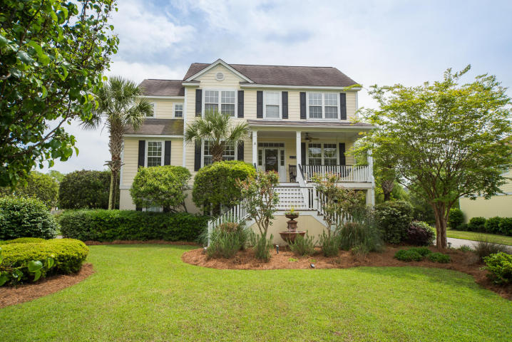
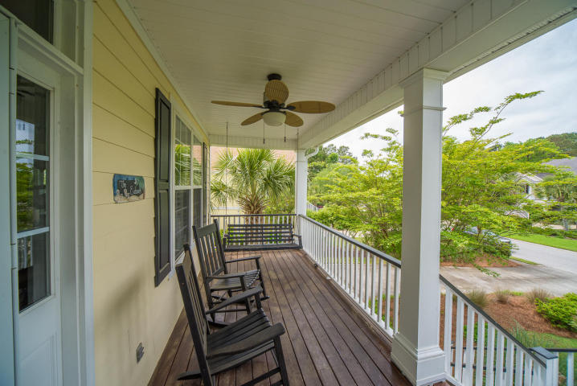
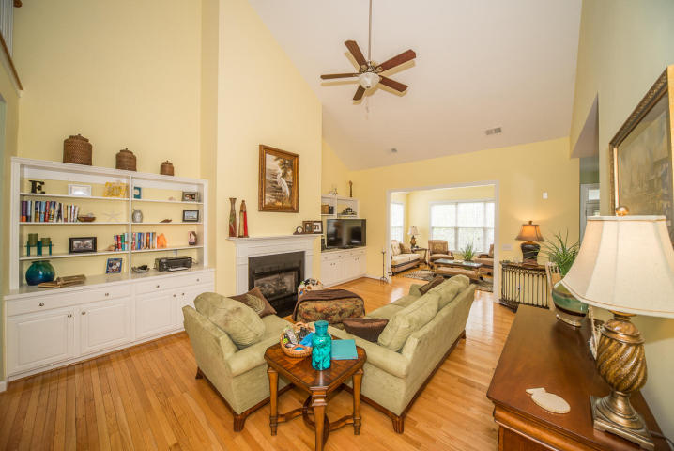
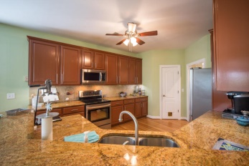
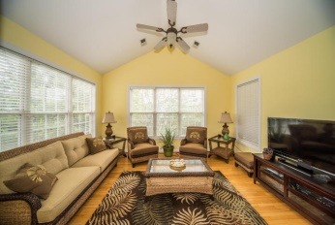
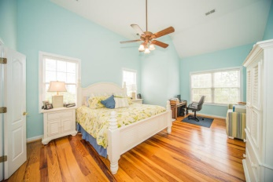
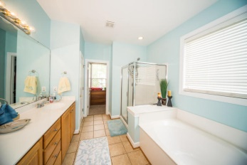
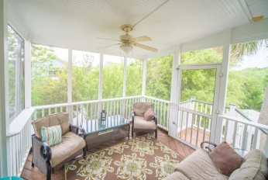


Open House - Thursday, April 30th Lunch will be served 11:30am- 2:00pm
3518 Stockton Drive
Mount Pleasant - MLS# 15010443 - $535,000
*Beautiful Home on Lagoon
*Wide Open Floor Plan with Hardwoods
*Updated Kitchen with New Stainless Appliances
*Screened in Porch overlooking Lagoon
*Garage with Huge Storage Area and Workshop
Visit www.1609poinsettaroad.com for more info and photos
Edmund Major
843-343-6666 C edmund@flywaysc.com
www.flywaysc.com
Flyway Real Estate, LLC
1630 Meeting St. Bldg 1
Ste 302
Charleston, SC 29405

