Slide 1

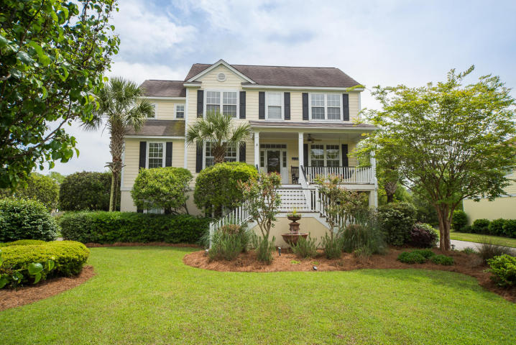
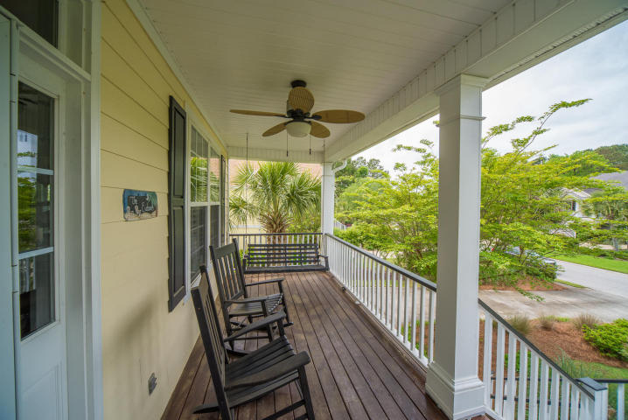
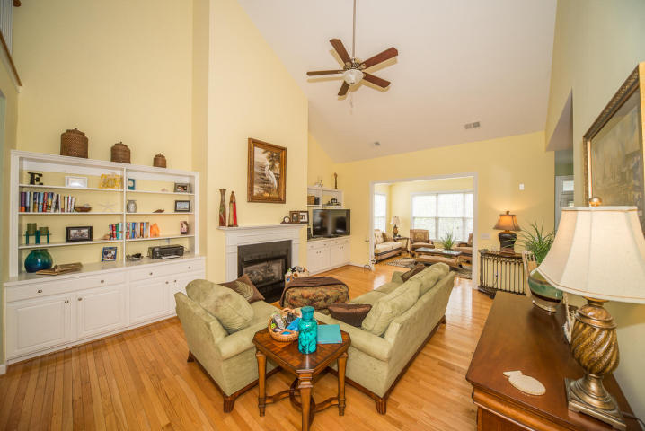
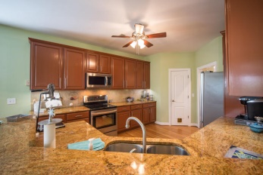
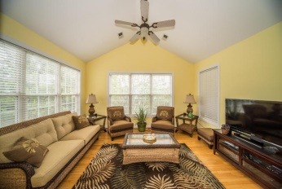
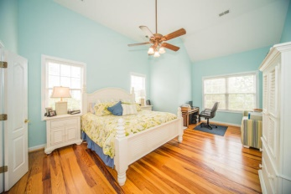
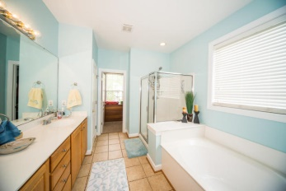
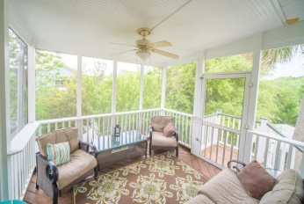


Just Listed in Charleston National!
3518 Stockton Drive
Mount Pleasant - MLS# 15010443 - $535,000
Beautiful Lowcountry style raised home in The Gallery at Charleston National. This wonderful home is located on a pond with a wide open floor plan. The formal dining and living rooms greet you as you step inside from the full front porch. Note the heavy trim with chair rail. The family room has soaring 18'+ ceilings and a gas burning fireplace. You will also notice the built in cabinets and book shelves. New lighting and ceiling fans. The kitchen has upgraded 42'' cabinets and granite counter tops with new stainless appliances. There is also a large pantry which gives the kitchen a ton of storage. The kitchen has a breakfast area with plenty of windows and views of the pond. Off of the breakfast area is a screened porch that catches a very nice afternoon and evening breeze. Attached to the family room is a large sun room. The master bedroom has wide plank pine floors and high ceilings With sitting or office area. The master bath is complete with garden style tub, separate shower, two vanities, and separate water closet. The spacious master closet is located in the bathroom as well. Upstairs are three large bedrooms with walk in closets. Two of the bedrooms share a Jack and Jill bath that has been new tile floors. Hall bathroom has new tile floors. Large laundry room with new tile. All new carpet recently installed throughout upstairs. The home has a spacious workshop/storage room/play room in the 1452 sq ft garage area. It has an enclosed workshop with two separate areas so that one could be used for storage/work room and the other could be used for recreation or an art studio. With the raised construction you will still have plenty of room for 3+ cars, golf cart, kayak, etc. Yard has been professionally landscaped and maintained lawn and garden including lighted water fountain. Back yard has been fenced in. Town Center and IOP connector are less than 15 minutes away. Charleston National has a Rees Jones designed golf course, swimming pools, fitness center, playgrounds and tennis courts. All of this within a short drive of downtown Charleston.
Visit www.1609poinsettaroad.com for more info and photos
Edmund Major
843-343-6666 C
edmund@flywaysc.com
www.flywaysc.com
Flyway Real Estate, LLC
1630 Meeting St.
Bldg 1
Ste 302
Charleston, SC 29405

