Slide 1
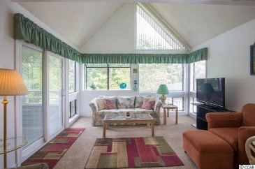
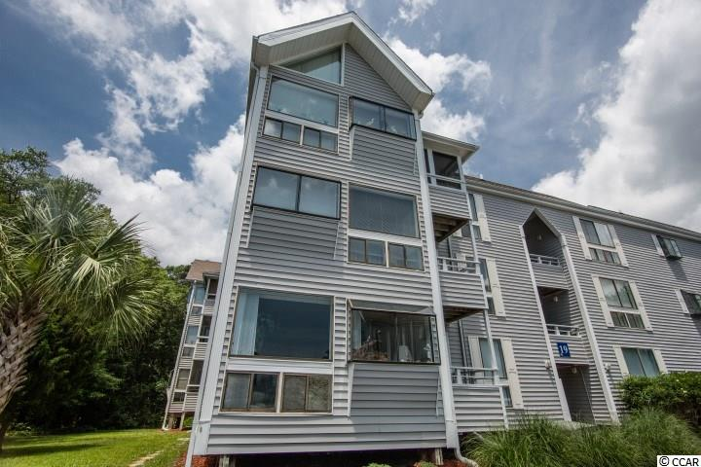
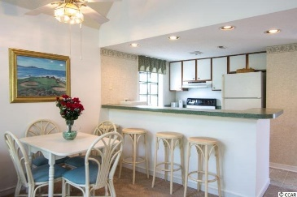
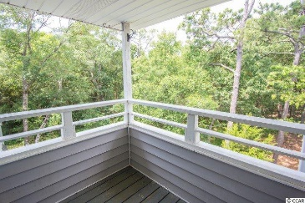
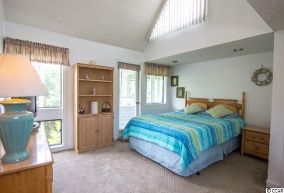
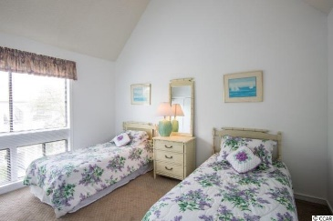
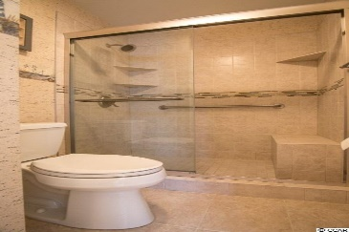
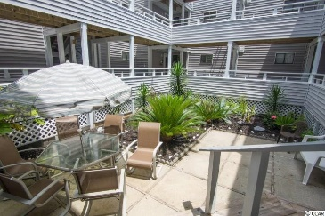
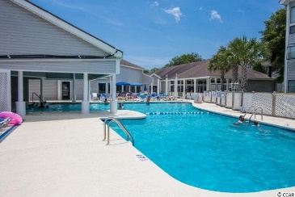


351 Lake Arrowhead Rd Unit 19-376
Arcadian Dunes ~ Myrtle Beach, SC
MLS# 1511894 ~ $110,000
STEPS TO THE BEACH! ONLY $110,000!
Price
Reduced
Steps to the Beach! Fabulous penthouse end unit in popular Arcadian Dunes resort. Sunny and pristine condo with lots of windows and cathedral ceilings. 2 bed 2 bath comes completely furnished including washer and dryer! Enjoy watching the wildlife in the woods from your balcony or drive your golf cart parked right outside your condo to the beach. Owners have lovingly taken care of this unit and have done many upgrades including new carpeting throughout. You will love the gorgeous bathrooms that they remodeled with all new tile, new fixtures and cabinets. The Master bath has a sit down shower and the guest bath has had a wall removed to install a larger shower and is the only unit for sale at Arcadian Dunes with this open larger guest bathroom! This is a great investment opportunity at the beach or make this your primary residence or 2nd vacation home. Short and long term rentals are allowed. Owners are allowed pets! Golf cart and motorcycle parking are also allowed. There are so many ways to have fun at this resort or if you want to entertain family and friends you have your choice of: 2 outdoor swimming pools, jacuzzi, tennis courts, onsite restaurant and bar, Arcade and recreation room, lounge with free WIFI, horseshoe pits, BBQ areas with gazebos and a play ground. There is also a work out room for owners which includes a sauna and steam room. You will have no worries with this condo since the owners are offering a 1 year home warranty at closing. Don't pass up your chance to own your own piece of paradise which is a 5 minute walk to the beach and within walking distance of several popular restaurants, bars and stores, the Apache Pier and the walking/biking path that runs along Arcadian Shores golf course. A quiet location yet only a 5 minute drive to Tanger Outlets, the Myrtle Beach mall and countless restaurants and stores along "Restaurant Row". Come experience one of the best neighborhoods and the largest and most beautiful beaches along the Grand Strand!
Julie Blethen | jazblethen@hotmail.com | (843) 564-8539
Wilkinson & Associates ERA Powered, 9652 North Kings Highway, Myrtle Beach, SC, 29572

