Slide 1
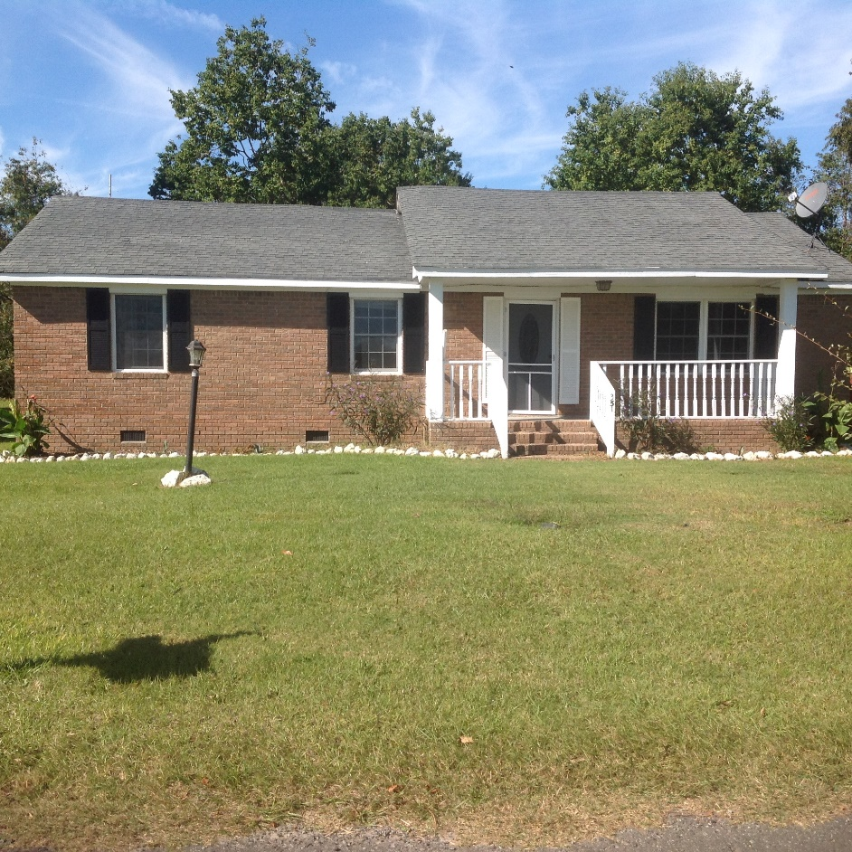
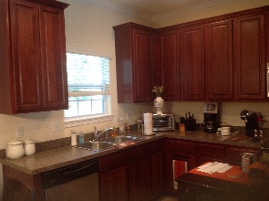
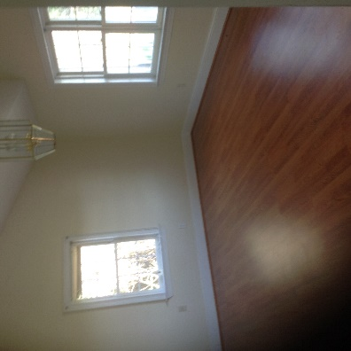
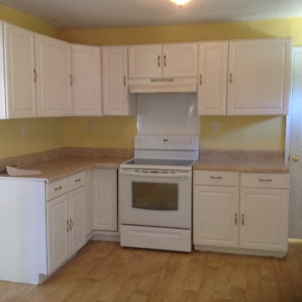
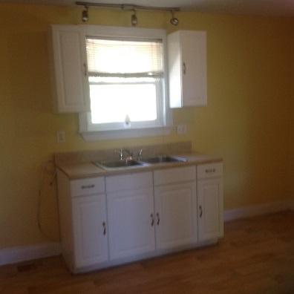
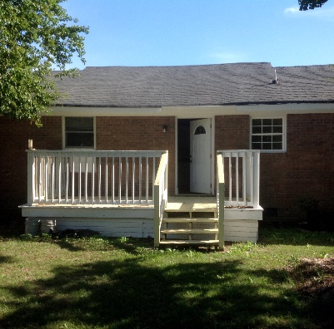

351 Lullwater Road
Eutawville, SC 29048
MLS# 16027684
$114,900
3 Bedrooms | 2 Baths | 1,350sf
Well maintained brick home that sits on almost 3/4 of an acre in Eutawville!
The work is already done for you.
Come see this jewel today.
Carla C Davis
Mobile - (843) 437-4873
gaweber@tds.net
AgentOwned Premiere Group
141 A N. Main Street
Summerville, SC 29483

