Slide 1
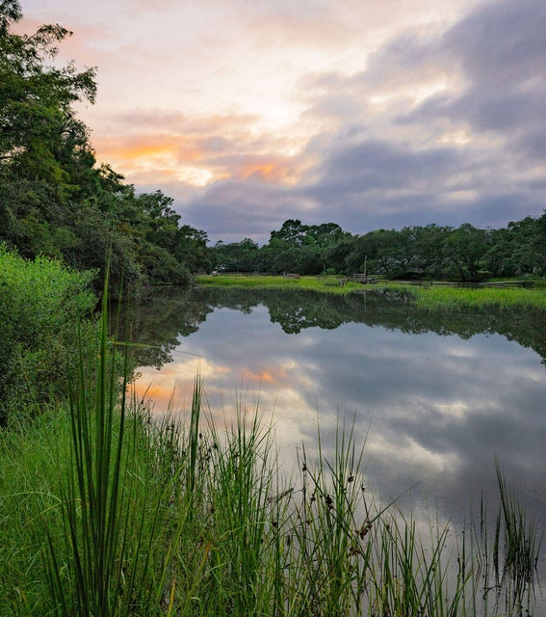
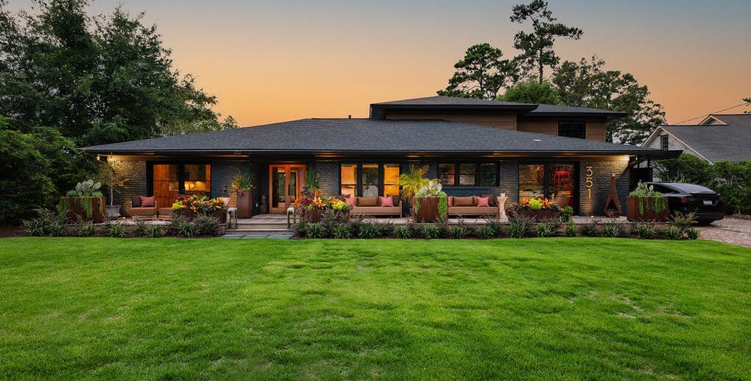
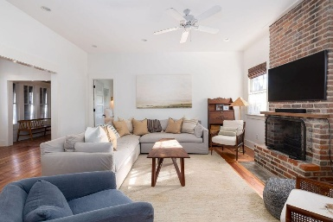
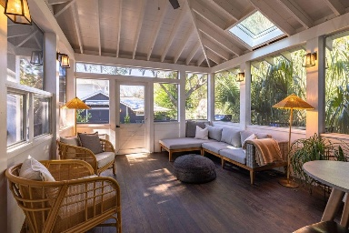
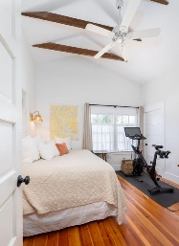
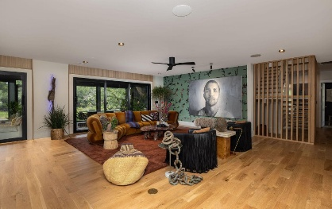
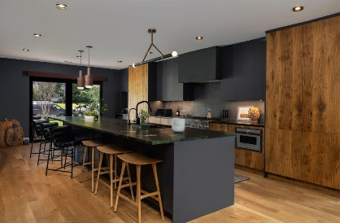
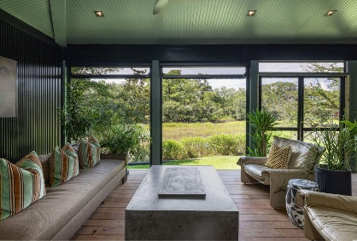
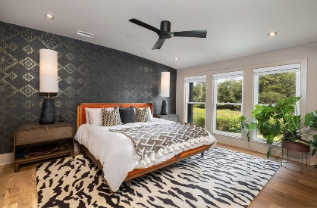

351 Confederate Circle Awaits You!
351 W Confederate Circle
South Windermere | Charleston, SC 29407 | MLS# 25021855 | $2,995,000
Welcome to 351 Confederate Circle, a one of a kind property! Located in the beloved neighborhood of South Windermere, this home has everything you could dream of - proximity to beaches, shops, & restaurants, an idyllic marsh view, mid-century modern architecture, and a contemporary design that perfectly blurs the lines between indoor & outdoor living. Upon entering the home through custom French doors, you'll immediately be welcomed by a large open floor plan and gorgeous hardwoods. You'll gaze ahead to the full sliding Euro Doors that lead you to the expansive porch. The chef's kitchen boasts a custom kitchen island with leathered quartzite countertops, and a tailor-made espresso cabinet with wine fridge. The entertaining area is picture perfect w/ panoramic views and a luxurious bar ready to host all of your friends. Step out onto the back screened-in porch for sweeping Lowcountry scenery, vaulted ceilings, and solar-powered retractable screens.
This modern home is incredibly unique for the Charleston area. The marsh front lot is surrounded by both mature trees and stunning new landscaping equipped with lights & irrigation. The expansive front porch features Ipe decking with three large sets of French doors, perfect for letting in natural light or opening up to enjoy a cross breeze through the home. 351 Confederate Circle was designed for those who love modern architecture and bringing the outdoors in. Schedule your showing today!
Greg Gelber
843-494-2354
greg.gelber@agentownedrealty.com
Kelly Snyder
843-457-5951
kelly.snyder@agentownedrealty.com
AgentOwned Charleston Group | 902 Savannah Hwy | Charleston, SC 29407-7802

