Slide 1
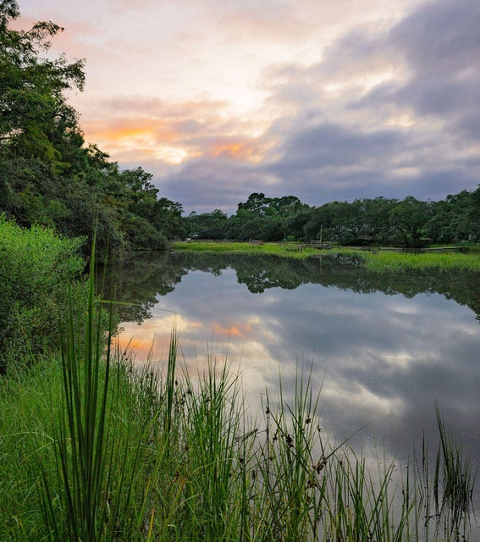
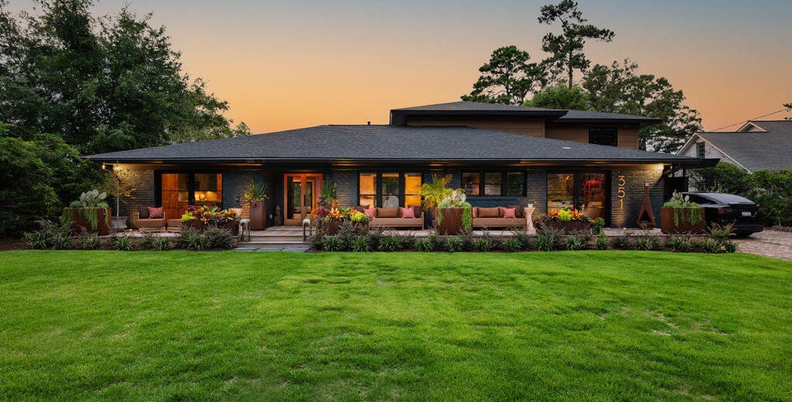
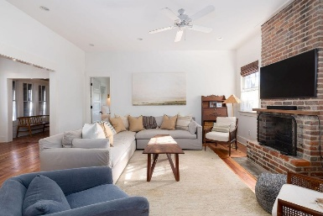
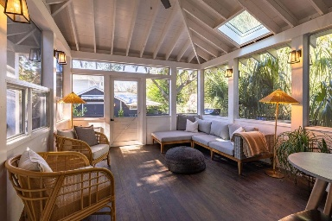
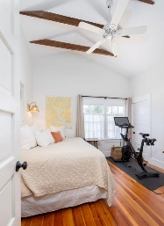
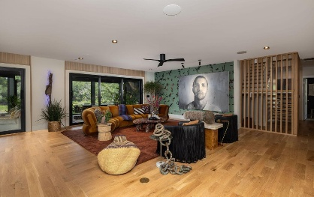
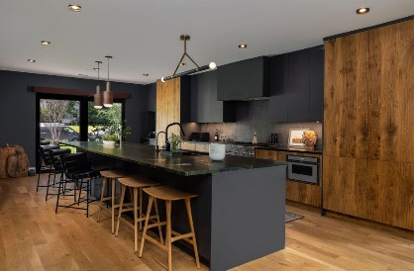
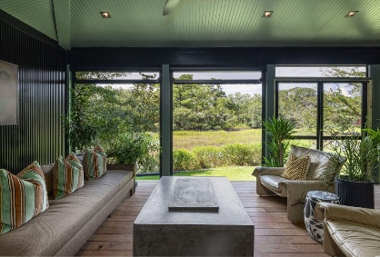
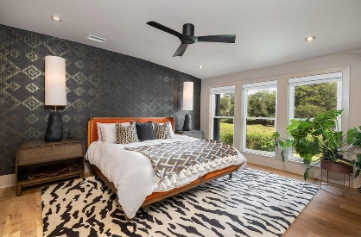

Seller Offering a $20,000 Bonus +2.5% BAC w/ Ratified Contract Before September 13th, 2025
351 W Confederate Circle
South Windermere | Charleston, SC 29407 | MLS# 25023982 | $2,975,000
Welcome to this one of a kind designer home being offered furnished! Located in the beloved neighborhood of South Windermere, this home has everything you could dream of - proximity to beaches, shops, & restaurants, an idyllic marsh view, mid-century modern architecture, and a contemporary design that perfectly blurs the lines between indoor & outdoor living. Upon entering the home through custom French doors, you'll immediately be welcomed by a large open floor plan and gorgeous hardwoods. You'll gaze ahead to the full sliding Euro Doors that lead you to the expansive porch. The chef's kitchen boasts a custom kitchen island with leathered quartzite countertops, and a tailor-made espresso cabinet with wine fridge. The entertaining area is picture perfect w/ panoramic views and a luxurious bar ready to host all of your friends. Step out onto the back screened-in porch for sweeping Lowcountry scenery, vaulted ceilings, and solar-powered retractable screens. Off of the large living space, you will find a cozy family room with a noise reduction wall that could easily transform into a home office or formal dining room. In your primary suite, enjoy the marsh views, a grand shower, and a custom walk-in closet locally designed by Inspired Closets. Downstairs you will find a second bedroom with French doors opening up to the front porch and a second full bathroom. Up the floating staircase you will find the third and fourth bedrooms, each with en-suite full bathrooms, spacious closets, and exceptional marshscape views. An upstairs laundry room has been added for convenience. This modern home is incredibly unique for the Charleston area. The marsh front lot is surrounded by both mature trees and stunning new landscaping equipped with lights & irrigation. The expansive front porch features Ipe decking with three large sets of French doors, perfect for letting in natural light or opening up to enjoy a cross breeze through the home. 351 Confederate Circle was designed for those who love modern architecture and bringing the outdoors in. Schedule your showing today!
Greg Gelber
843-494-2354
greg.gelber@agentownedrealty.com
Kelly Snyder
843-457-5951
kelly.snyder@agentownedrealty.com
AgentOwned Charleston Group | 902 Savannah Hwy | Charleston, SC 29407-7802

