Slide 1
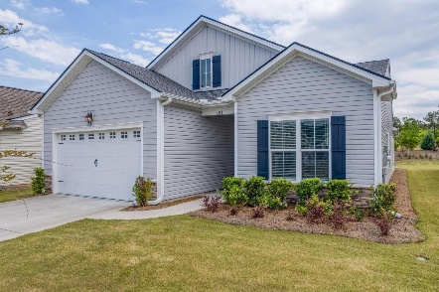

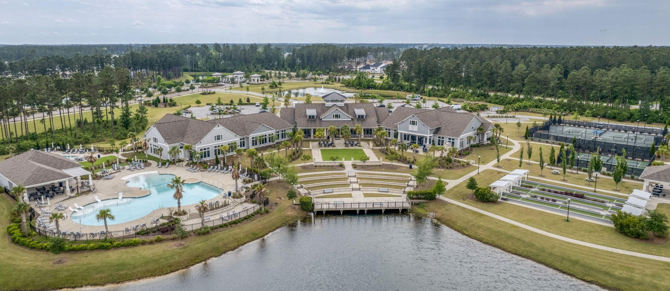
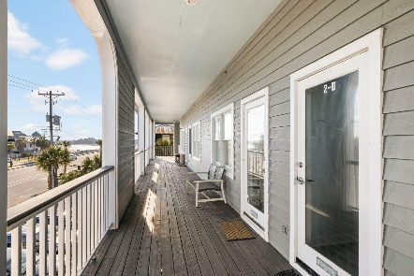
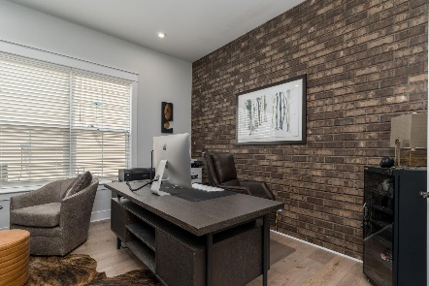
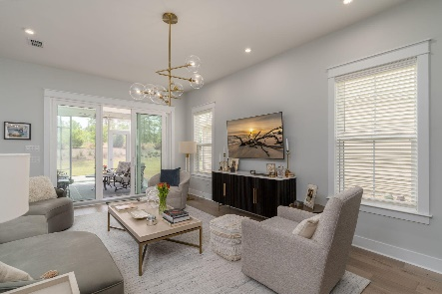
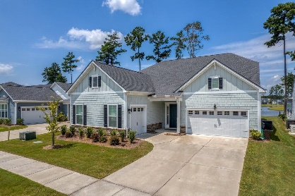
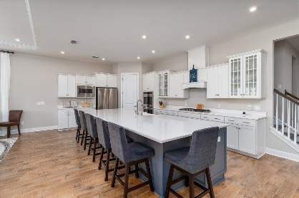
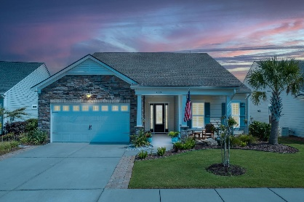
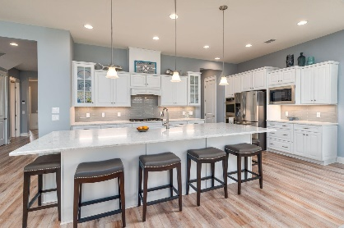
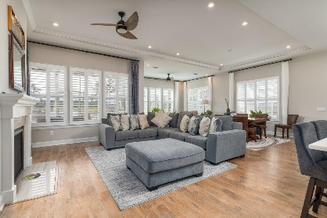
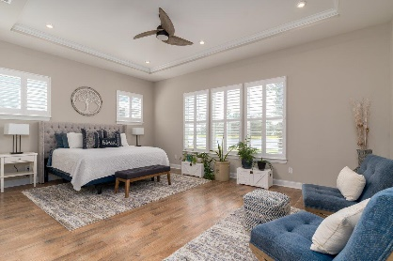
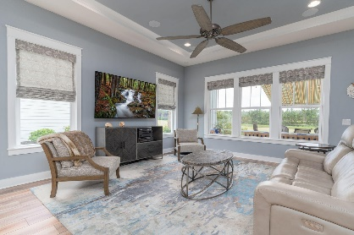
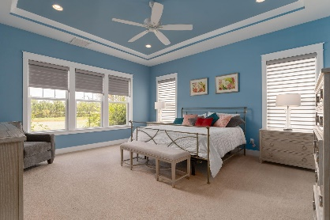
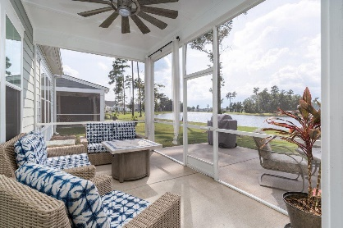
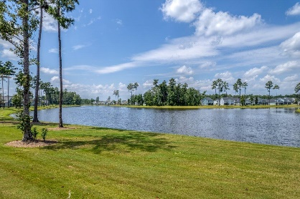
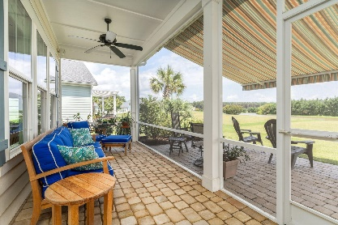
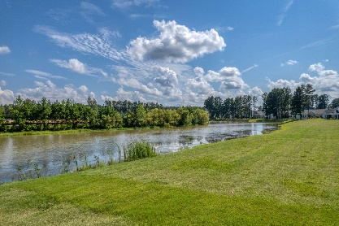
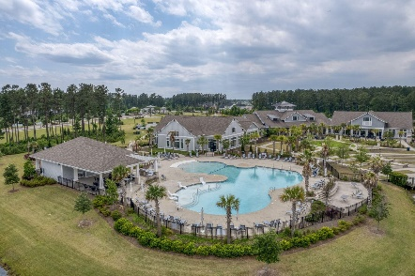
351 Tupelo Lake Drive
MLS# 23018801 | $779,000
Video Walkthrough
Darrell Creek Elevated Home With Elevator & Salt Pool
2 New Listings & Open House Extravaganza
in the Four Seasons
Saturday, August 19th from 11-2 PM
Co-sponsored by
Offering $3000
Lender Credit
Mimosas and Sweet Treats will be served. Door prizes for all and Grand Prizes at each house!
577 Tidewater Chase Ln
MLS# 23016976 | $749,000
Video Walkthrough
Take a Video Tour
Elissa Campbell
843-853-1433 | elissa.campbell@agentownedrealty.com
Lauren Parker
843-607-0971 | lauren.parker@agentownedrealty.com
AgentOwned Realty Preferred Group | 824 Johnnie Dodds Blvd | Mt Pleasant, SC 29464

