Slide 1
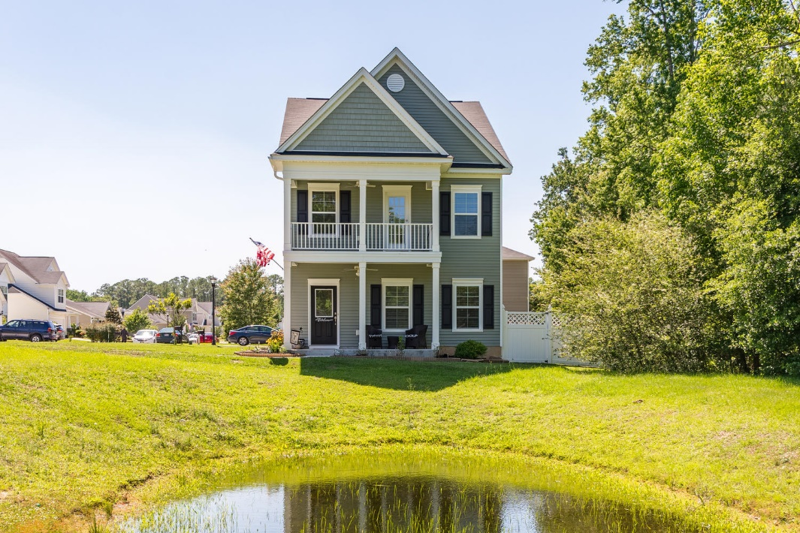
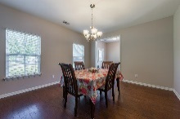
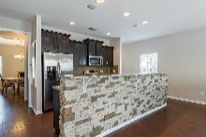
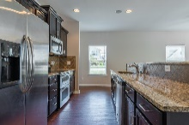
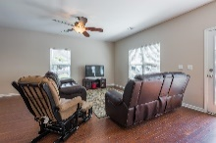
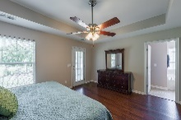
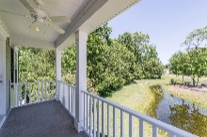
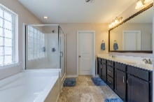
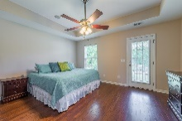
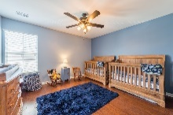
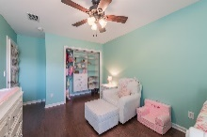
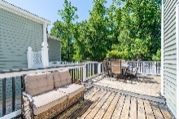
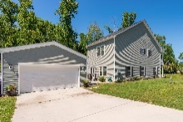
Price Reduced In Paddock Point
3522 Agape Court Ladson, SC 29456
MLS# 17013017 ~ $224,500
New Price on this Stunning Charleston-Style home with double porches and offers tons of curb appeal that is situated on a quaint homesite that backs up to a protected wooded area and overlooks a pond. This two-story home features three extra large bedrooms, two and a half baths, & formal dining room. On the first floor a gracious foyer and hallway leads to a huge great room that opens to the kitchen with a long raised breakfast bar and island. You'll find gorgeous hardwood floors throughout the home except for the bathrooms and laundry room upstairs . If you enjoy cooking, you will absolutely love this gourmet kitchen. The kitchen is appointed with many sophisticated features including beautiful granite countertops finished with a ceramic tile backsplash, staggered-height cabinets with 4" crown molding, GE Stainless Steel Appliances including double oven, & a very nice butler's pantry also finished with granite. There's also a music port with speakers offering distributed audio downstairs as well as the master bedroom with which you will find upstairs. The master suite is spacious and the luxurious master bath features a double vanity, separate garden tub and oversized shower, as well as a separate water closet, and a large walk-in closet. Off the master bedroom is also where you will find the upstairs porch that already is equipped with ceiling fan, providing the perfect place to relax after a long day. Upstairs is where you will also find two more spacious bedrooms that the owners have added features to the closets as well as a roomy laundry room with cabinets. This home truly has a lot of space to move around and really is the PERFECT home to entertain in or out on the large deck in the back that is surrounded by a 6 ft. Vinyl Fence. A detached two car garage completes this home. The home also has a Taexx in wall Pest Control System.
Bruce Miller
charlestownehomes@comcast.net | (843) 813-4591 | www.charlestonlifestyle.com
Brand Name Real Estate | 4 Carriage Lane, Suite 106 | Charleston, SC 29407

