Slide 1
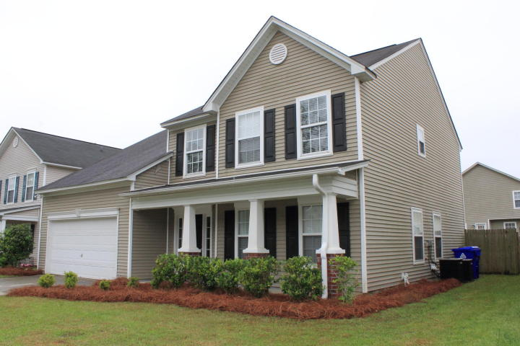
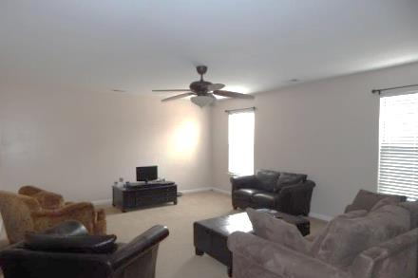
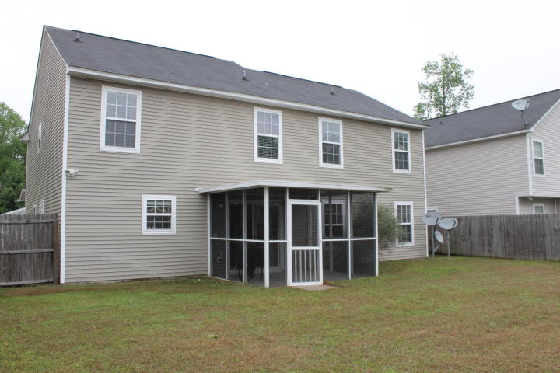
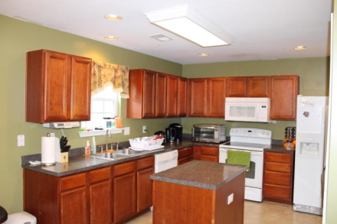
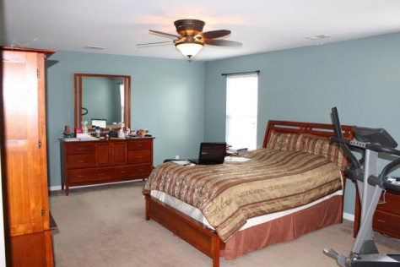
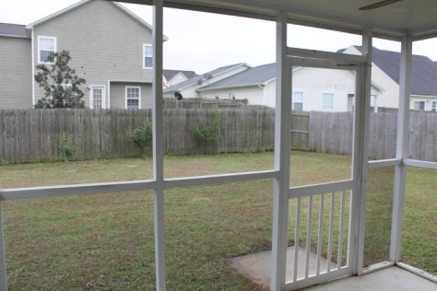
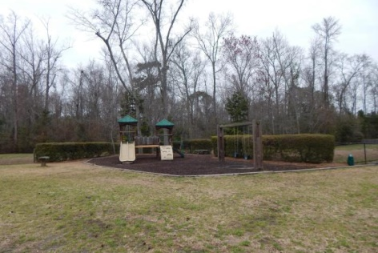
$15,000 Price Reduction!!! Motivated Seller!
3525 Agape Ct | Paddock Pointe | Ladson | MLS# 15004499 | $200,000
Welcome Home! As you enter this beautiful home you are met with stunning hardwood floors in the foyer and continue into the formal living and formal dining rooms. The bright, and airy living room offer plenty of space for comfort. The over-sized kitchen offers tons of cabinets a kitchen island and creates the perfect area to entertain. Upstairs you will find three surprisingly sizable secondary bedrooms and a hall bath. The Master Bedroom is strikingly large with lots of light and a ceiling fan. Master bathroom offers his and her sinks and a garden tub. Master closet is located in the bathroom leaving you more wall space for furniture in the bedroom. Enjoy the cozy screen porch overlooking the privately fenced backyard. Don't miss out on this well kept jewel!!
Jennifer Laffey-Foster, MRP
Real Estate Agent
Miler Properties
Office: 843-821-1111
Cell: 843-708-1582
jlfoster86@gmail.com
www.milerproperties.com

