Slide 1
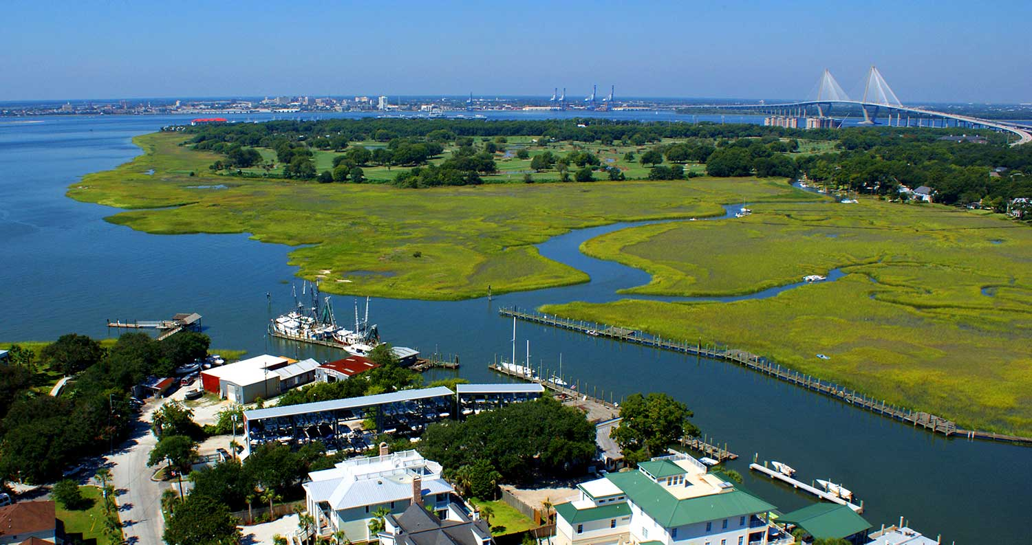

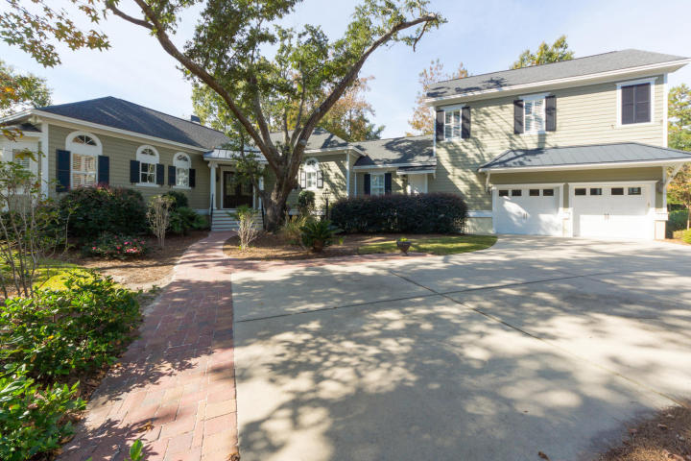
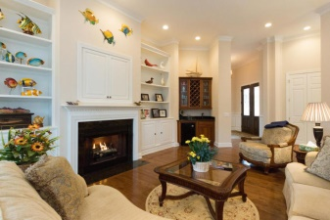
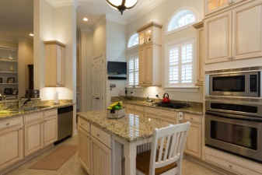
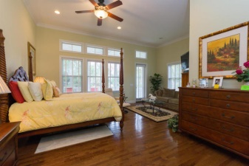
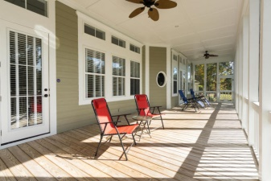
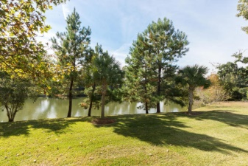

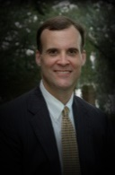
Custom Dream Home
3525 Henrietta Hartford Rd
Park West ~ Mount Pleasant
MLS# 14029452
$850,000
This one-of-a-kind, Katy McCarthy custom designed home is picture perfect inside & out. Nestled on a beautiful pond in the desirable Tennyson neighborhood of Park West, this incredible house wraps around a huge, stately live oak tree. Upon entering this well-designed 5 bedroom, 4 bath home, you are greeted with soaring 12' ceilings throughout most of the first level, hardwood floors and beautiful architectural detail. In the oversized family room, there are built-in cabinets & shelving, gas logs in the fireplace & a wet bar. The large gourmet kitchen has custom cabinets, granite countertops, an island with lots of storage, stainless appliances, a 4 burner gas cooktop, spacious pantry & gracious eat-in area for a sizable table & chairs. The formal dining room has a beautiful tray ceiling, wainscoting & french doors opening up into the family room. The generous master suite also has 12' ceilings, a sitting area and a large walk-in closet w/ custom shelving. The master bath has a jetted tub & huge walk-in shower. Also on the first floor is a nice size office, a laundry room with sink & cabinets and two additional bedrooms that share a full bath. Upstairs are two more bedrooms, a full bath and sitting area. Off the family room & master suite is an enormous screened porch that stretches along the backside of the house. From here you can enjoy peaceful time overlooking the pond or use it for entertaining family & friends. The two car garage has an epoxy floor and plenty of storage cabinets. Other features of this home include 8' solid doors, plantation shutters & wood blinds throughout, an alarm system & plenty of storage space. Since the owner has used it as a second home for many years & kept it well maintained, it looks like new. This home is definitely a must see! Tennyson Park is located just down the street....a great spot for the kids to play & family picnics. Park West offers amenities including swimming pools, hiking and biking trails, tennis courts and quick access to public schools, shopping and Town of Mount Pleasant recreational facilities.
Virtual Tour Available at
http://tours.listingsinmotion.com/271785?idx=1
Bill Barnhill
843-364-6903
bill@billbarnhill.com
496 Bramson Ct., Suite 200
Mount Pleasant, SC 29464

