Slide 1
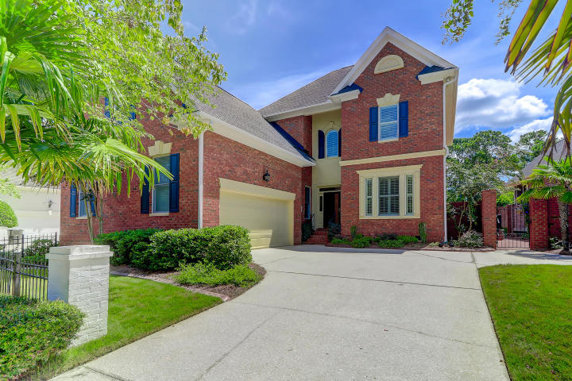
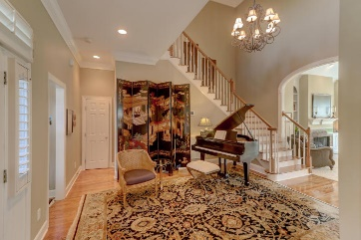
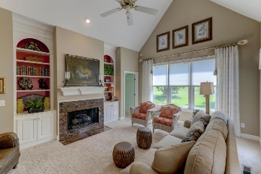
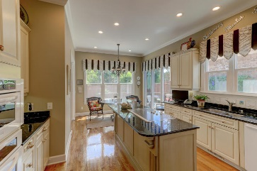
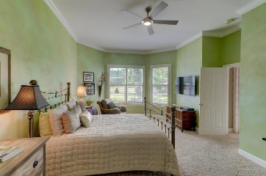
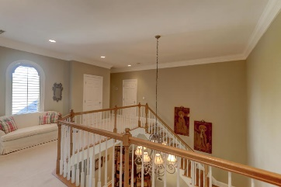
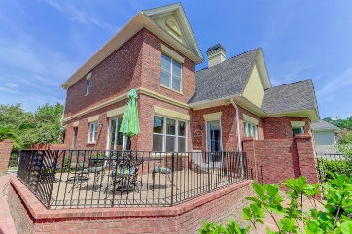
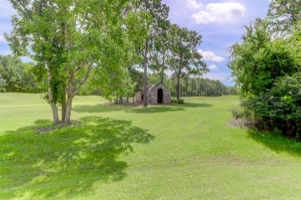


3527 Hartford Village Way
Dunes West ~ Mount Pleasant
MLS# 18024895 ~ $589,000
Perfection and Gorgeous In & Out
Master Down on Golf Course
Price Reduced ~ Seller Motivated
You will enter this 2 story brick home through a stunning, open foyer large enough for a baby grand piano and shows off views of a gorgeous open stairway, great room and dining room. The dining room features wainscoting, gorgeous crown molding and large enough for large gatherings. The very comfortable great room features a gas fire place with marble surround and beautiful built in bookcases with tons of light. The spacious, master bedroom is on the 1st floor and the master bath has a jetted tub, double vanities, and double closets. Anyone would enjoy this bright, opened eat-in kitchen with large windows and triple slider door surrounding the space. The granite counter tops and tile back splash, island and Kitchenaid appliances make an efficient and gorgeous kitchen.
Upstairs is a loft area perfect for an office or sitting room plus 2 more bedrooms, a huge FROG with private bath and another full bath. You and your guests will enjoy the golf course views and the beautiful upper and lower patio areas with rod iron railings and a brick wall enclosing much of the oversized patio space. 3527 Hartford Village Way is nestled within the subsection of Hartford Village just steps to the Club House and the only adult community pool in Dunes West. This is truly a spectacular, extremely well maintained home and one that will fit most any buyer's wish list.
Darlene Smith
Office - (843) 886-8110
Mobile - (843) 696-7824
darlenesmith@carolinaone.com
DarleneSmithTeam.com
Carolina One Real Estate
1503 Palm Blvd Ste
Isle of Palms, SC 29451

