Slide 1
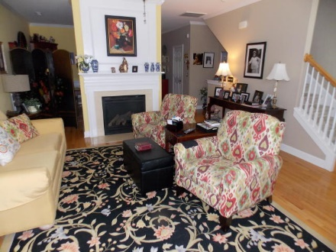
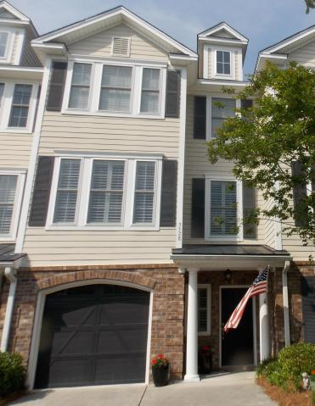
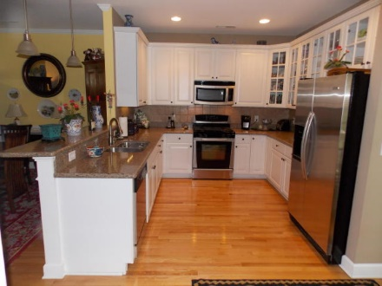
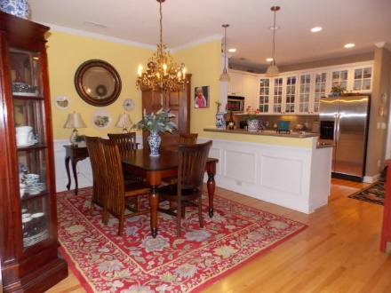
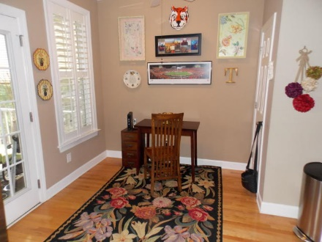
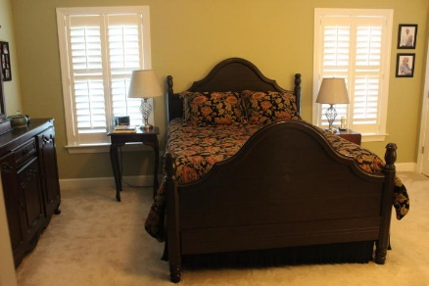
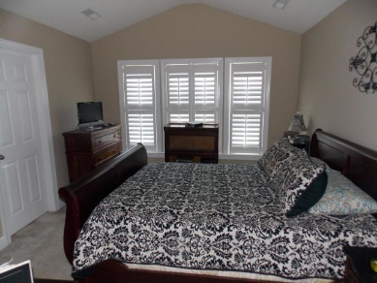
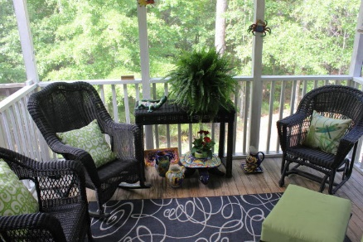
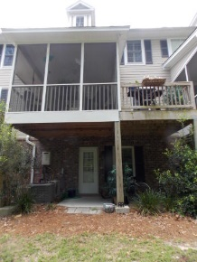

3528 Bagley Drive
Mount Pleasant · MLS# 17012511 · $365,000
Just Listed in Park West!
You need to see this upscale, roomy townhouse to appreciate the built-in quality and comfortable living style it offers. Living areas are on the 2nd floor with oak hardwoods throughout, a spacious family room, dining room and eat-in-kitchen with granite, glass-front cabinets and stainless appliances including gas range. All windows have plantation shutters on both upper levels. Just outside the kitchen is the screened porch and open deck. The next floor has a large master suite with separate shower and garden tub, his-and-hers closets and vaulted ceiling. Down the hall is the 2nd bedroom with private bath, vaulted ceiling and huge walk-in closet. The laundry room is also on this floor. Back on the ground floor is a 385 sq. ft. bonus room that has been professionally finished out and includes a split tandem HVAC unit of its own. There is a window and a door leading to the rear patio an back yard. This fun room has been used as guest bedroom on a regular basis and comes with an armoire installed in it for closet space - making it the 3rd bedroom. This is also a TV room for sports and kids' entertainment and even has room for a bumper pool table. In spite of this room taking part of the garage space there is adequate space in the one-car garage for a fridge and shelving in addition to a car. Plenty of driveway space just outside as well. The Park West pool and tennis courts/play areas are adjacent to Preston, so everyone just conveniently walks there. Park West also boasts walking/jogging trails all around and is convenient to plenty of shopping, schools and necessities. Town house living, with all the yard work done for you, can be yours with Preston at Park West. Take a look!
Lender paid closing costs of 0.50% of the loan amount, redeemable only at time of closing when financing is completed by the seller's preferred lender. Closing costs credit must be mentioned at application and may only be applied to offset actual costs.
Phil Tompkins
(843) 729-2693
phil@agentowned.com
AgentOwned Realty Co. Preferred Group, Inc.
824 Johnnie Dodds Blvd
Mt Pleasant, SC 29464

