Slide 1
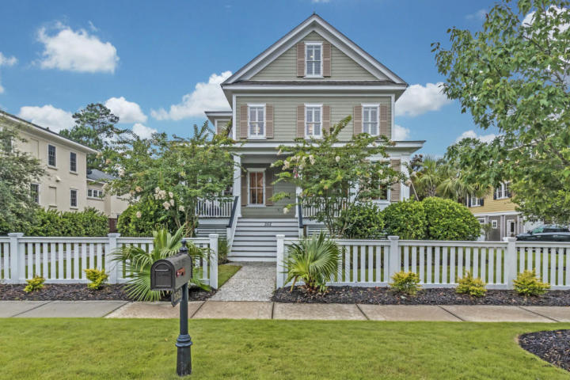
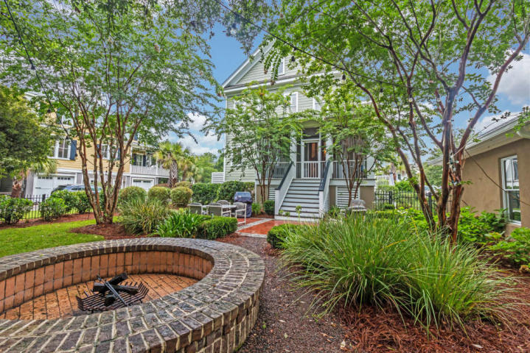
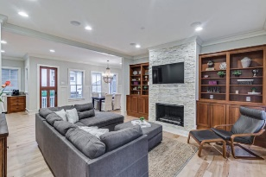
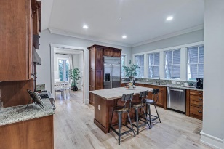
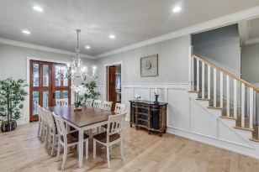
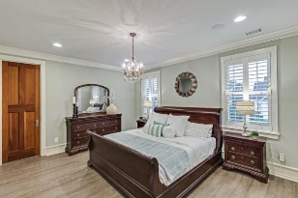
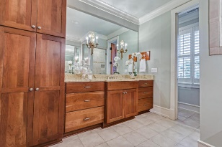
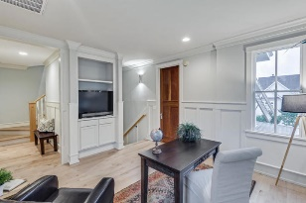
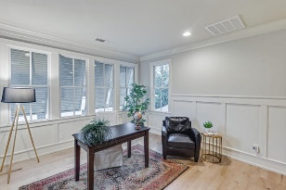
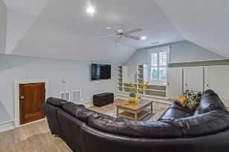
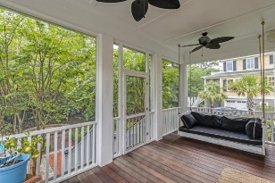
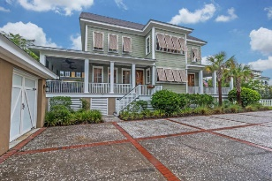


4 bed, 3.5 bath
Private Boatlift
Broker Open House!
Thursday September 21st | 10:00am-12:00pm
Tour this gorgeous lowcountry custom home, enter to win
a Yeti tumbler and gift card!
352 Evian Way
Belle Hall | Mount Pleasant | MLS# 17020238 | $930,000
"Evian" is Belle Hall's premier gated community.
This property exudes curb appeal and includes a desirable open floor plan loaded with custom features. Built in 2005 the home boasts many very recent updates including refinished hardwood floors, several bathroom renovations, new stone mantle and firebox, professionally landscaped yard and much more.
4 bedrooms
4½ baths
3,588 sqft
Crissy Rowell
Mobile - (843) 377-5177
crissy.rowell@carolinaone.com
www.crissyrowell.com
Carolina One Real Estate | 195 W Coleman Blvd | Mt Pleasant, SC 29464

