Slide 1
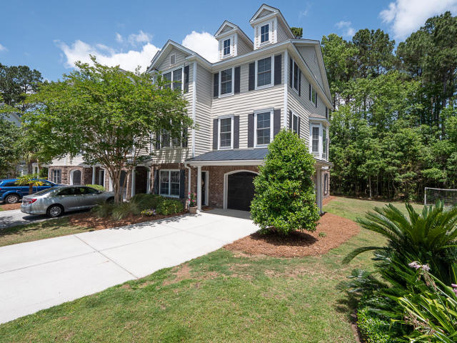
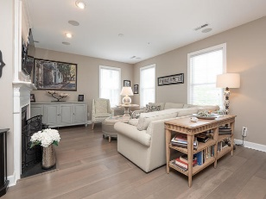
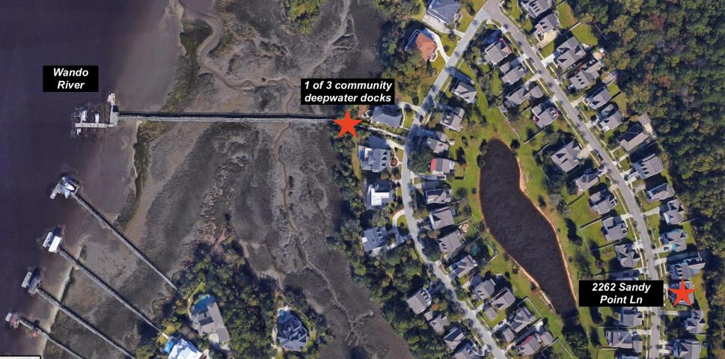
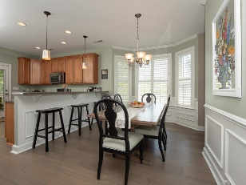
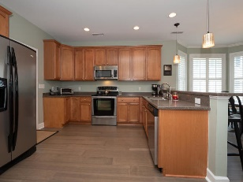
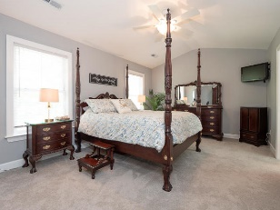
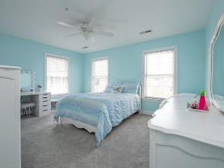
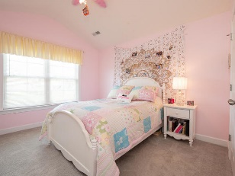
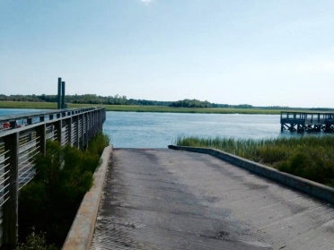
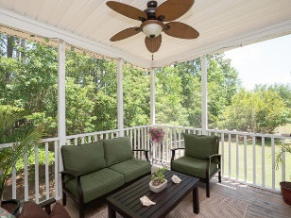
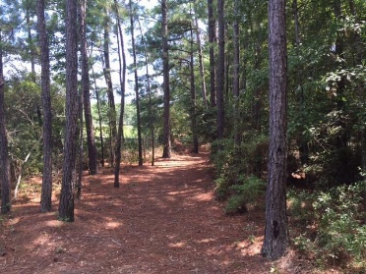
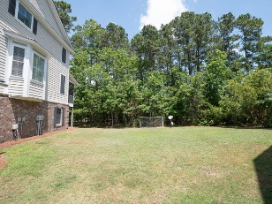
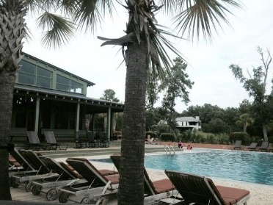


3532 Bagley Dr
Preston @ Park West | Mount Pleasant
MLS# 19014182 | $375,000
If you are looking to be in a neighborhood with a great family community feel and Wando River sunset views...then this is the place! Rivertowne on the Wando offers many amenities similar to other local neighborhoods, like pools, tennis courts, and green space...but what those others are missing is the river! With 3 community docks on deepwater Wando River, there's no shortage of crabbing, fishing, boating activity here! Another great feature, Rivertowne on the Wando is zoned for award-winning schools (including Laing, the #1 STEM middle school in the country)! And only a short distance to downtown Charleston, Isle of Palms and Sullivan's Island beaches, town recreation center/fields, medical facilities, dining and shopping, you're close to everything you need! Come see for yourself!
Over 2500 SqFt End Unit
Right Next to Park West Amenities
4 bedrooms
2.5 bathrooms
2629 sqft
Upgraded detailing such as crown molding and wainscoting in the dining room
Wood flooring throughout the entire home (including all of the bedrooms)
Contemporary ceiling fan in the family room
Decorative backsplash and pendant lighting in the kitchen
Kitchen also includes granite countertops, a full set of stainless steel appliances (including a Samsung refrigerator), solid wood cabinetry and additional storage in the full pantry
The eat-in kitchen and family room have plenty of space to entertain, but continue outside onto the large deck and brick fire pit area if you need more!
2552 sqft
4 Bed / 3 Bath
Move-in Ready
All new flooring throughout
Stainless steel appliances & granite countertops in kitchen
Updated and stylish
Large lot with outside space
Oversized garage for 2-cars plus extras like golf cart, kayaks, etc.
FOR MORE INFO CALL 843.810.8824
Kris Higman
(843) 810-8824
kris.higman@cbcarolinas.com
www.CharlestonHomesByKris.com
Coldwell Banker Residential Brokerage | 1127 Queensborough Blvd. 103 | Mt Pleasant, SC 29464

