Slide 1
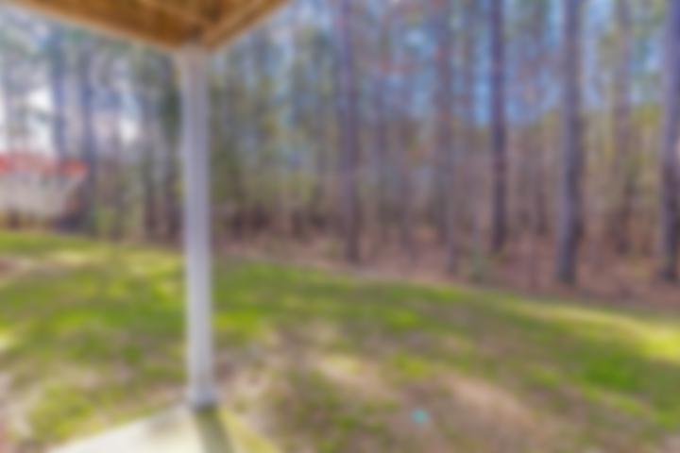
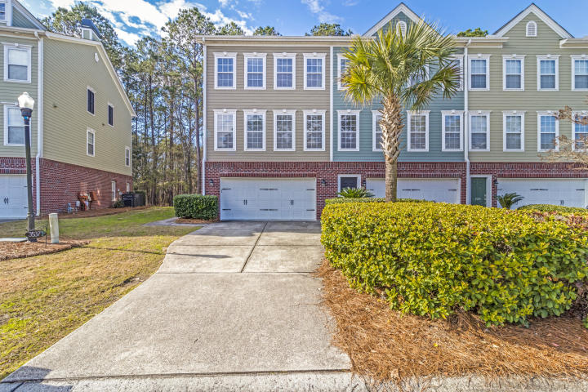
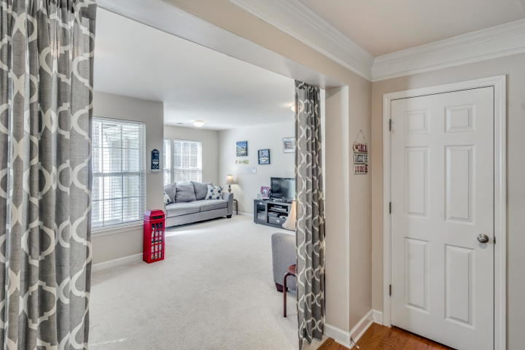
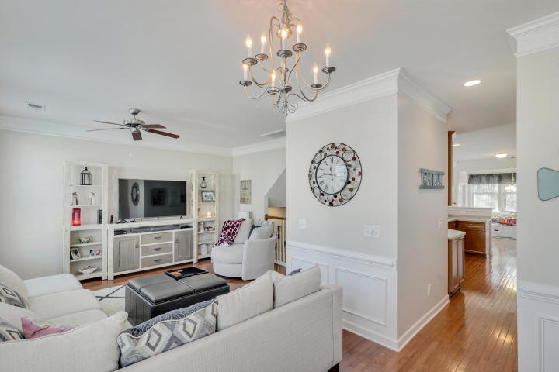
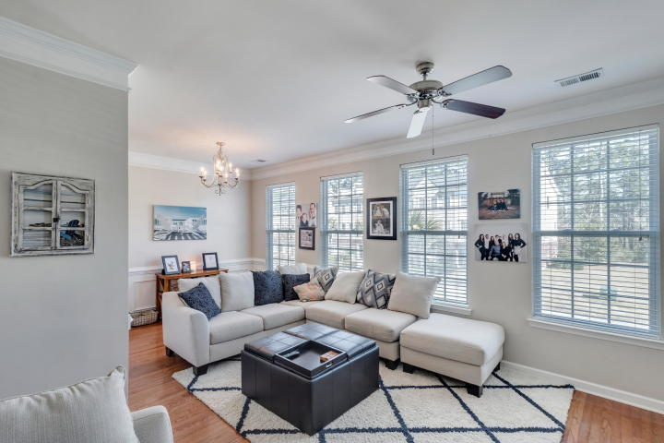
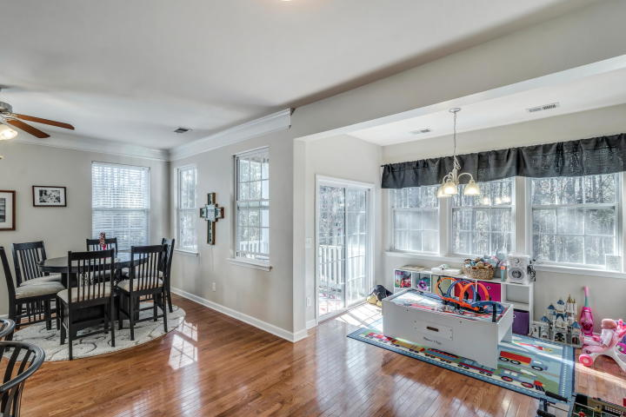
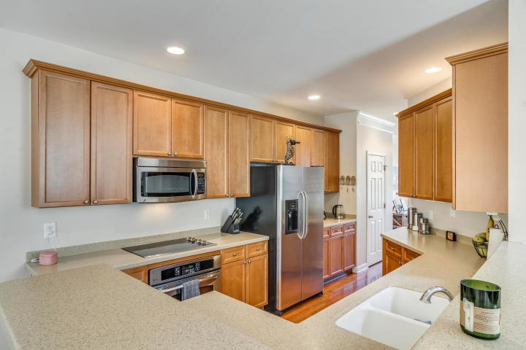
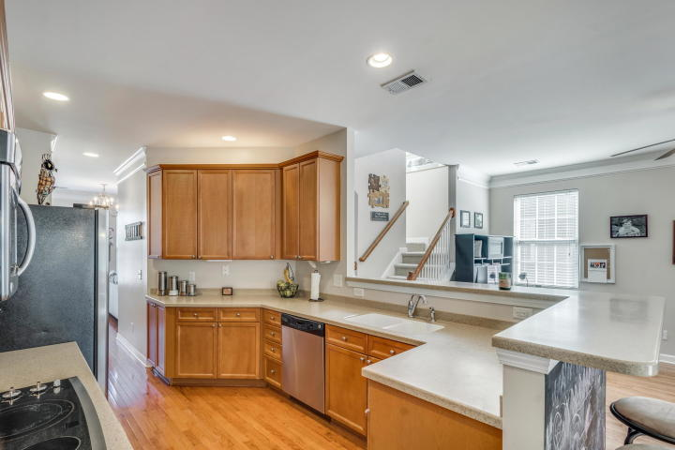
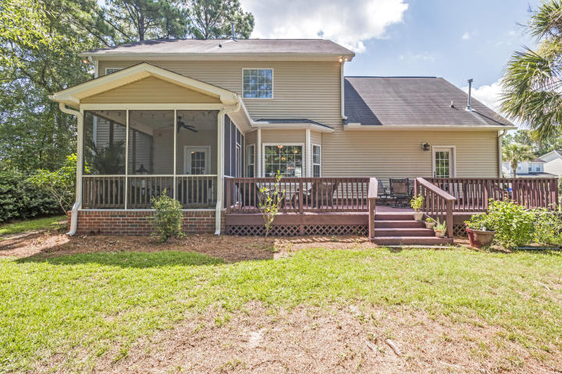
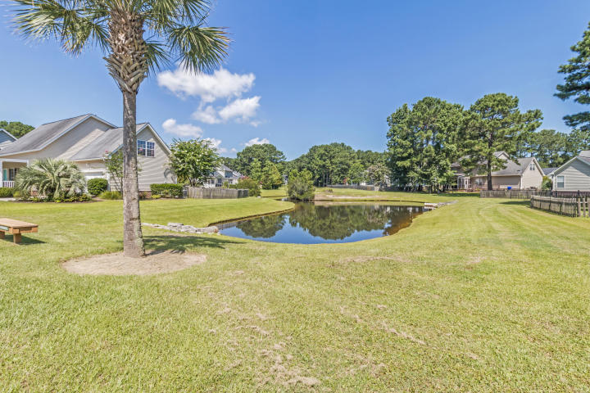
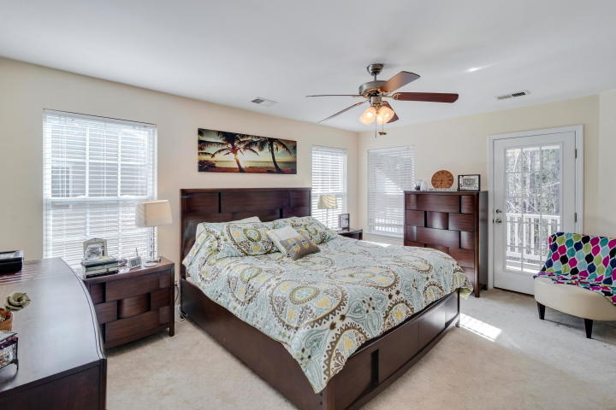
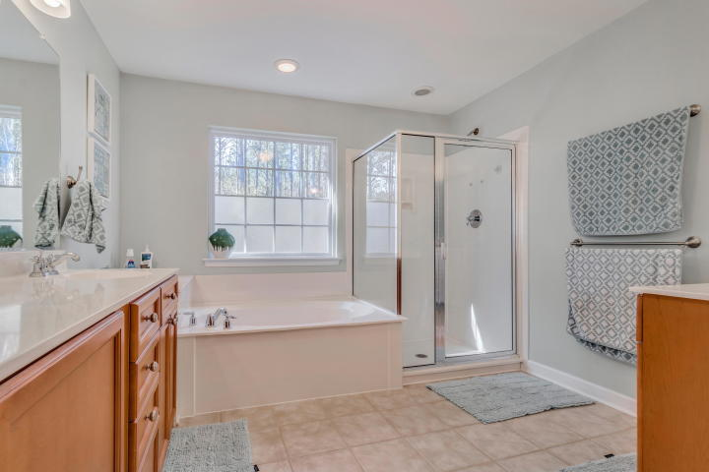
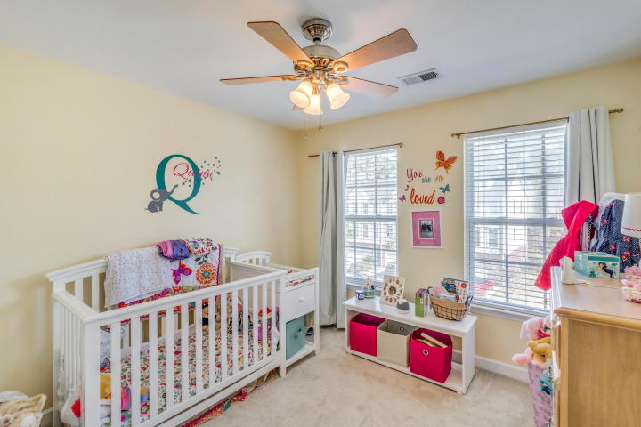
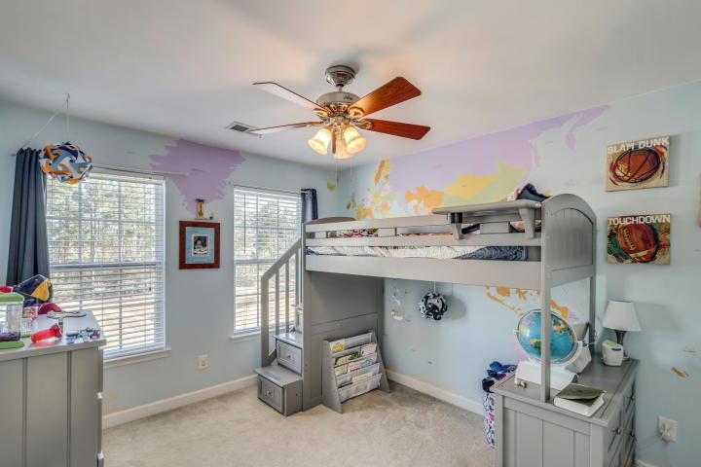
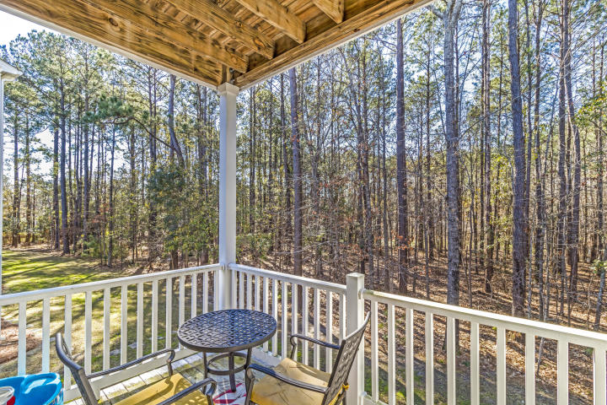
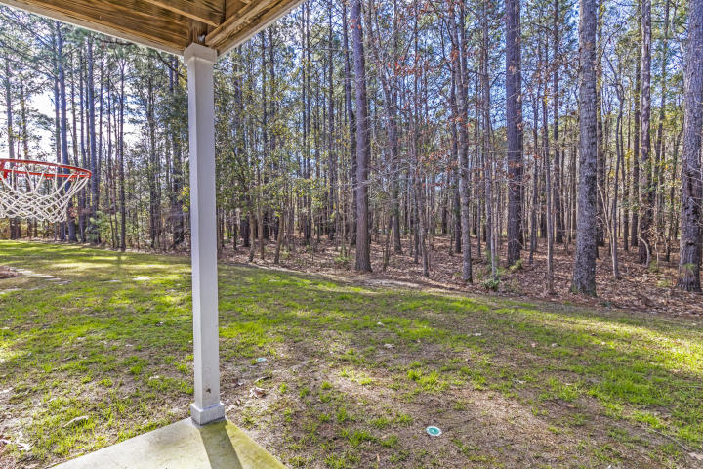
Great End Unit And Only $125/SqFt
Seller
Motivated!
3537 Claremont Street
Park West | Mount Pleasant, SC 29466 | MLS# 19002908 | $309,900
Side private entry also backing up to the woods! This spacious unit has a downstairs flex space with a half bath that is NOT behind the 2 car garage as seen in the interior units. Great feature, as in most of the townhomes, this space is usually only accessible by walking through the garage. Beautiful open unit that flows nicely throughout the home. The 2nd floor features wood floors, lots of windows for natural lighting and includes a large kitchen that is open to an eat-in area, dining room, family room, study, half bath, and a deck that offers a great view of the trees in the back of the home. The 3rd floor has a large master bedroom with a walk-in closet, a private deck, and a master bath that includes a garden tub, dual vanities, and a walk-in shower area. This floor also includes two more bedrooms, a full bath, and a laundry room. THIS IS ALSO A FABULOUS INVESTMENT OPPORTUNITY! The rental potential for these end units can run up to $2400/month. Don't miss out on this great price in Mount Pleasant! This home is vacant and is ready for a quick move in. Come enjoy all the great amenities Park West has to offer including bike and walking paths, 2 swimming pools, clubhouse, tennis courts, playground, and volleyball!
Catherine Parker
843-814-0551 | catherine@cpreco.com | www.cpreco.com
Carolina Places Real Estate Co. | 1000 Johnnie Dodds Blvd, Ste 303 | Mt. Pleasant, SC 29464

