Slide 1
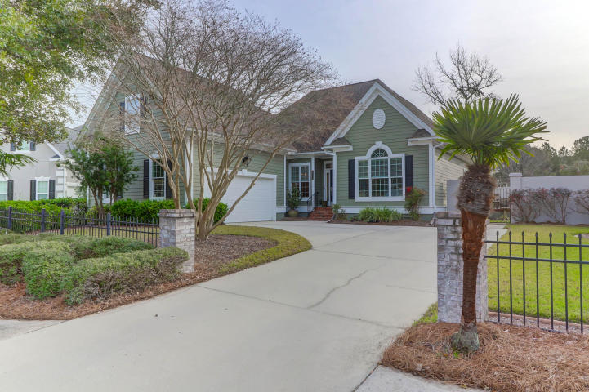
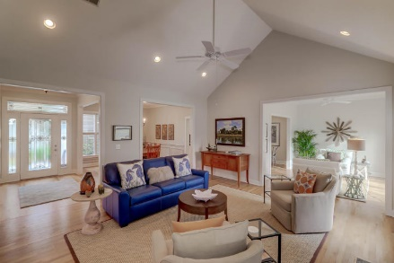
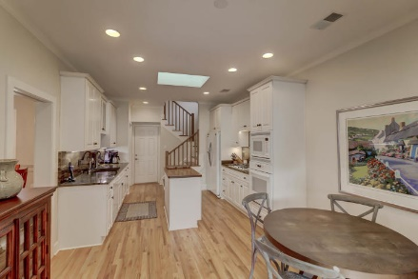
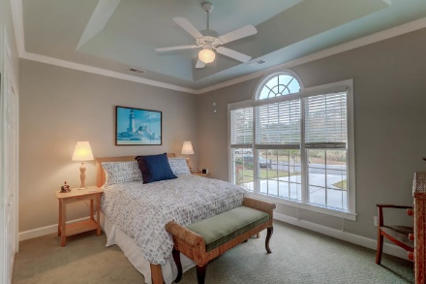
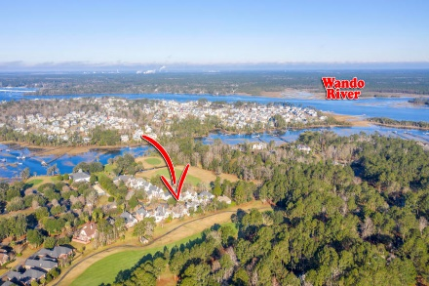


3537 Hartford Village Way Dunes West | Mount Pleasant, SC 29466 | MLS# 20002237 | $549,000
Beautiful One Story
Hartford Village of Dunes West
MOTIVATED SELLER!! REDUCED 150K!
Welcome to Hartford Village within Dunes West. This quiet cul-de-sac and sought after neighborhood is within walking distance to the Hartford Village adult community pool, golf, tennis and clubhouse. Outdoor living and entertaining with multiple patios, 1st fairway golf course views and a lovely sun room are just a few of the attractive features. Custom cabinetry, stunning master suite, and gourmet kitchen will speak to the most discriminating buyer. The first floor master suite, study and frog offer this home flexible space and ample storage throughout.
3537 Hartford Village Way is truly Stunning and Immaculate.
Darlene Smith Office - (843) 886-8110
Mobile - (843) 696-7824
darlenesmith@carolinaone.com
DarleneSmithTeam.com
Carolina One Real Estate
1503 Palm Blvd Ste
Isle of Palms, SC 29451

