Slide 1
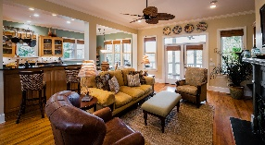
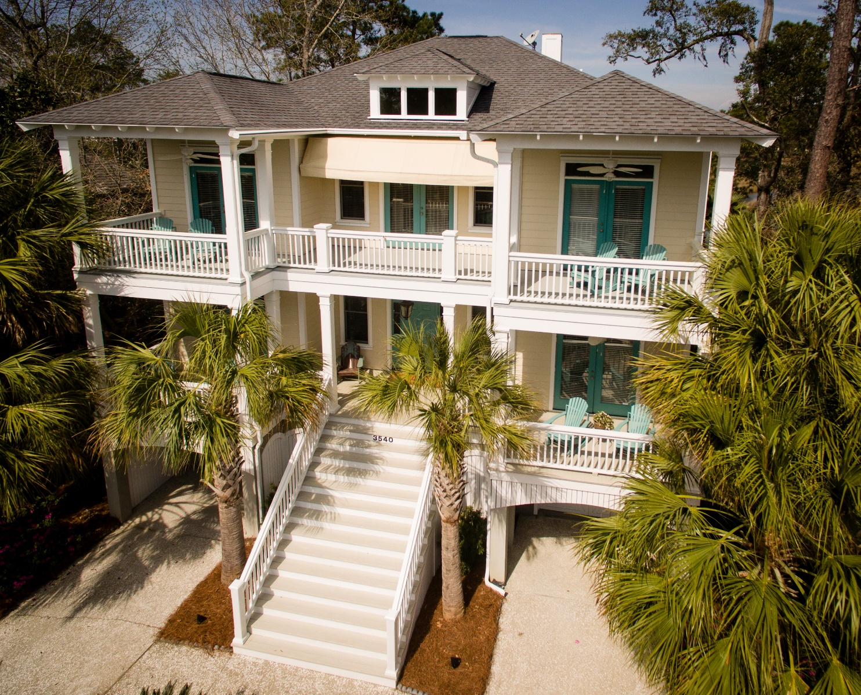
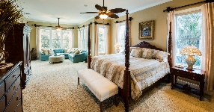
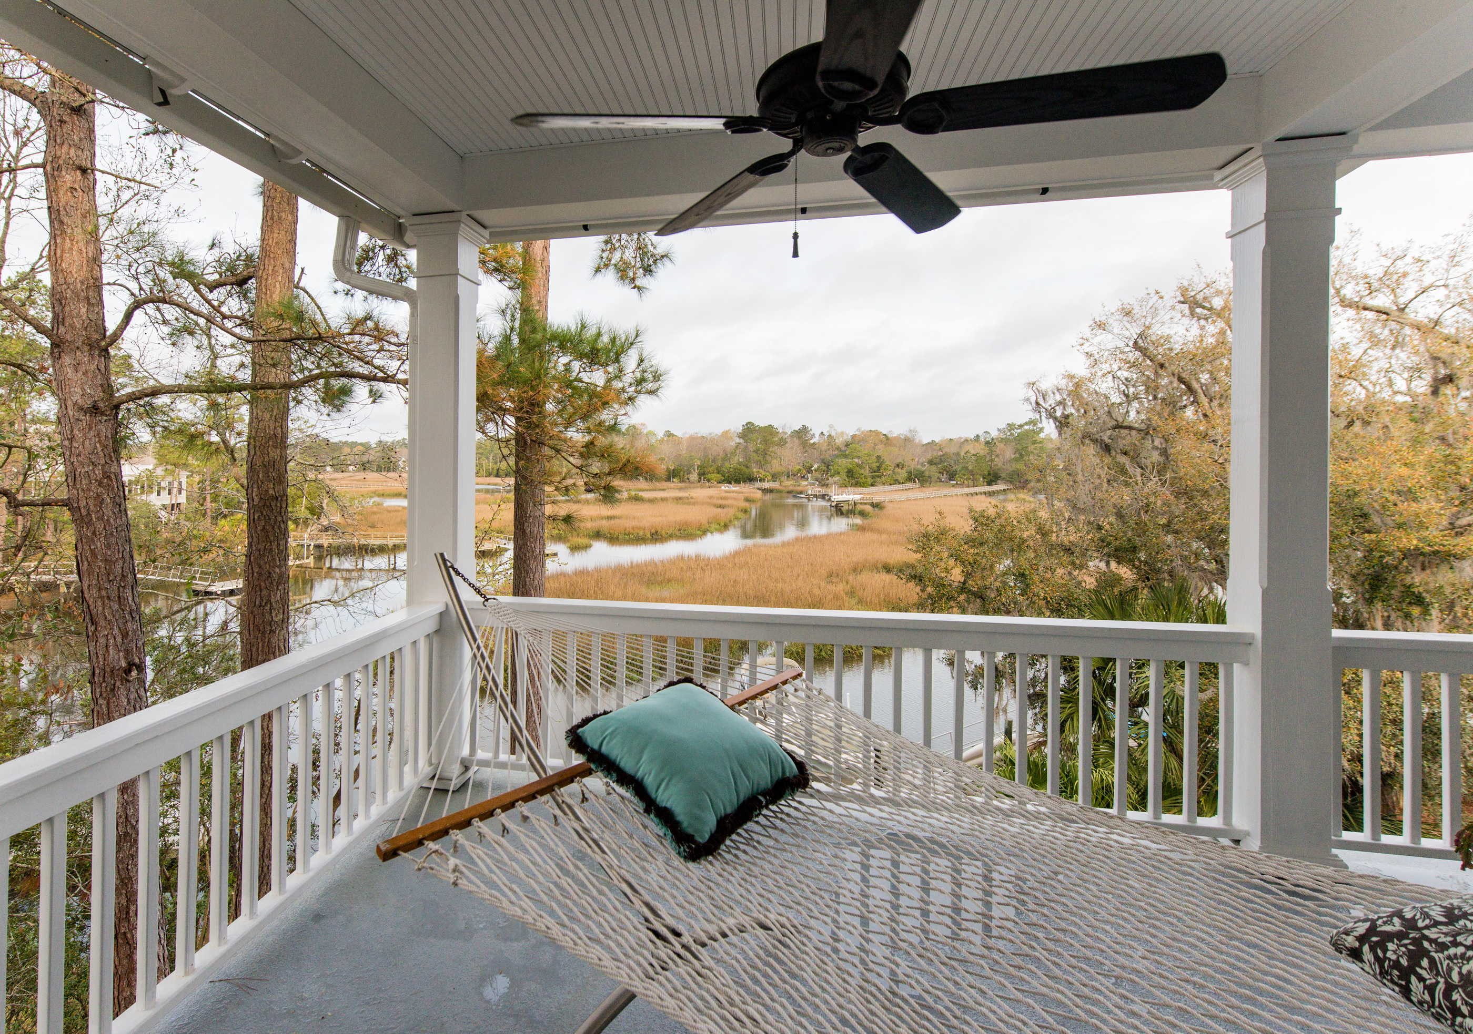
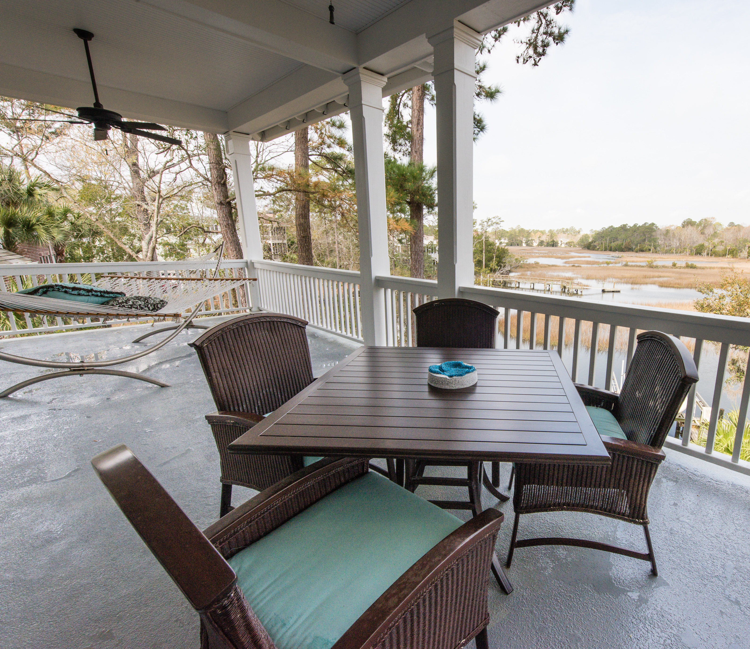
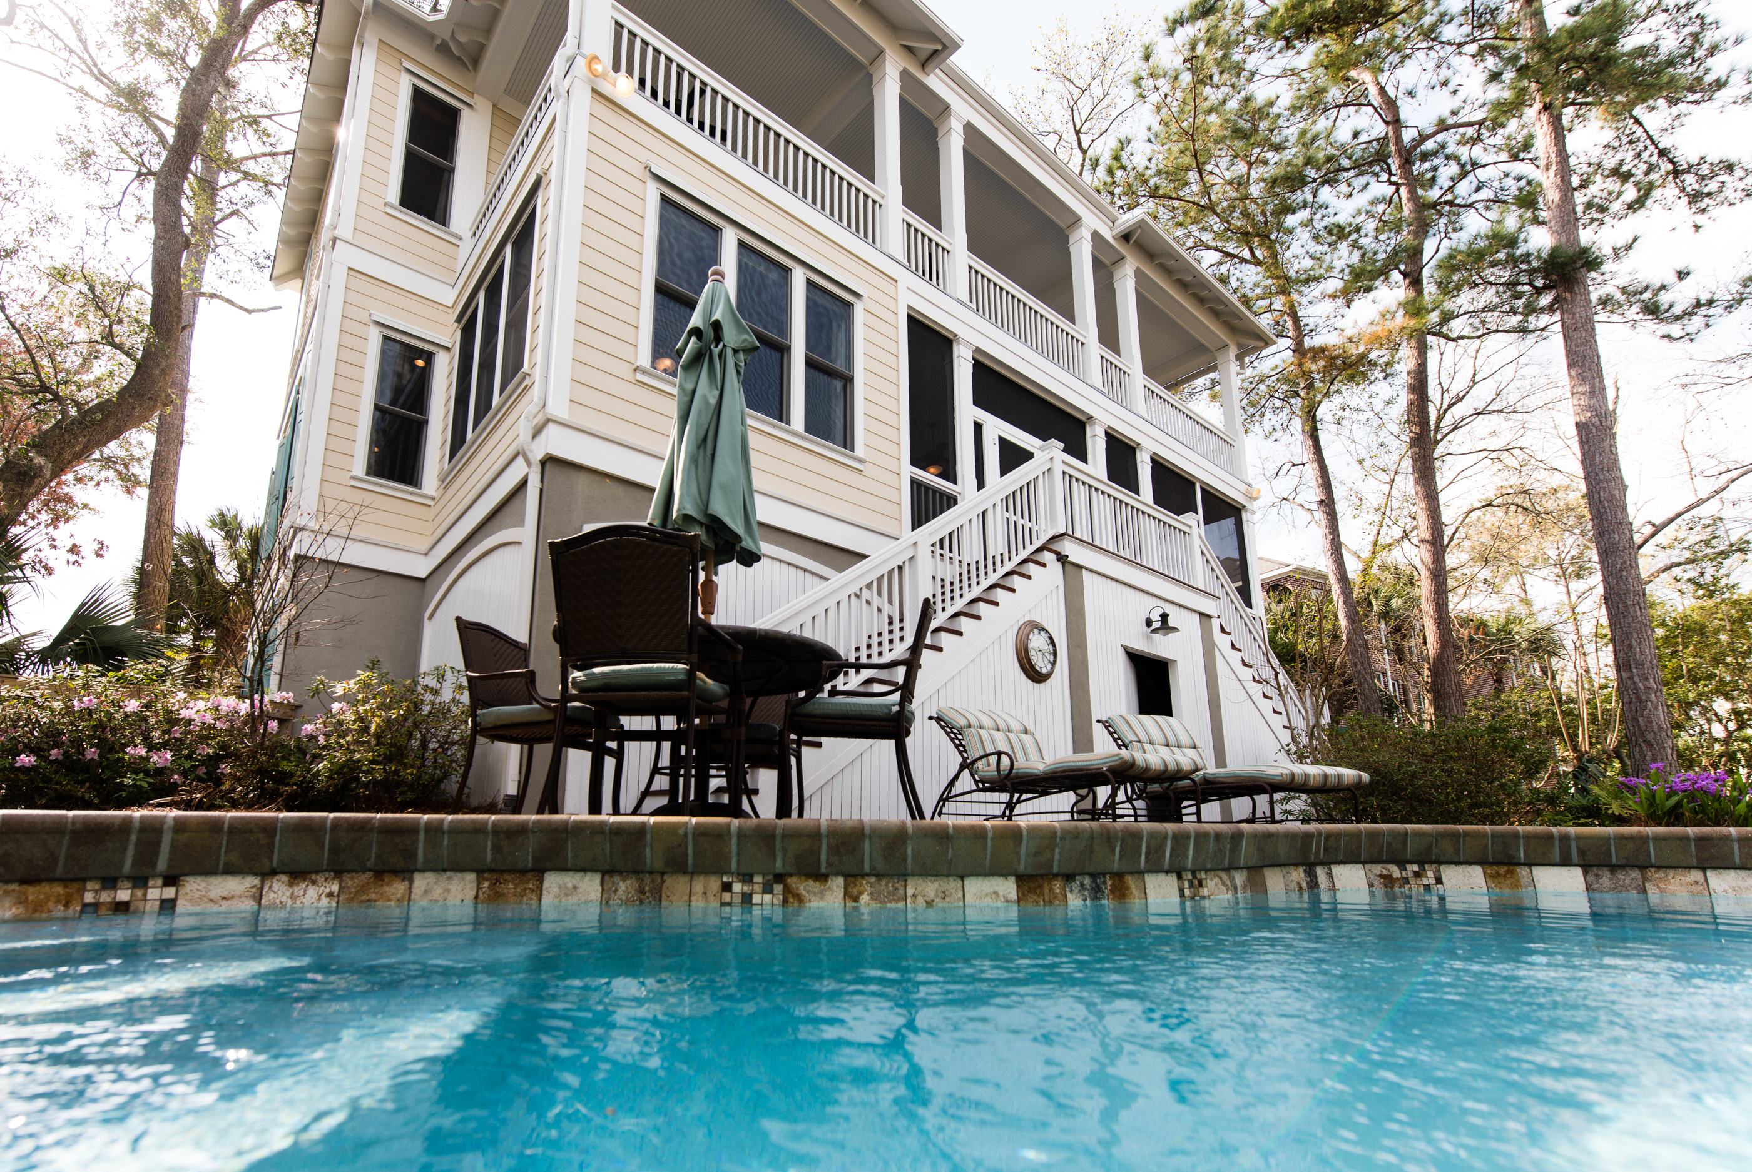
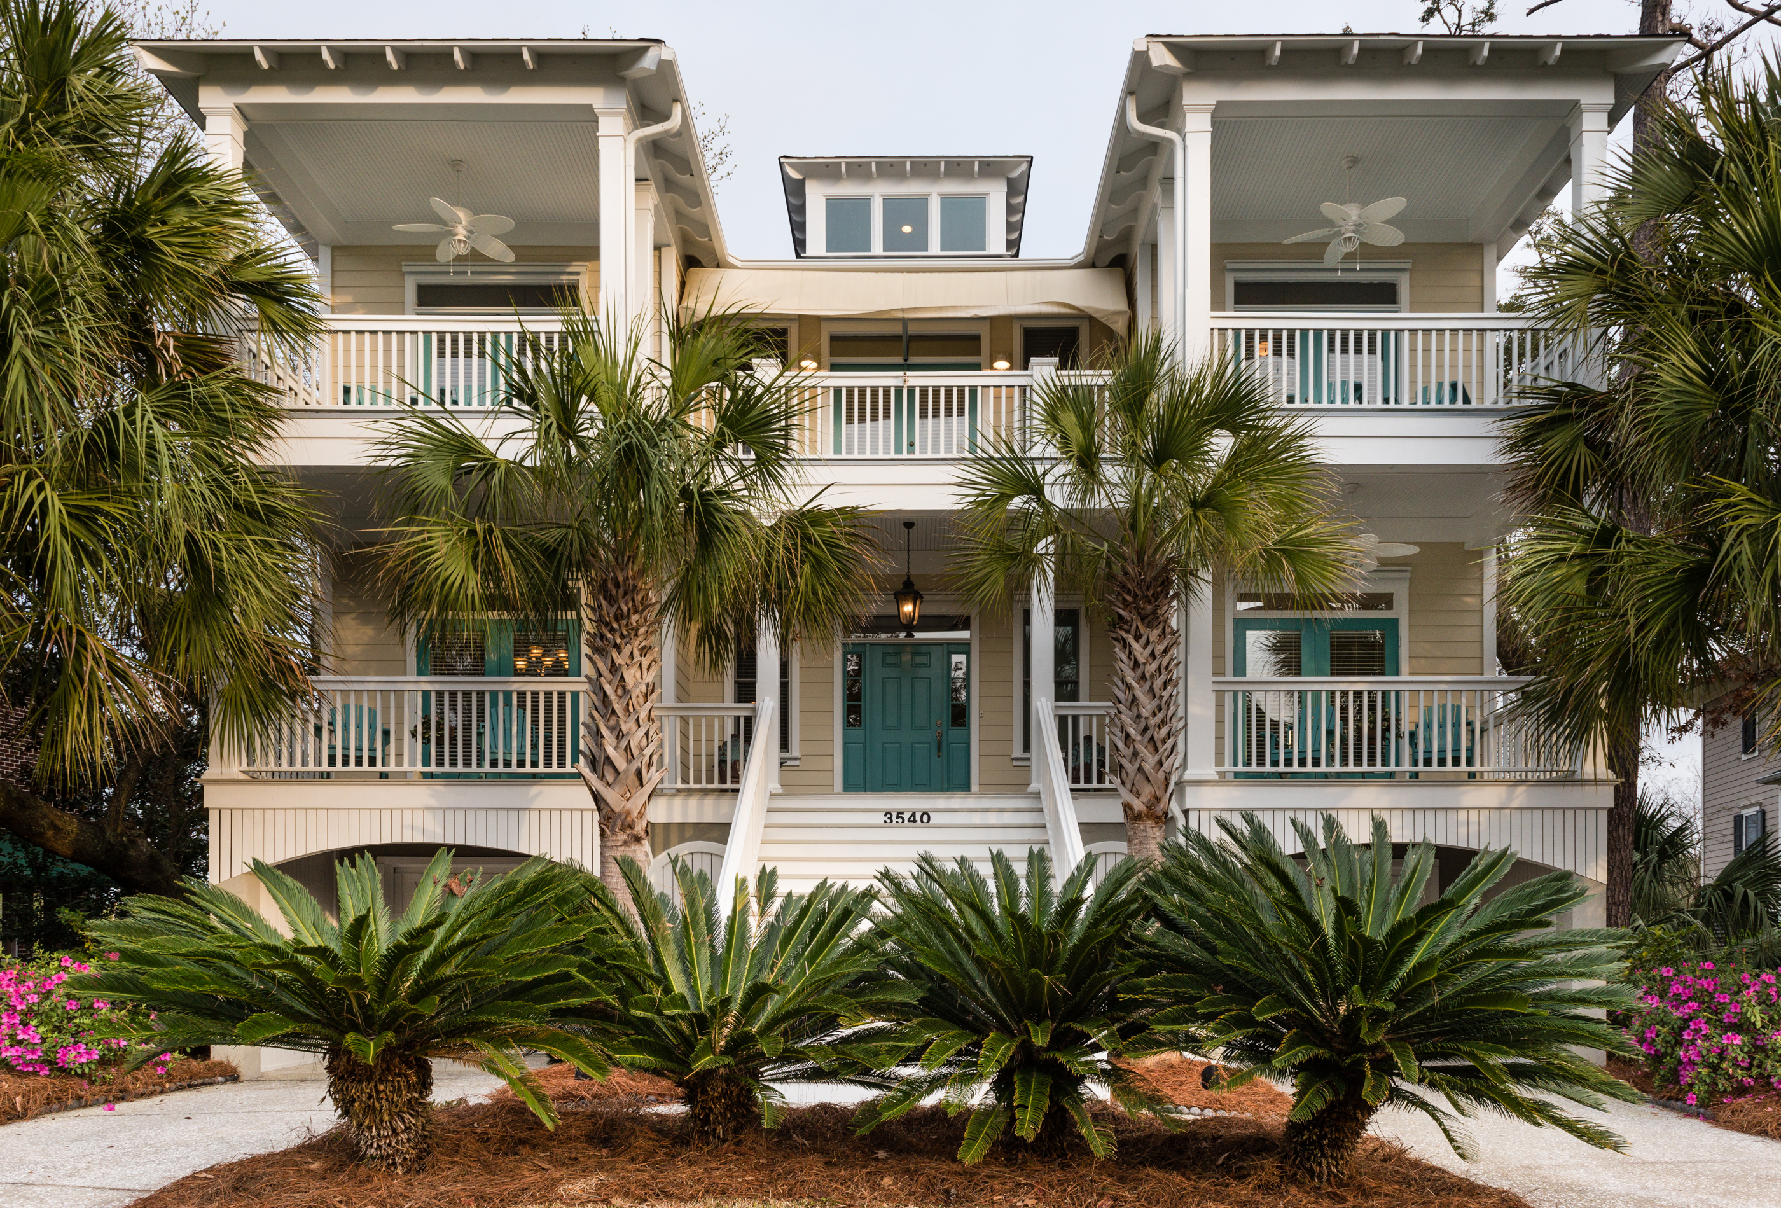
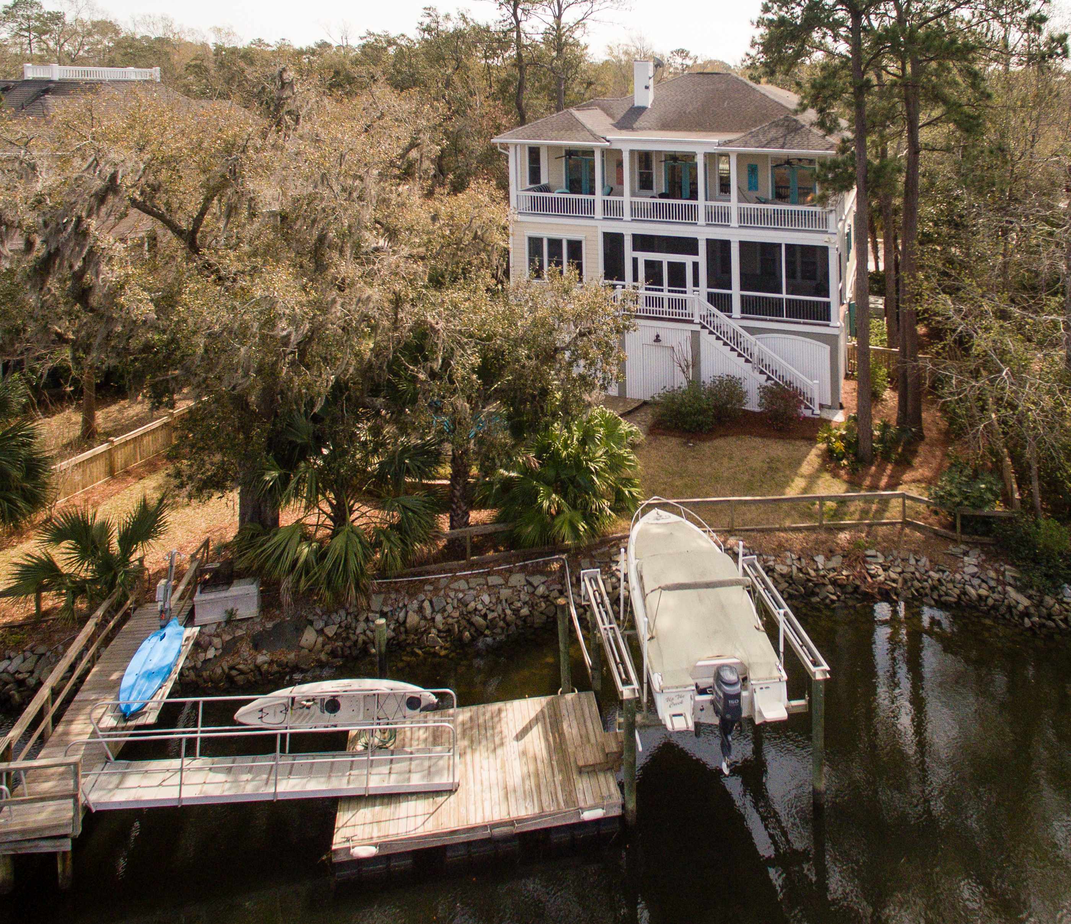
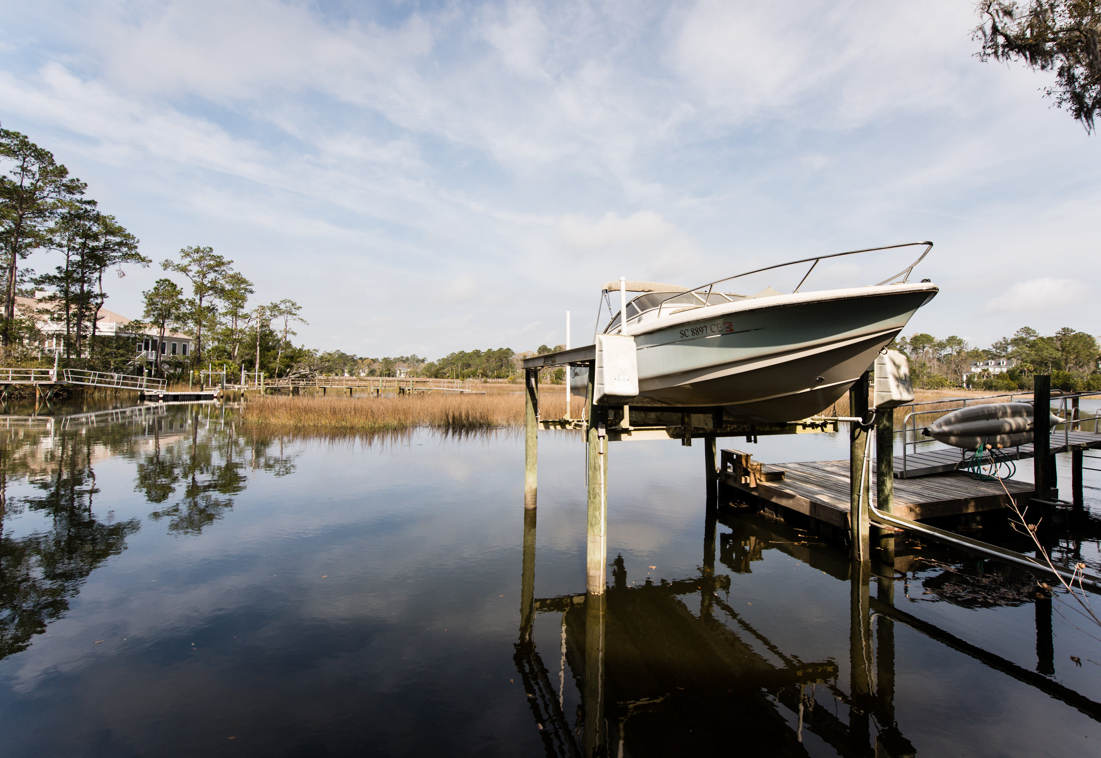


3540 Henrietta Hartford Road Park West :: Mount Pleasant :: MLS# 17005917
Waterfront Paradise
$1,250,000
If you are searching for your own waterfront paradise, look no further! You can fish, boat, kayak, swim, cast your shrimp net, paddle board, or just relax and soak up the serenity. Indoor features a Master Suite on the main level with a spacious sitting area, French doors, and numerous windows overlooking the creek. The Master Bath was recently renovated. The Kitchen is loaded with fine appliances, Glass Front Cabinets, Travertine Backsplash, and Walk-In Pantry. Three Guest Rooms each with their own Bath, an Office, and Huge Game/Flex space Room overlooking the Marsh. And did I mention the amazing Sunset view from over 1500 Sqft of Charleston Style Porches? This home has Windows, French Doors, and Porches galore to enjoy the gorgeous views afforded by creek side living.
Welcome to Paradise!
Wendy Arnsdorff
843-364-8619 – M :: 843-284-1800 – O
wendy.arnsdorff@carolinaone.com www.wendyarnsdorff.com
Carolina One Real Estate :: Mt. Pleasant North Office :: 2713 N Highway 17 :: Mt. Pleasant, SC 29466

