Slide 1
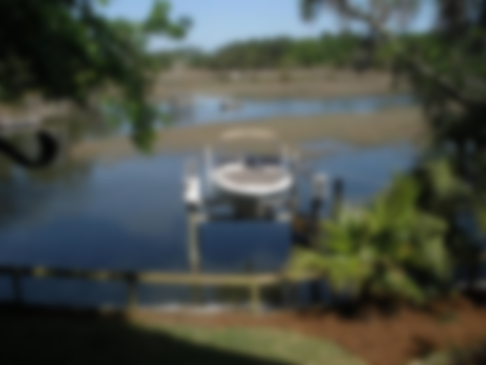
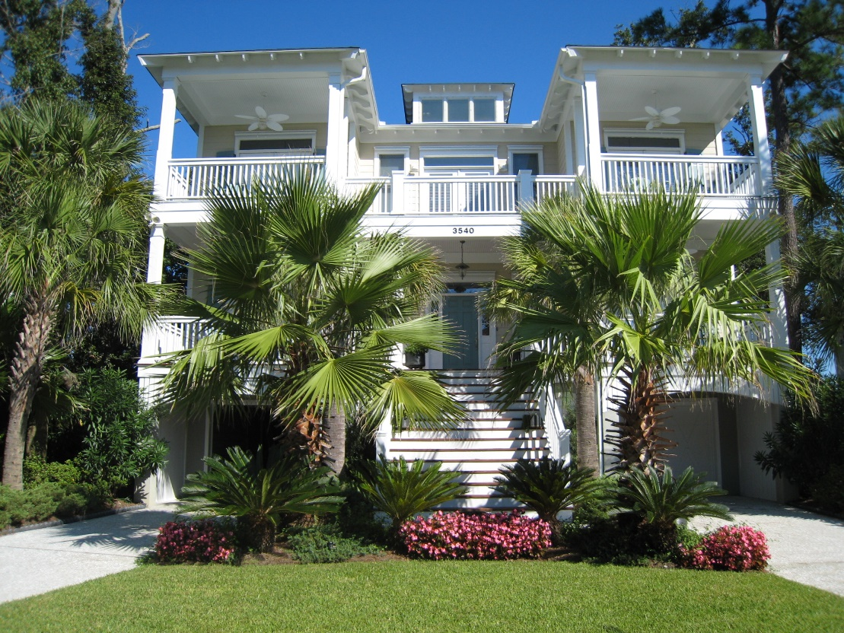
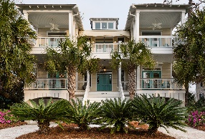
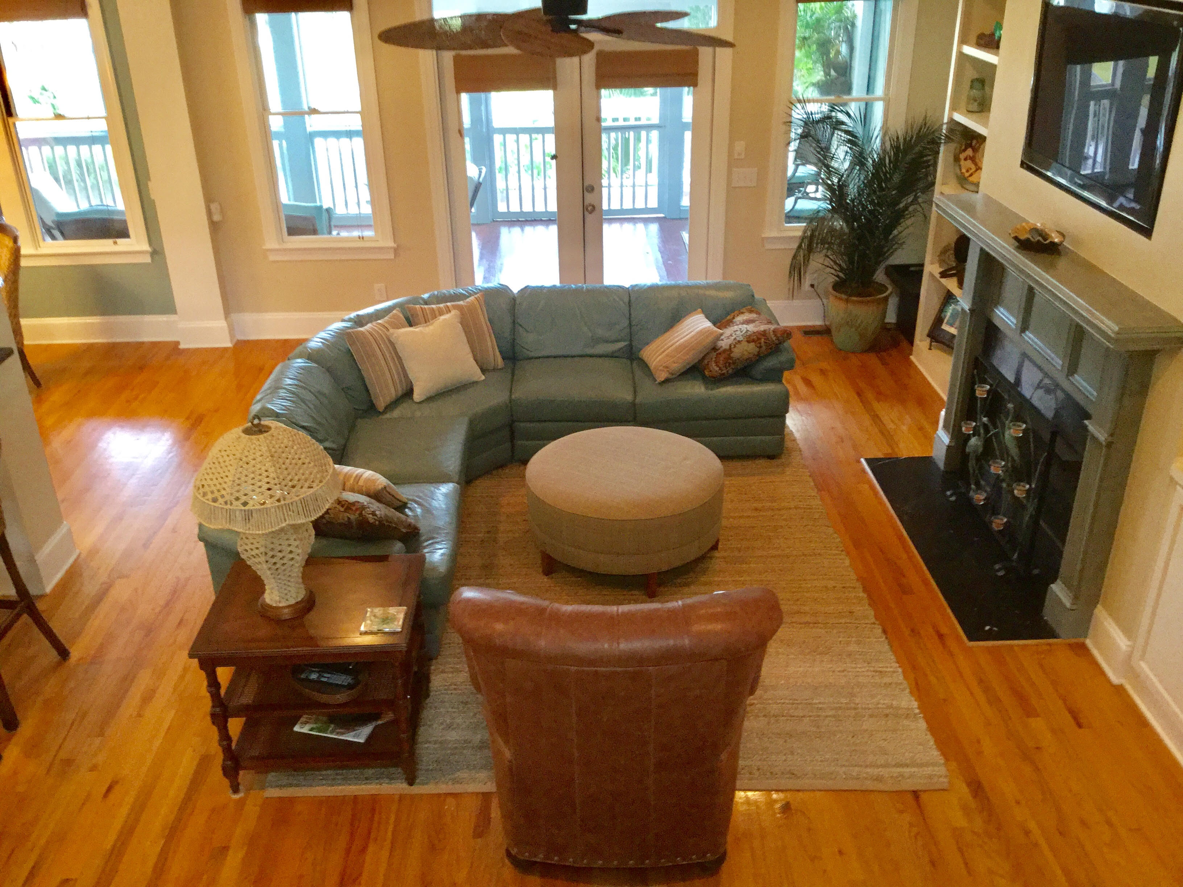
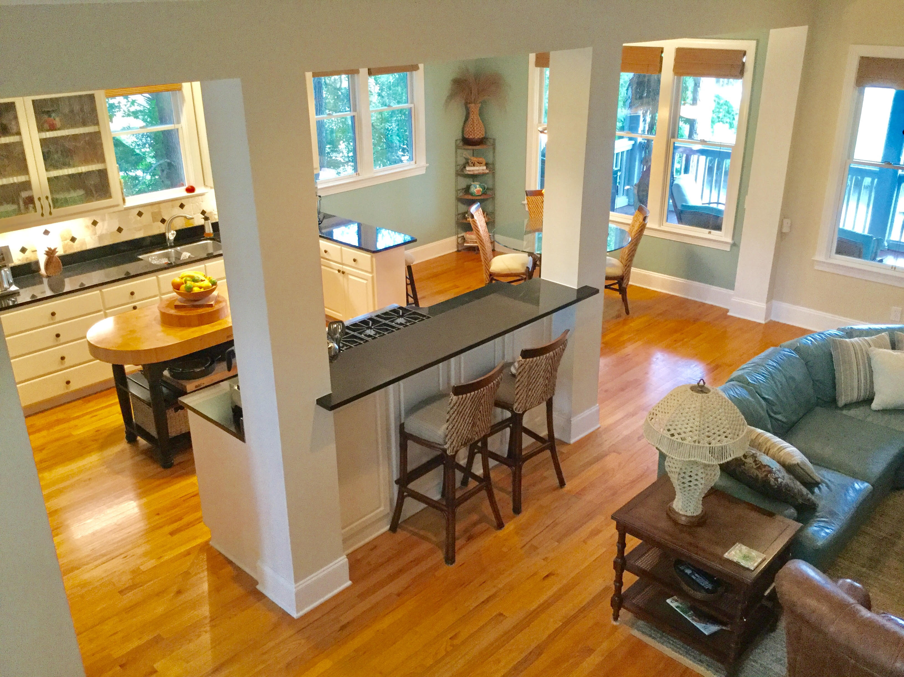
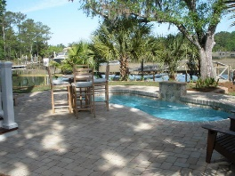
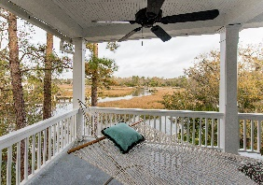
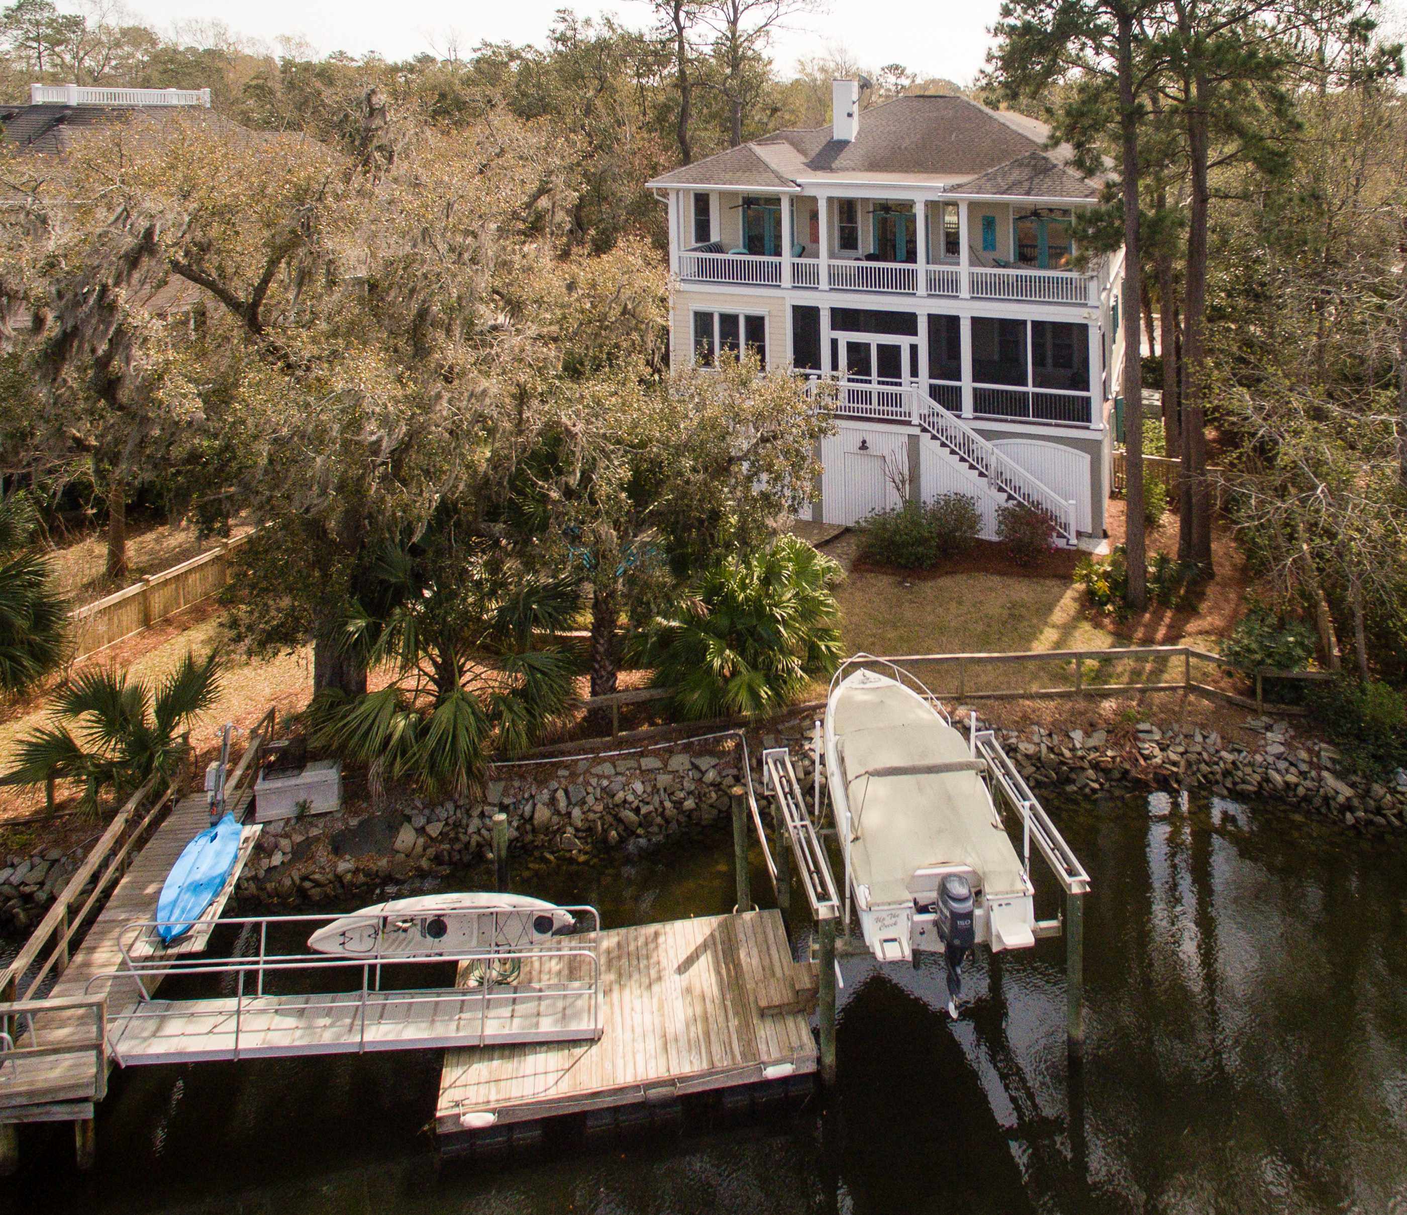
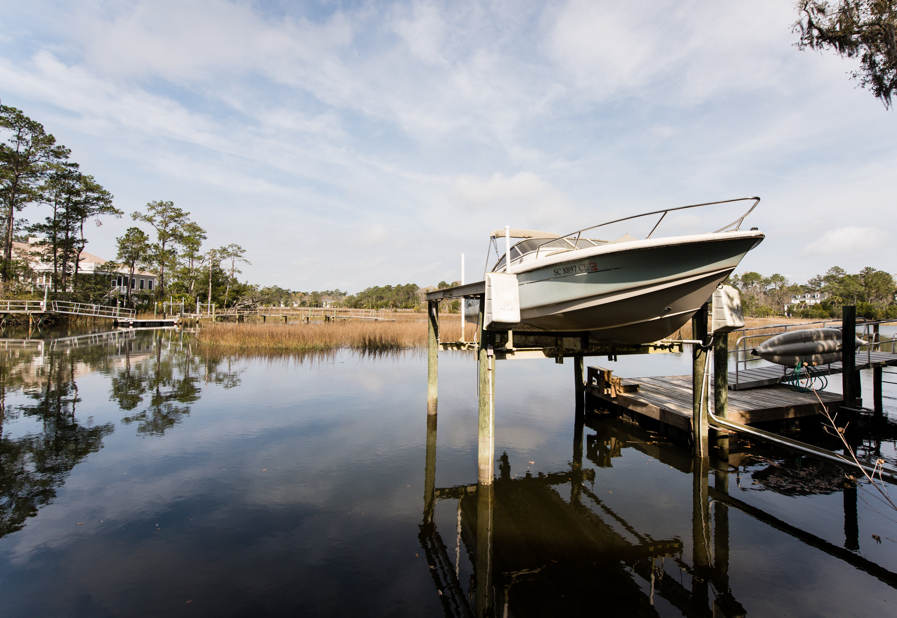


3540 Henrietta Hartford Road Park West :: Mount Pleasant :: MLS# 17005917 :: $1,250,000
Waterfront, Dock, and Pool!
$1,250,000
Resort Style Living on the Waterfront With salt water pool, private dock and boat lift! This custom built Lowcountry home is nestled between dozens of palm trees and three 100+ year old oaks right on the bank of Toomer Creek. Enjoy panoramic views of your pool, dock with generous floater and boat lift framed by the beautiful marsh and tidal creek, and did I forget to mention the sunsets!? You can fish, boat, kayak, swim, cast your shrimp net, paddle board, or just relax and soak up the serenity. Indoor features include a Master Suite on the main level with spacious sitting area, French doors and numerous windows overlooking the creek. The Master Bath was recently renovated to include Blue Oyster granite counter tops, separate His and Hers vanities, free standing luxury Tub, shower, French Doors that open the front porch, and 2 Walk-In Closets. The Kitchen is loaded with fine appliances, Glass Front Cabinets, Travertine Backsplash, and Large Walk-in Pantry. This home has Windows, French Doors, and Porches galore to enjoy the fabulous views afforded by creekside living. Schools, shopping, and dining are also located inside the neighborhood...you may never have to leave Paradise!
Wendy Arnsdorff
843-364-8619 – M :: 843-284-1800 – O
wendy.arnsdorff@carolinaone.com www.wendyarnsdorff.com
Carolina One Real Estate :: Mt. Pleasant North Office :: 2713 N Highway 17 :: Mt. Pleasant, SC 29466

