Slide 1
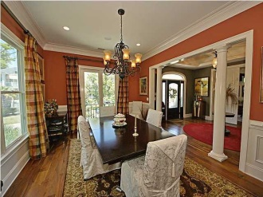
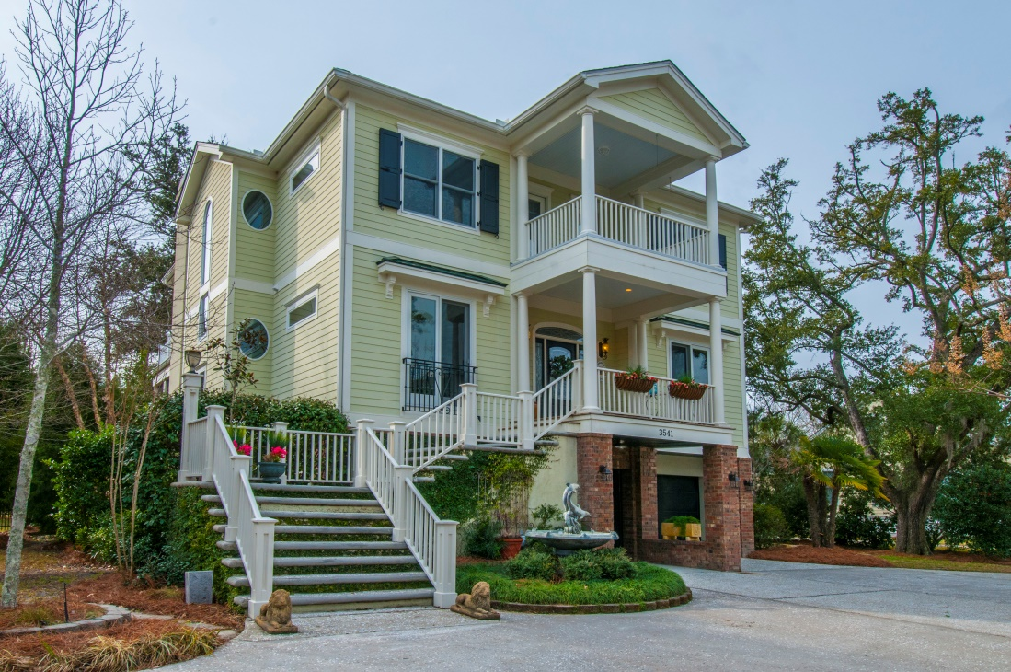
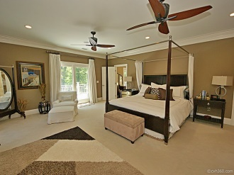
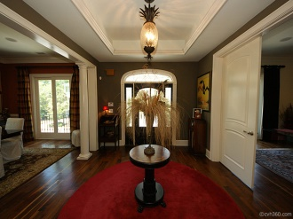
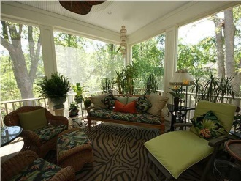
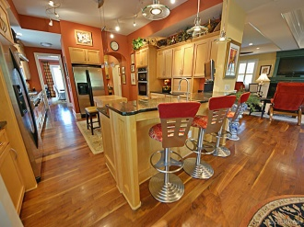
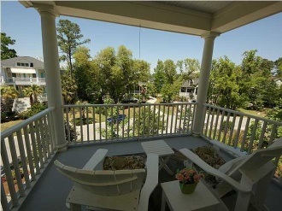

3541 Henrietta Hartford Road Park West :: Mount Pleasant :: MLS# 14032026 :: $844,000
$3,000 Agent Bonus
with ratified contract by 3/31/15!!
Just Reduced!
Located in Park West's desirable Tennyson subsection, this custom designed home features 3 floors, working elevator, a chef or entertainer's dream kitchen, upgrades throughout, lower level suite perfect for your mother-in-law, luxurious master bath with multiple walk-in closets and sauna, beautiful scenery from various porches, and storage space galore! The main level boasts wide plank walnut floors with satin finish, a gourmet kitchen with a double drawer dishwasher, Kitchen Aid professional grade gas cooktop with hood, 2 separate sinks, tile backsplash, 2 refrigerators, built in microwave, warming oven, custom pantry, butler's pantry, pendant lighting, bar seating and an eat-in area. The family room includes a gas fireplace, built-in shelves, wet bar with refrigerator and access to a 14 x 35 screened in porch that provides a peaceful retreat and overlooks a beautifully landscaped private yard. The upper level features the master bedroom with a cozy gas fireplace, ceiling fan, and the ultimate his and hers walk-in closets! The master bath offers a dual granite vanity, custom-built steam shower with multiple heads, sauna, tile floor, plantation shutters, soaking tub, linen closet, mini refrigerator, and access to a full width terrace to sunbathe or enjoy your favorite book. This level also has 2 large guest bedrooms with 2 full baths and a laundry room with cabinets and hang-up space. From these bedrooms there is access to a deck with marsh views! The ground level offers a spacious mother-in-law suite equipped with large bedroom, full bath with linen closet, kitchenette, living room, fitness area, wine room, as well as access to a covered patio, and a gardening/potting room, 2 car garage, and workshop area. Please note this fabulous offering also includes a 3 stop elevator, surround sound, central vacuum, accent lighting, whole house water filter, and irrigation system. Park West amenities include 2 pools, a clubhouse, play area, six-lighted tennis courts, and miles of trails for walking and biking. It is only a short walk to Tennyson's community park and garden on the banks of Toomer Creek. It is a short trip by bike or golf cart to stores, gyms, offices, restaurants, and the highly sought after schools that are located right in Park West. The Mt. Pleasant recreational department and sport fields are conveniently located in the neighborhood for the entire family to enjoy! Only a short drive to the beach and historic Charleston.
Wendy Arnsdorff
843-364-8619 - M
843-284-1800 – O
wendy.arnsdorff@carolinaone.com www.wendyarnsdorff.com
Carolina One Real Estate
Mt. Pleasant North Office 2713 N Highway 17
Mt. Pleasant, SC 29466

