Slide 1
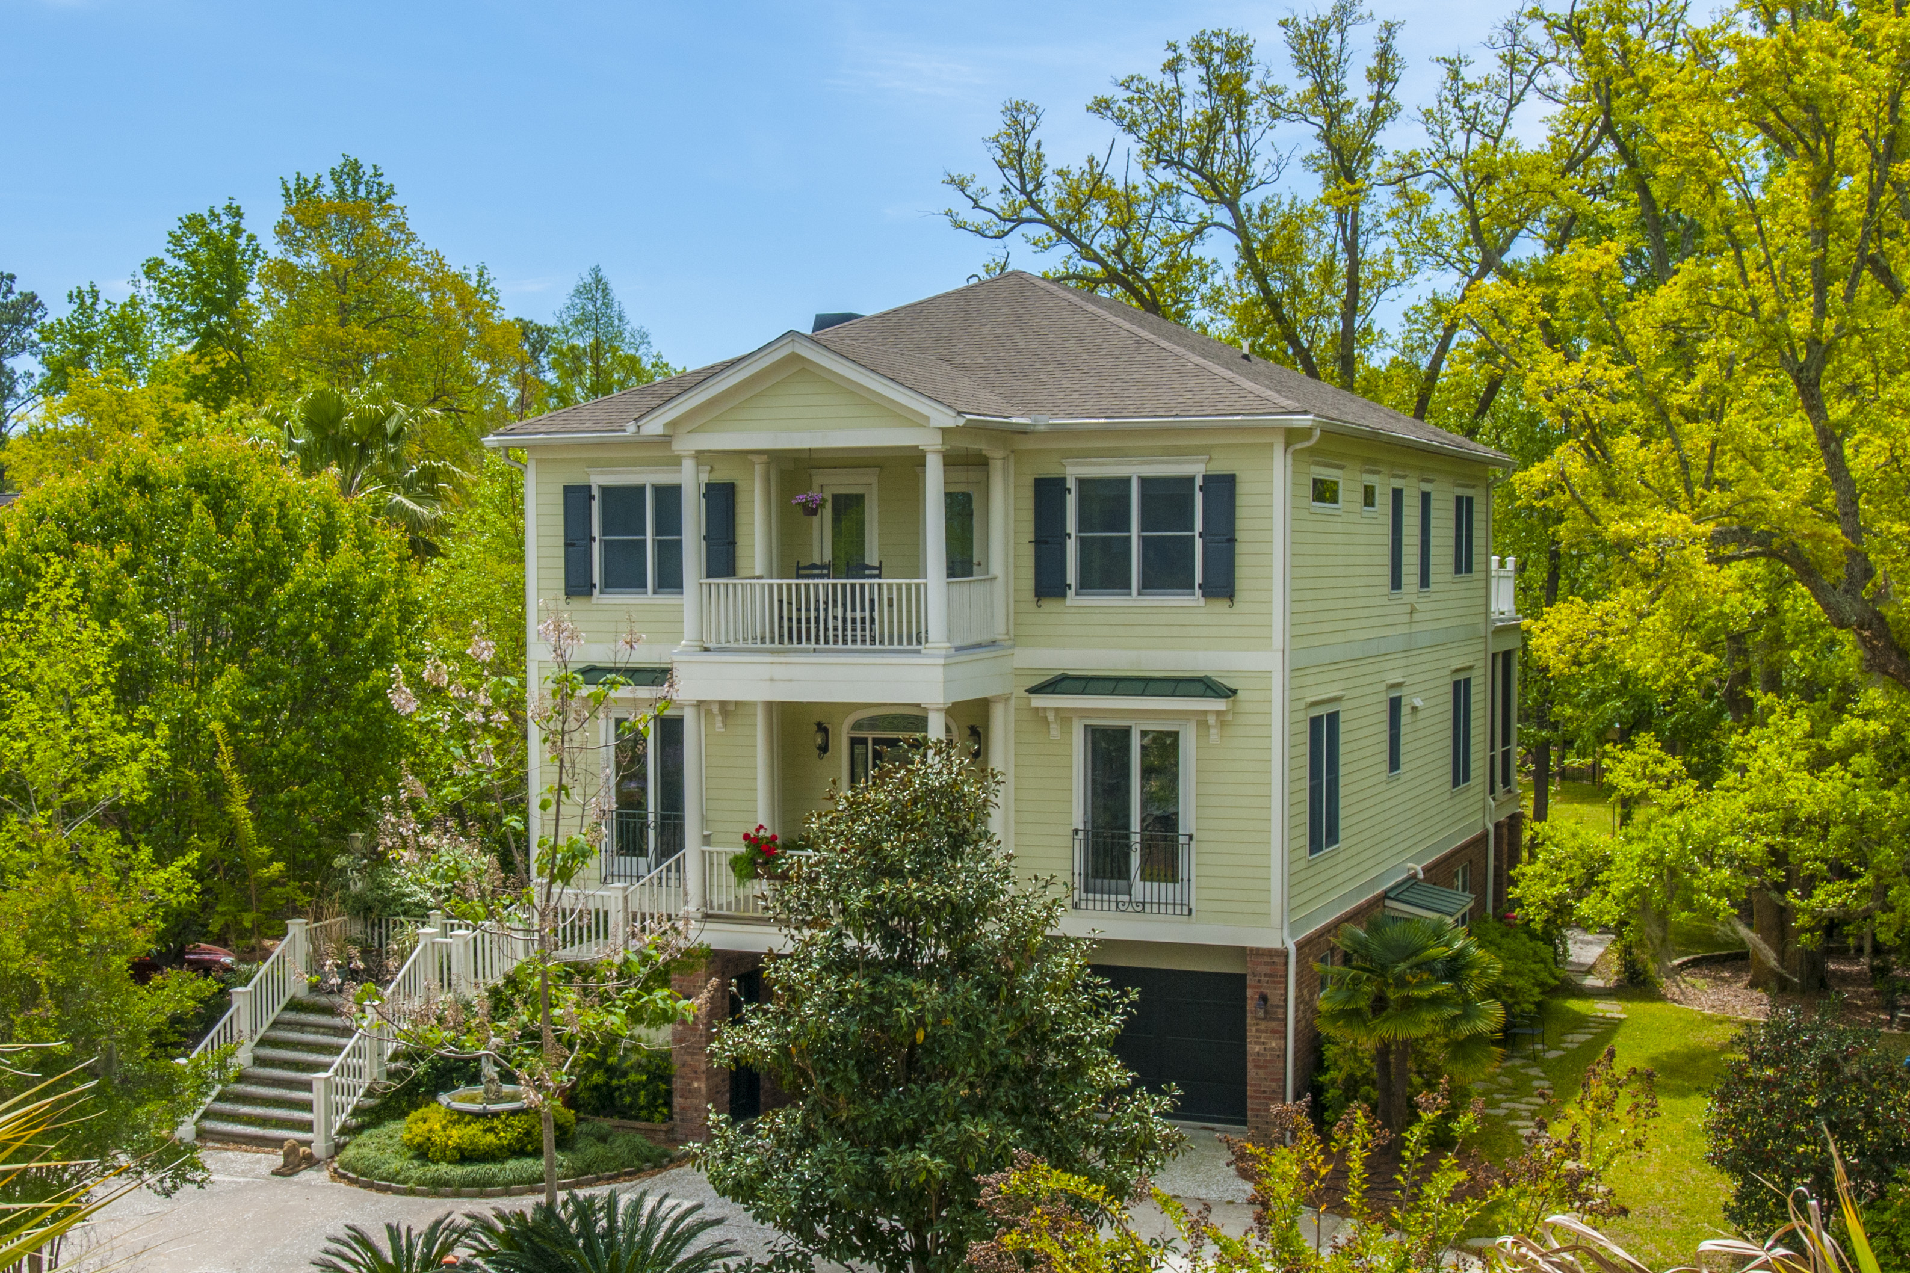
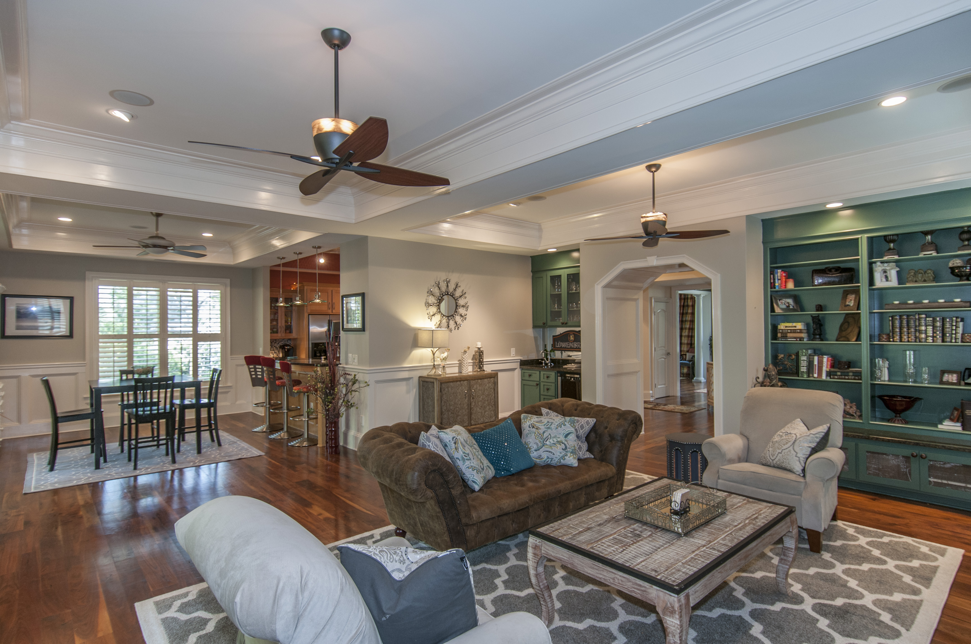
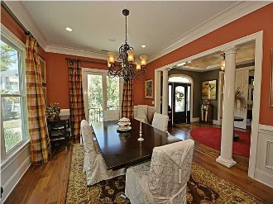
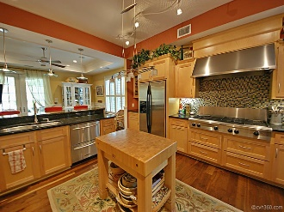
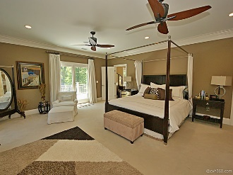
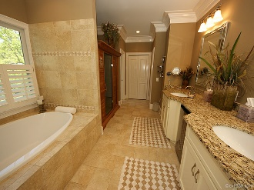


3541 Henrietta Hartford Road
Park West :: Mount Pleasant :: MLS# 16009250
Tennyson at Park West
Just Reduced!
This beautiful custom home features a working elevator servicing all 3 floors, a Kitchen any professional Chef would envy, a Master Suite with multiple walk-in closets, sauna, and steam room, a Lower Level Suite perfect for a live in Nanny or Mother-in-Law, beautiful scenery from various porches, and storage space galore!
Offered at $850,000
Wendy Arnsdorff
843-364-8619 – M :: 843-284-1800 – O
wendy.arnsdorff@carolinaone.com
www.wendyarnsdorff.com
Carolina One Real Estate :: Mt. Pleasant North Office :: 2713 N Highway 17 :: Mt. Pleasant, SC 29466

