Slide 1
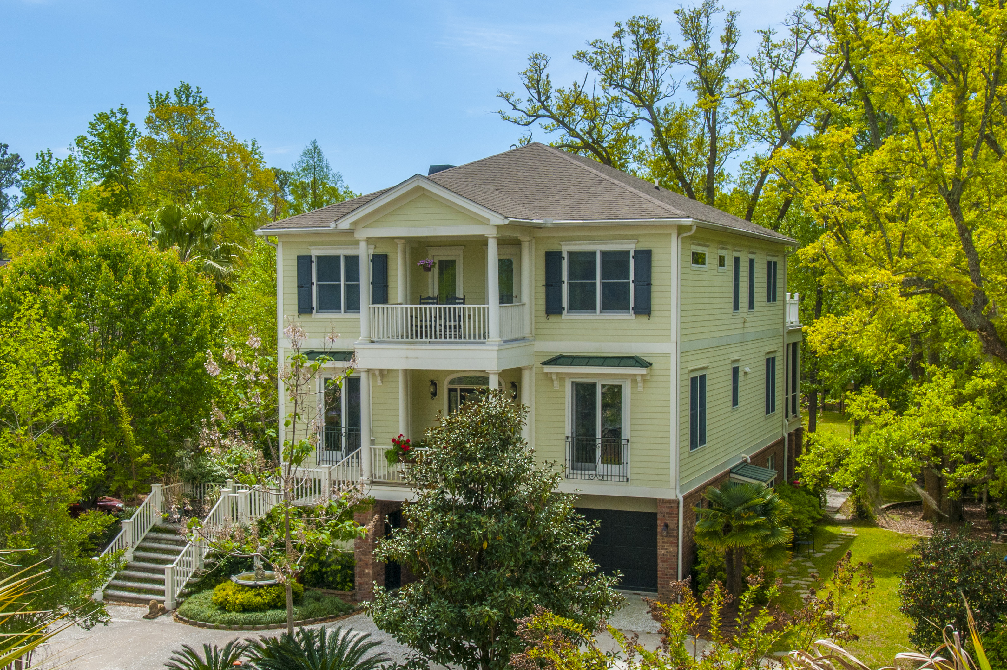
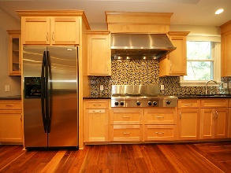
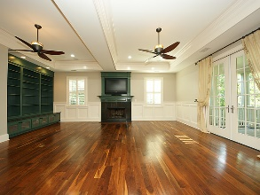
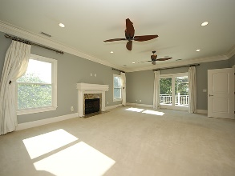
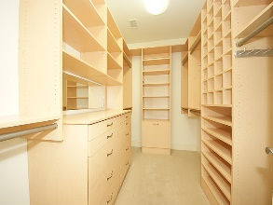


3541 Henrietta Hartford Road Park West :: Mount Pleasant :: MLS# 17013093
Lowest Price Per Square Foot in
Tennyson or Masonborough
Significant
Price Reduction!
Located in desirable Tennyson at Park West. Enjoy Park West's fabulous amenities, highly sought after schools, Mt. Pleasant Recreation Dept & fields, miles of walking and biking trails, shopping and dining!
Loaded with exquisite trim, molding, coffered ceilings, wainscoting, custom built-ins and plantation shutters
A Chef's kitchen that features a prep galley and serving kitchen each with their own sinks, dishwashers, 2 Refrigerators, Kitchen Aid Grill Top with Hood, Convection/Microwave Oven, Gas Oven, and Warming Drawer
Spacious Master Bedroom Suite with Fireplace, Steam Shower, Sauna, Private Balcony, and His and Hers Custom Walk-in Closets
1st floor Mother-in-Law Suite, 3 stop Elevator, tons of storage, and 2 car garage with workshop area
JUST REDUCED to $795,000!
Welcome Home!!
Wendy Arnsdorff
843-364-8619 – M :: 843-284-1800 – O
wendy.arnsdorff@carolinaone.com www.wendyarnsdorff.com
Carolina One Real Estate :: Mt. Pleasant North Office :: 2713 N Highway 17 :: Mt. Pleasant, SC 29466

