Slide 1
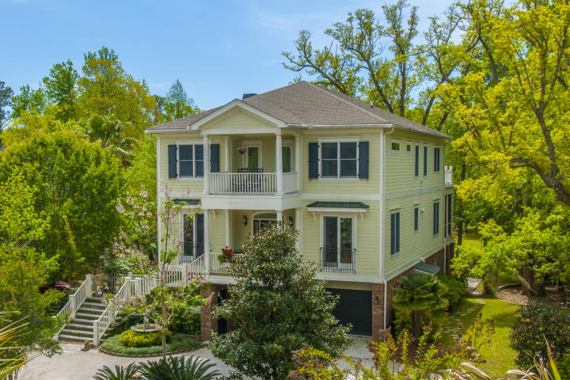
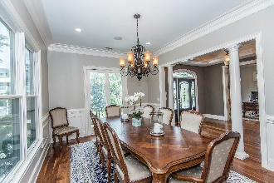
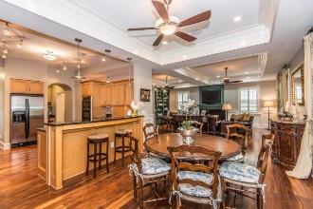
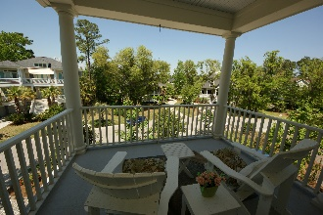
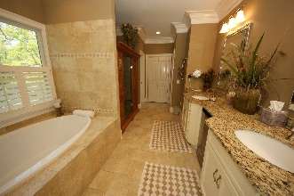
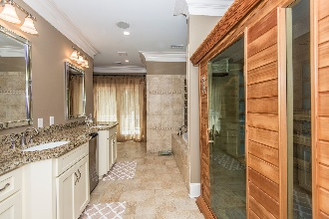


3541 Henrietta Hartford Road Mount Pleasant :: MLS# 17013093
Just Reduced $785,000!
Unique Modern Living in Park West
Just Reduced to $785,000!
Spacious Master Bedroom Suite with Fireplace, Steam Shower, Sauna, Private Balcony, and His and Hers Custom Walk-in Closets
1st floor Mother-in-Law Suite, 3 stop Elevator, tons of storage, and 2 car garage with workshop area
A Chef's kitchen that features a prep galley and serving kitchen each with their own sinks, dishwashers, 2 Refrigerators, Kitchen Aid Grill Top with Hood, Convection/Microwave Oven, Gas Oven, and Warming Drawer
Loaded with exquisite trim, molding, coffered ceilings, wainscoting, custom built-ins and plantation shutters
Located in desirable Tennyson at Park West. Enjoy Park West's fabulous amenities, highly sought after schools, Mt. Pleasant Recreation Dept & fields, miles of walking and biking trails, shopping and dining!
Welcome Home!!
Wendy Arnsdorff
843-364-8619 – M :: 843-284-1800 – O
wendy.arnsdorff@carolinaone.com www.wendyarnsdorff.com
Carolina One Real Estate :: Mt. Pleasant North Office :: 2713 N Highway 17 :: Mt. Pleasant, SC 29466

