Slide 1


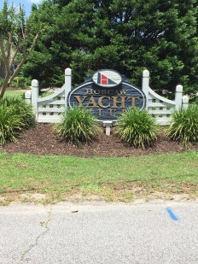
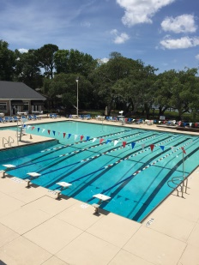
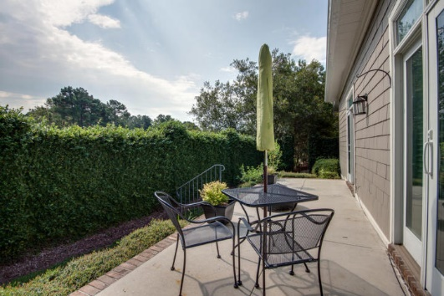
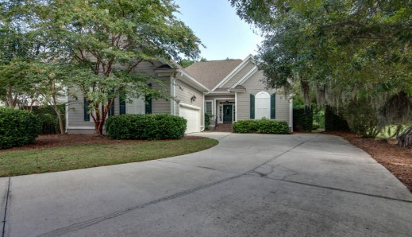
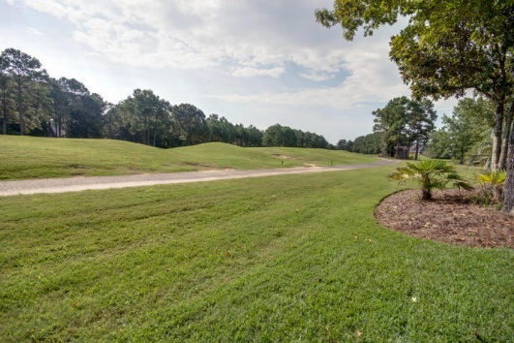
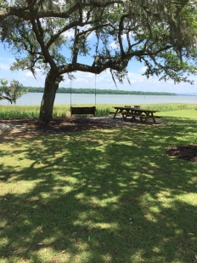
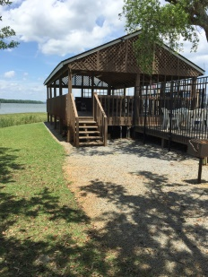
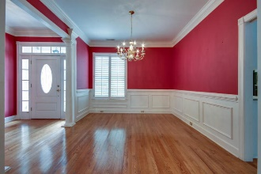
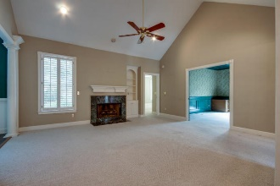
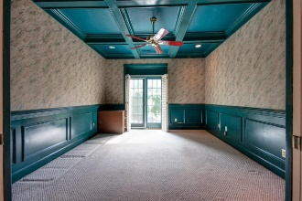
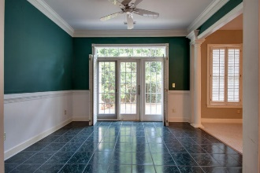
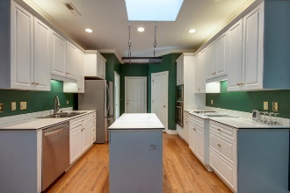
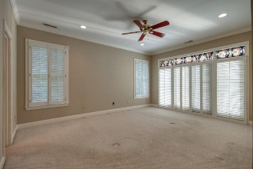
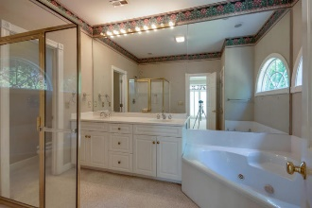
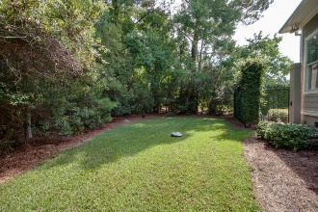

Golf Cottage in Gated Community
3545 Hartford Village Way
Dunes West - Mount Pleasant
MLS# 15022748 - $435,000
Wonderful golf cottage in gated Dunes West community. Single story design located on the first and ninth holes of the golf course.
The home features large living area with vaulted ceiling and gas fireplace, dining room with trim work, large study with double doors and coffered ceiling and a nice size kitchen with plenty of room for two cooks. Newer appliances include a wall oven and built-in microwave, refrigerator and dishwasher.
The master suite is spacious and includes a large walk-in closet and jetted tub and opens into the ivy covered walled courtyard. The breakfast room has tiled floors and overlooks the back patio and private backyard.
The exterior was recently painted, the roof and HVAC unit are also relatively new. Separate memberships are available for golf, tennis and swimming.
Lori Claussen loric@goldenbearrealty.com
www.GoldenBearRealty.com
Golden Bear Realty | 654 Coleman Blvd, Suite 100 | Mt Pleasant , SC 29464
Cell (843) 224-8506 | Office (855) 352-9088 | Fax (561) 721-3311

